Slide 1
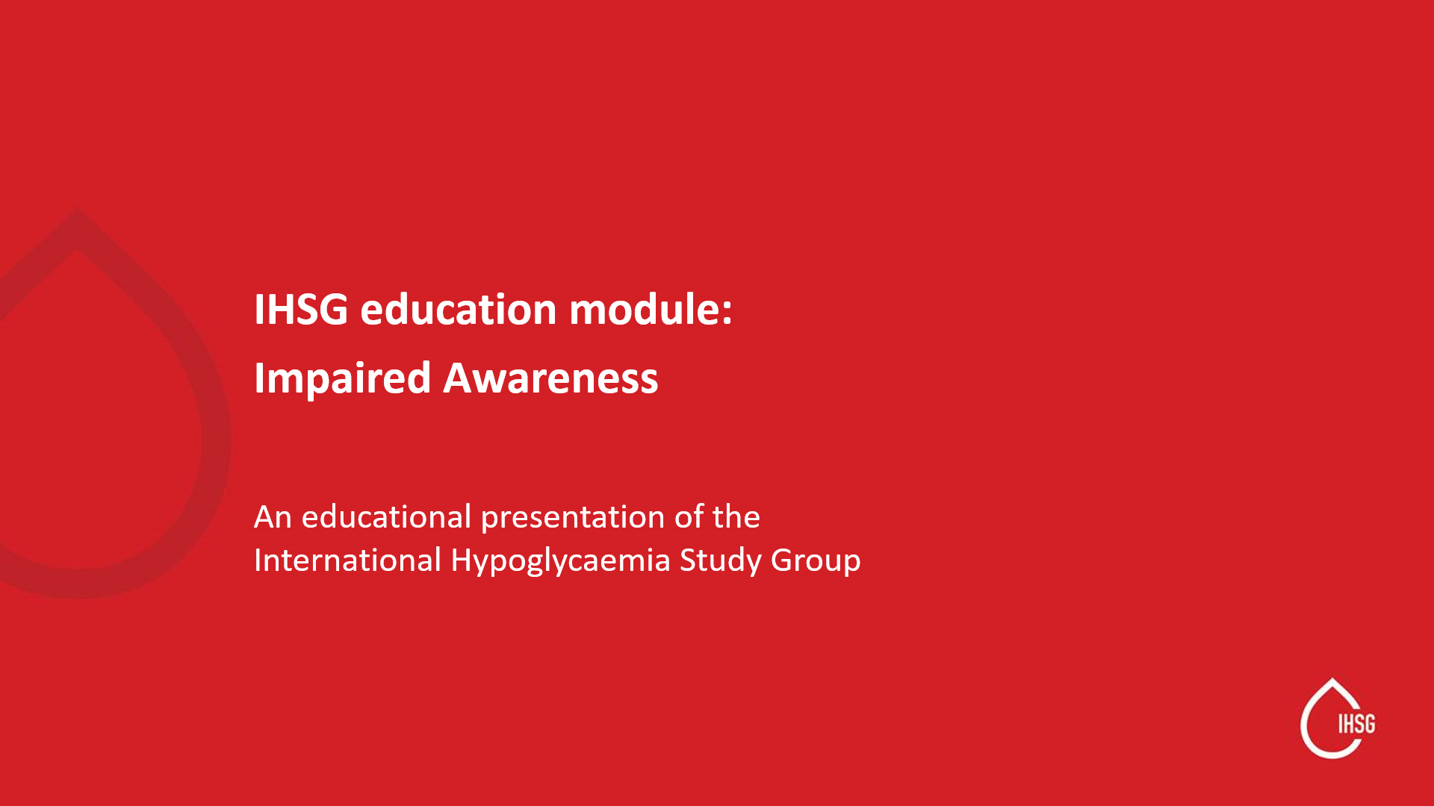

Slide 2
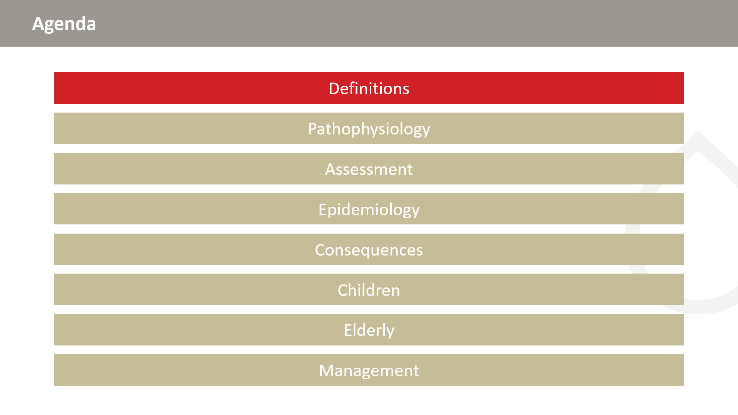

Slide 3
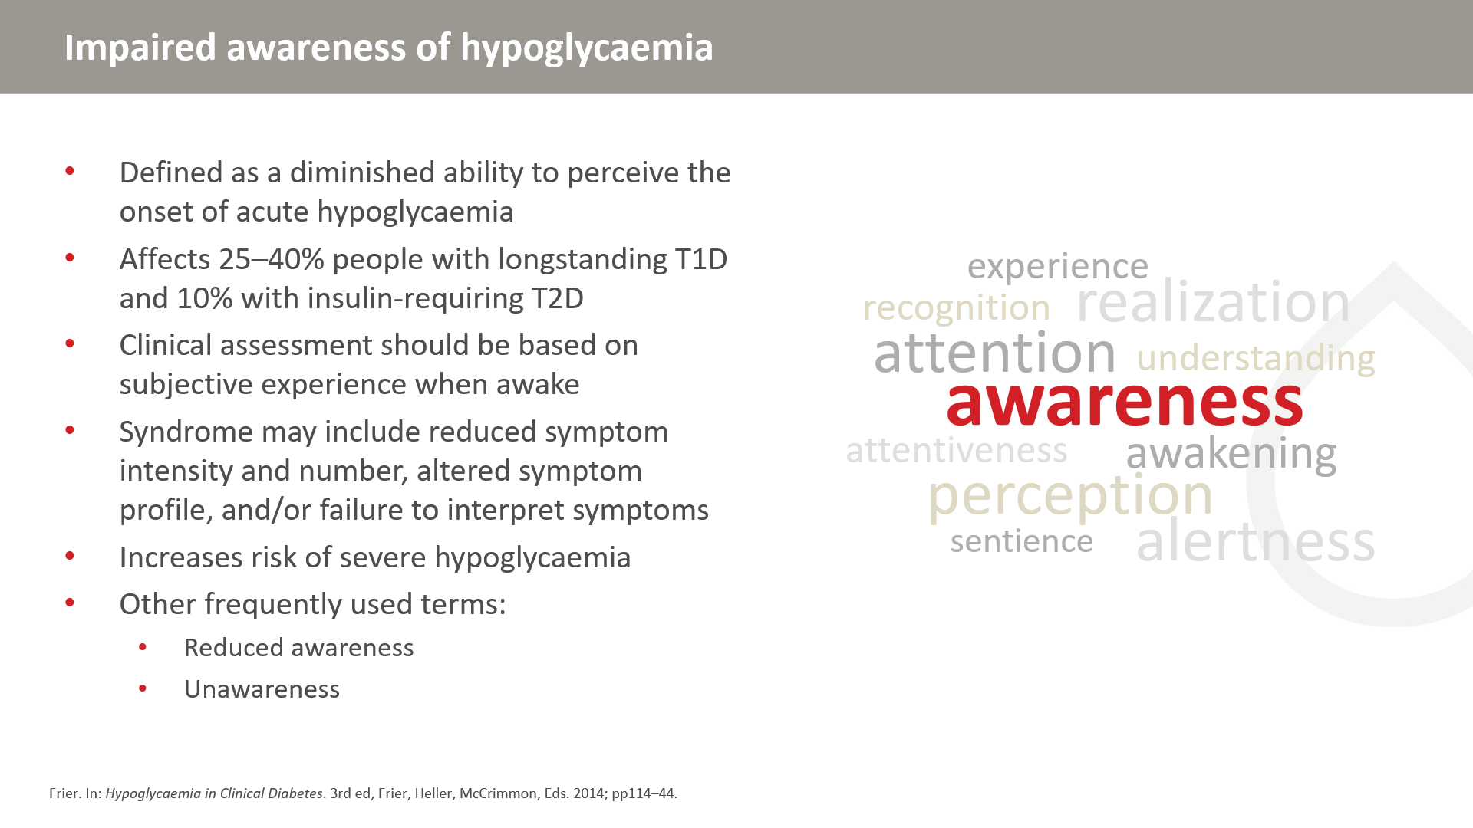

Slide 4
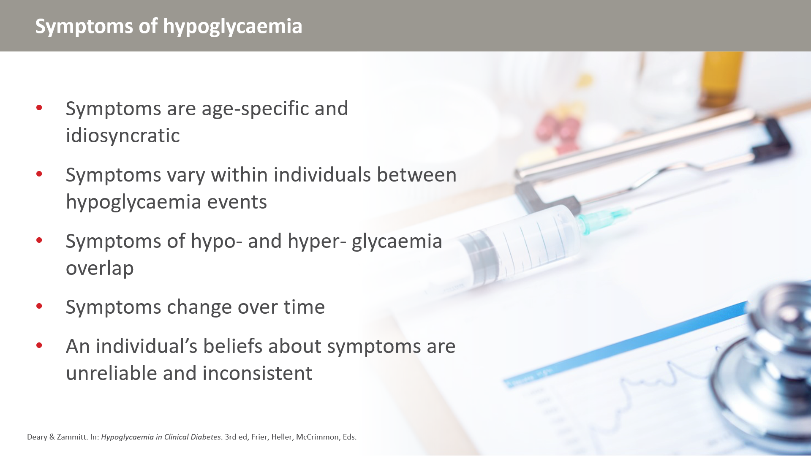

Slide 5
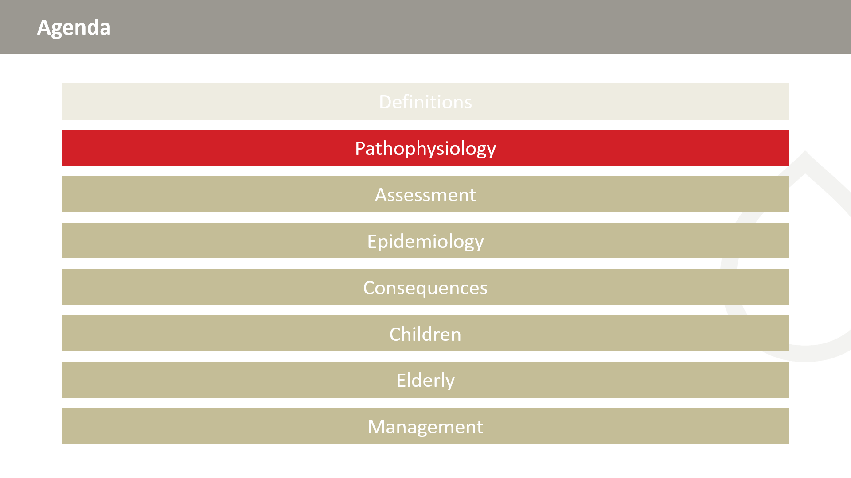

Slide 6
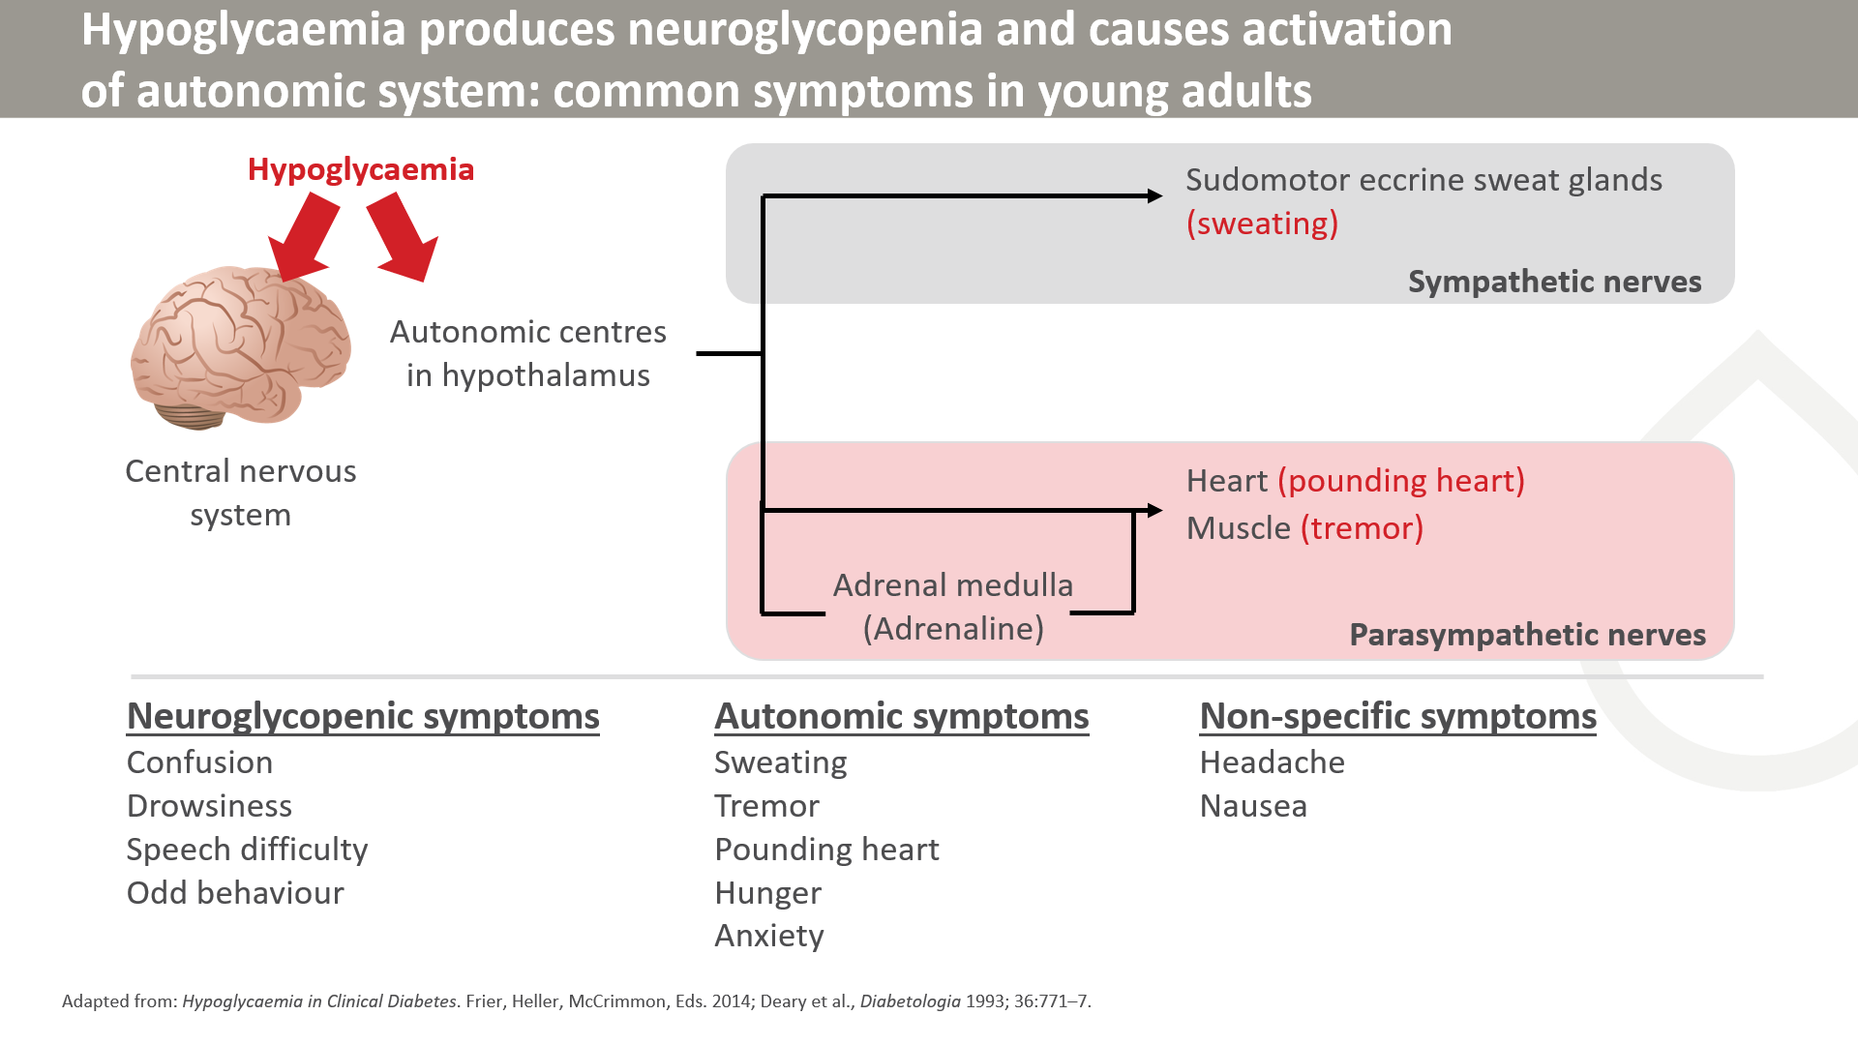

Slide 7
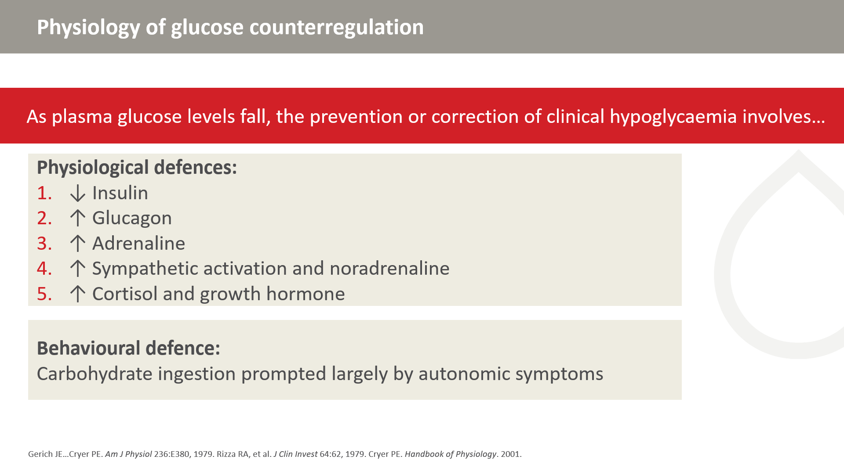

Slide 8
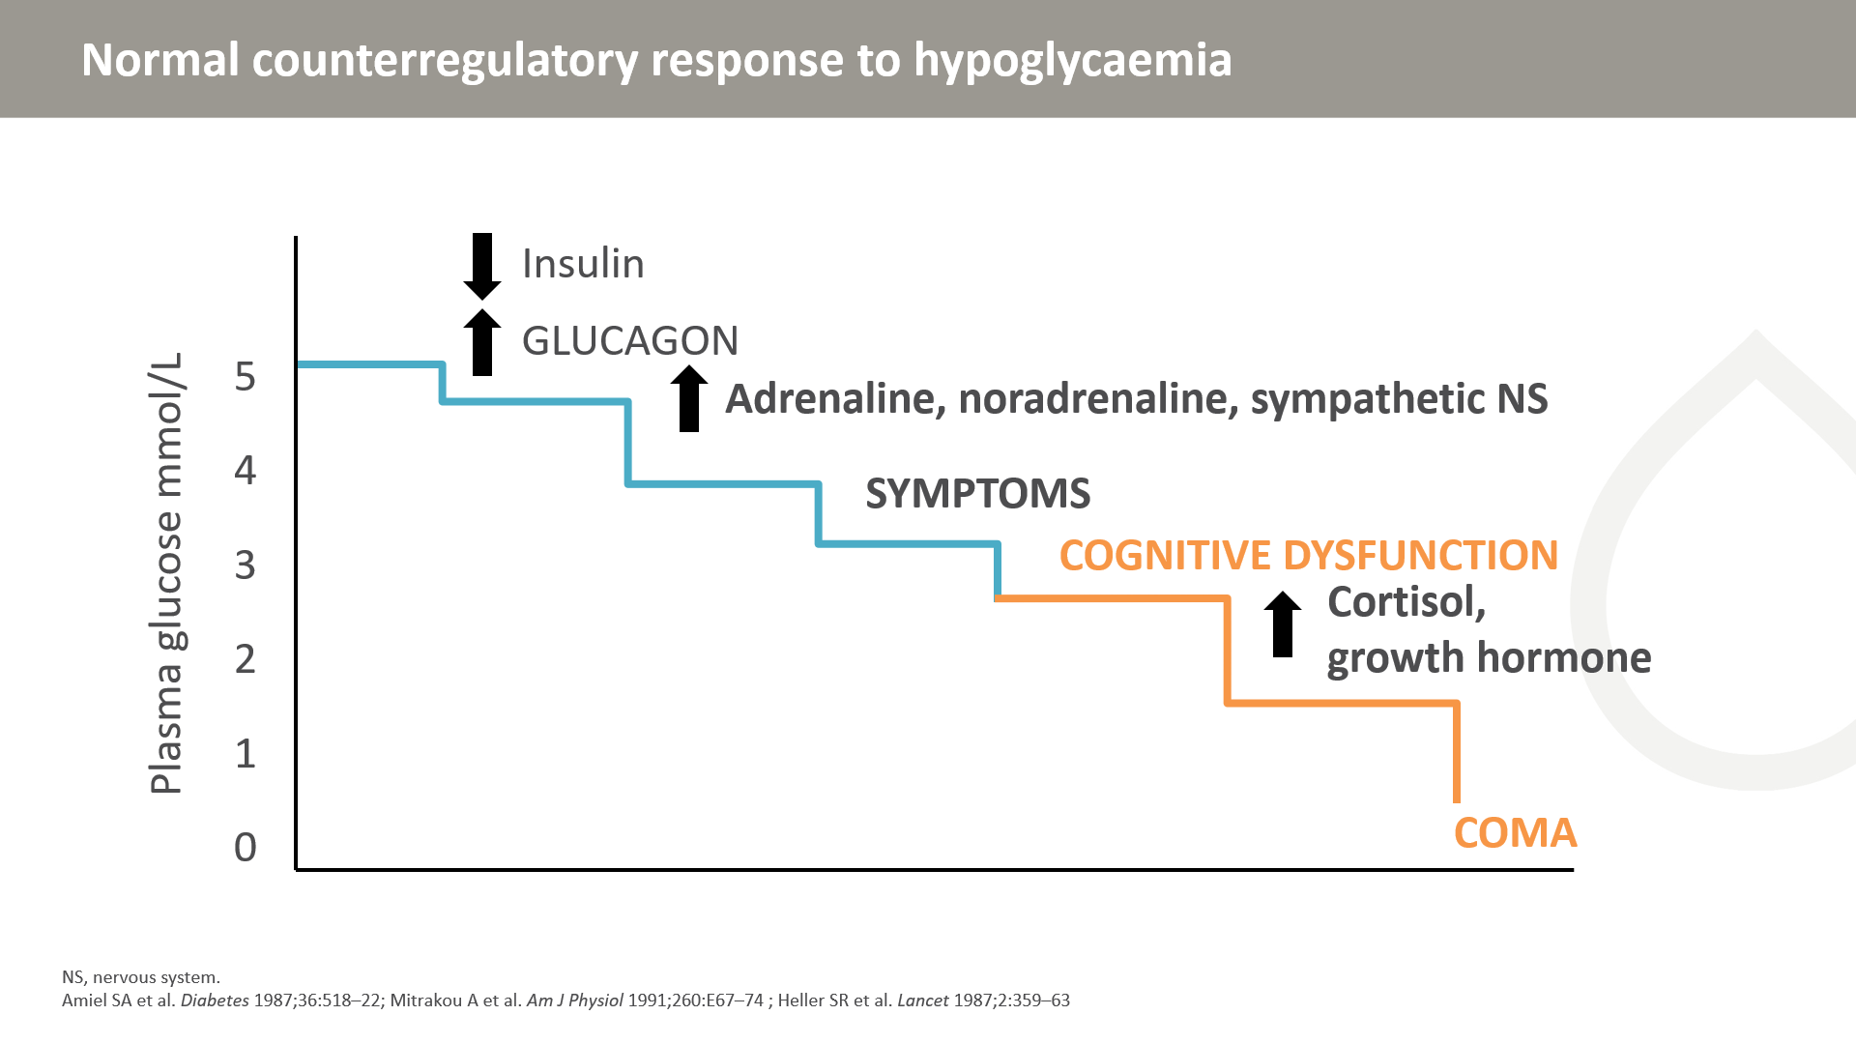
Notes:
These data on the levels at which responses to a falling plasma glucose concentration start have been acquired by inducing controlled slow-fall hypoglycaemia using an insulin clamp technique. Hyperinsulinaemia is created by infusion of intravenous insulin and the glucose profile created by the investigator using frequent bedside plasma glucose measurements and an adjustable intravenous glucose infusion.^{1,2} Cognitive disruption or coma may occur at higher glucose levels.
1. Amiel SA et al. Diabetes 1987;36:518–22;
2. Mitrakou A et al. Am J Physiol 1991;260:E67–74.

Slide 9
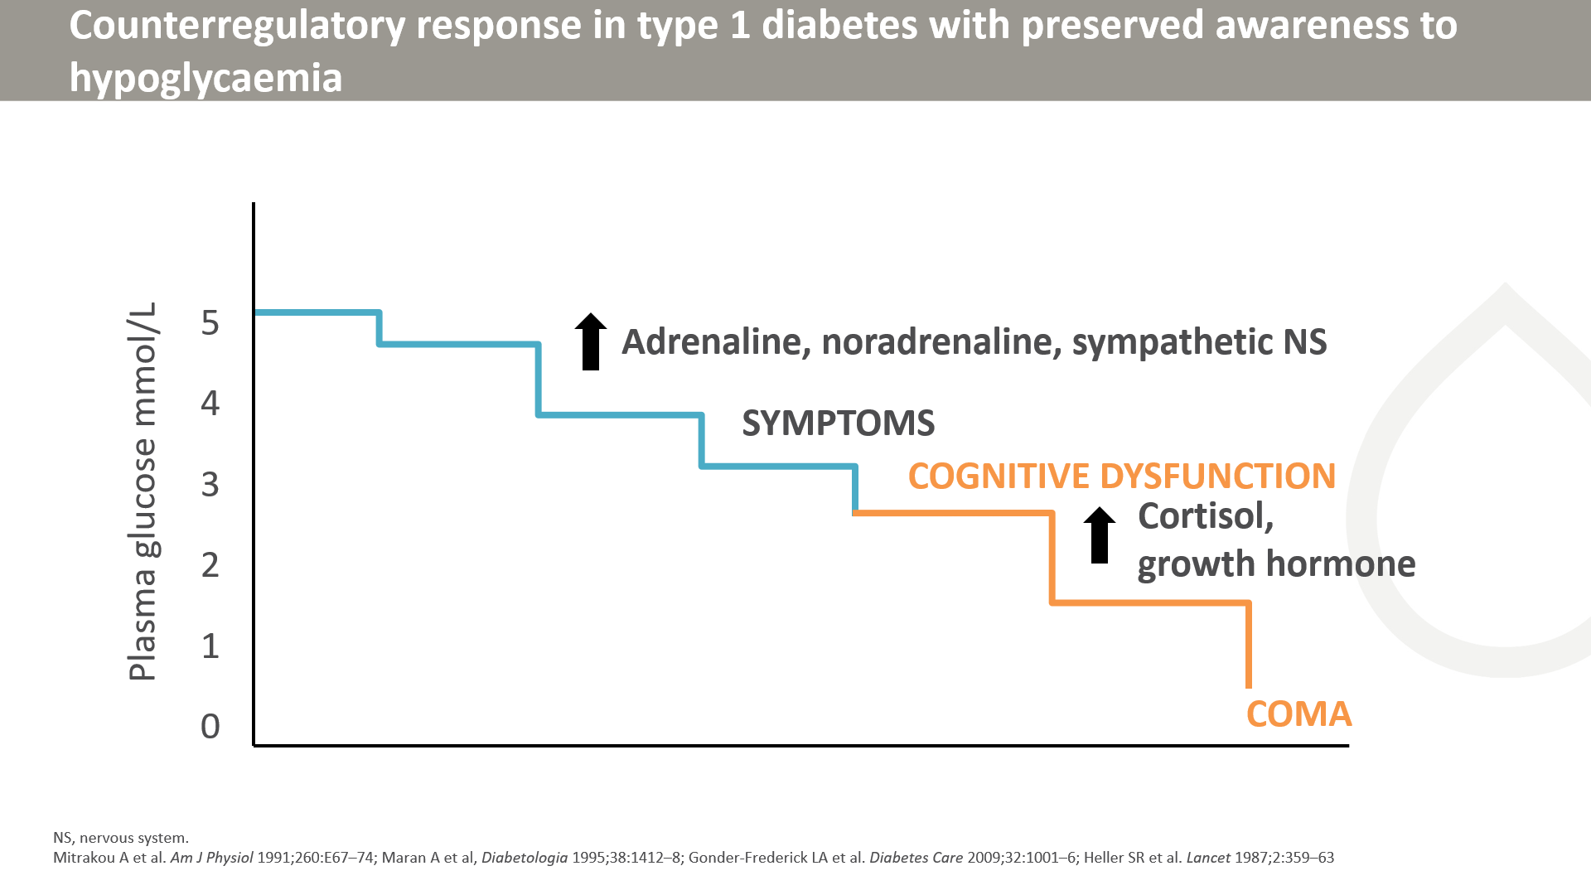
Notes:
In insulin-treated diabetes, the ability to reduce circulating insulin in response to falling plasma glucose is lost. In insulin-deficient diabetes, the ability to release glucagon in response to a falling plasma glucose is lost, and is thought to relate to loss of a signal of declining insulin secretion from the beta cell to the glucagon-secreting alpha cell. Thus, the first line of defence becomes the adrenaline and sympathetic responses and the generation and perception of symptoms of hypoglycaemia associated with the autonomic activation. Cognitive impairment is detectable on formal testing as plasma glucose concentrations fall below 3 mmol/L (54 mg/dL). This has been found in experimental hypoglycaemia and in hypoglycaemia in free-living individuals with type 1 diabetes.

Slide 10
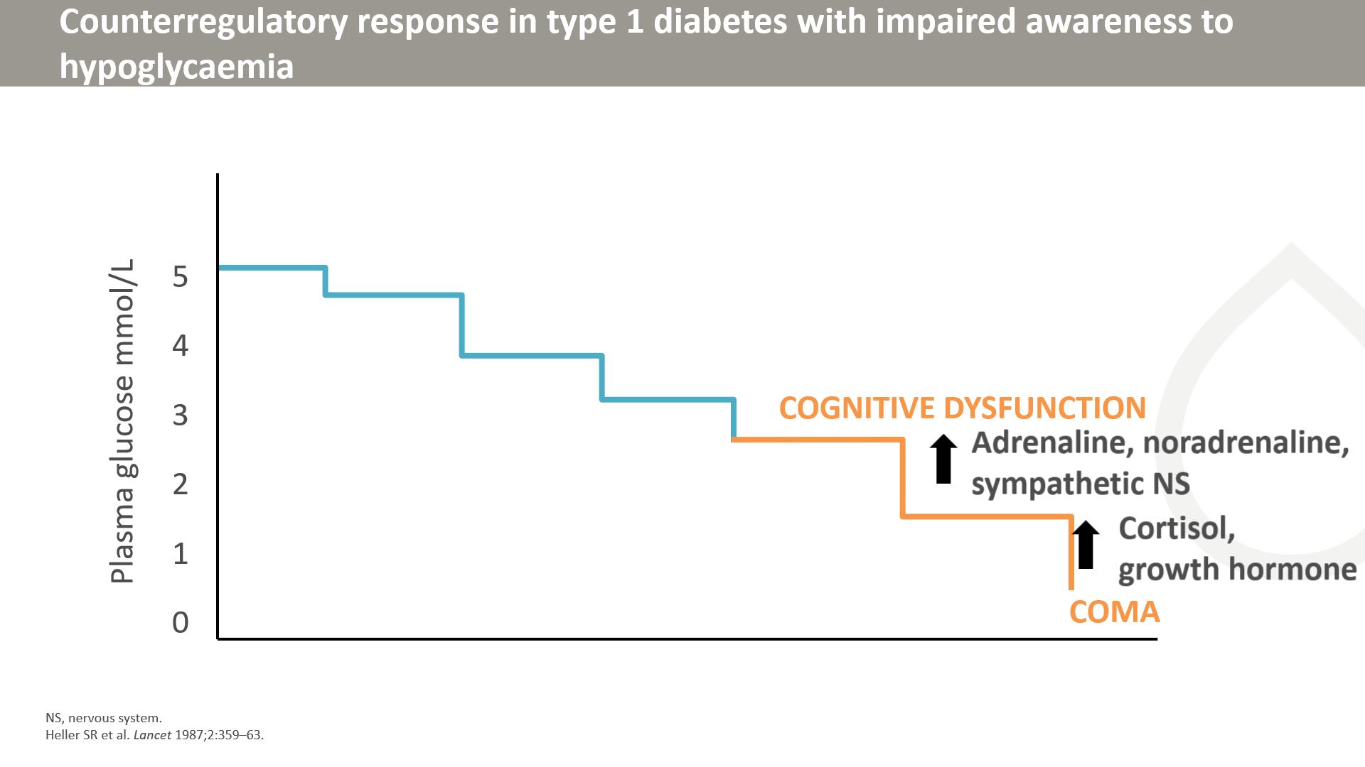
Notes:
In people with impaired awareness of hypoglycaemia, the counterregulatory responses to hypoglycaemia shifts to a lower glucose concentration than in people with intact awareness, and lower than the 3 mmol/L (54 mg/dL) at which cognitive dysfunction is first evident. The magnitude of the stress responses is also much reduced. This is associated with a loss of symptoms of hypoglycaemia – the person experiencing the hypoglycaemia has impaired subjective awareness of the state.

Slide 11
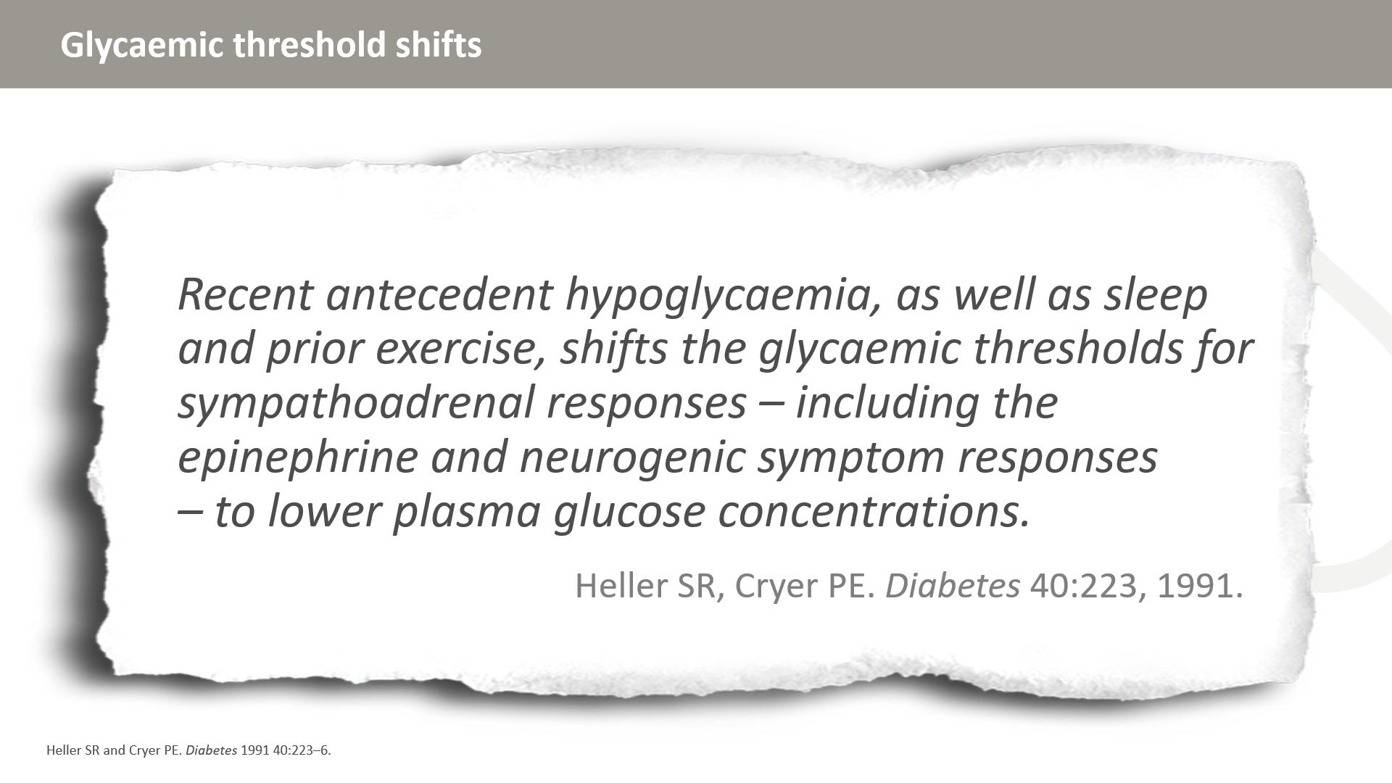

Slide 12
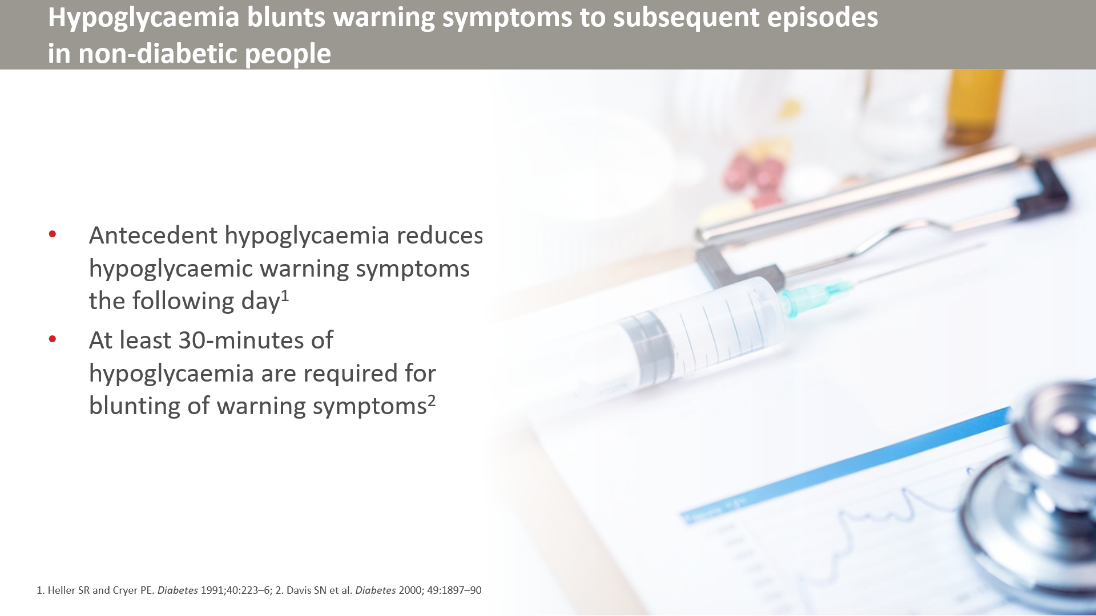

Slide 13
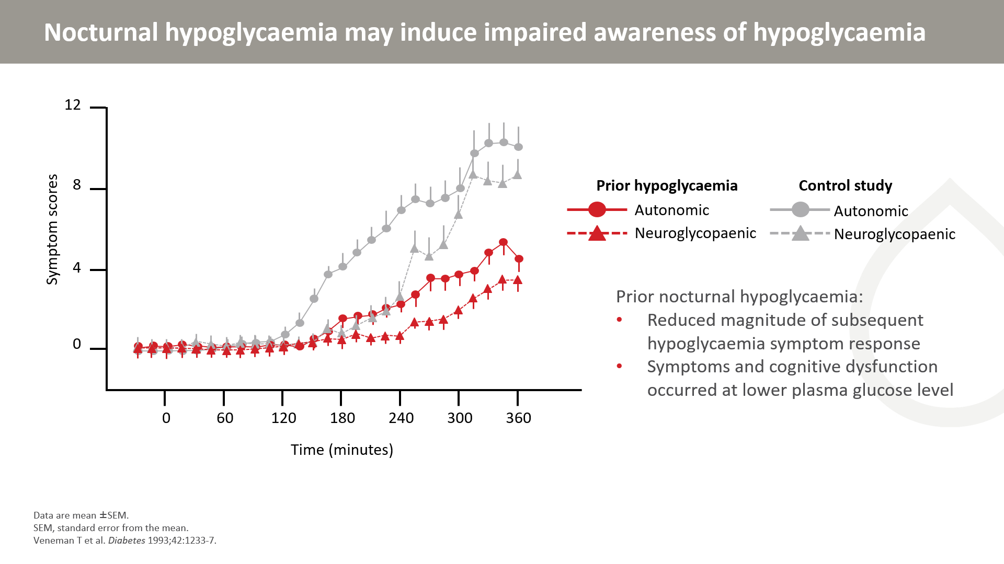
Notes:
Hypoglycaemia (2.4 mmol/L) was induced in 10 non-diabetic adults on the morning after:
Euglycaemic during night (control study)
2 hours of asymptomatic hypoglycaemia during night (plasma glucose: 2.4 mmol/L)
Asymptomatic nocturnal hypoglycaemia increased the treshold and reduced the magnitude of autonomic and neuroglycopaenic sumptoms, counterrgulatory hormone responses and cognitive dysfunction during hypoglycaemia.

Slide 14
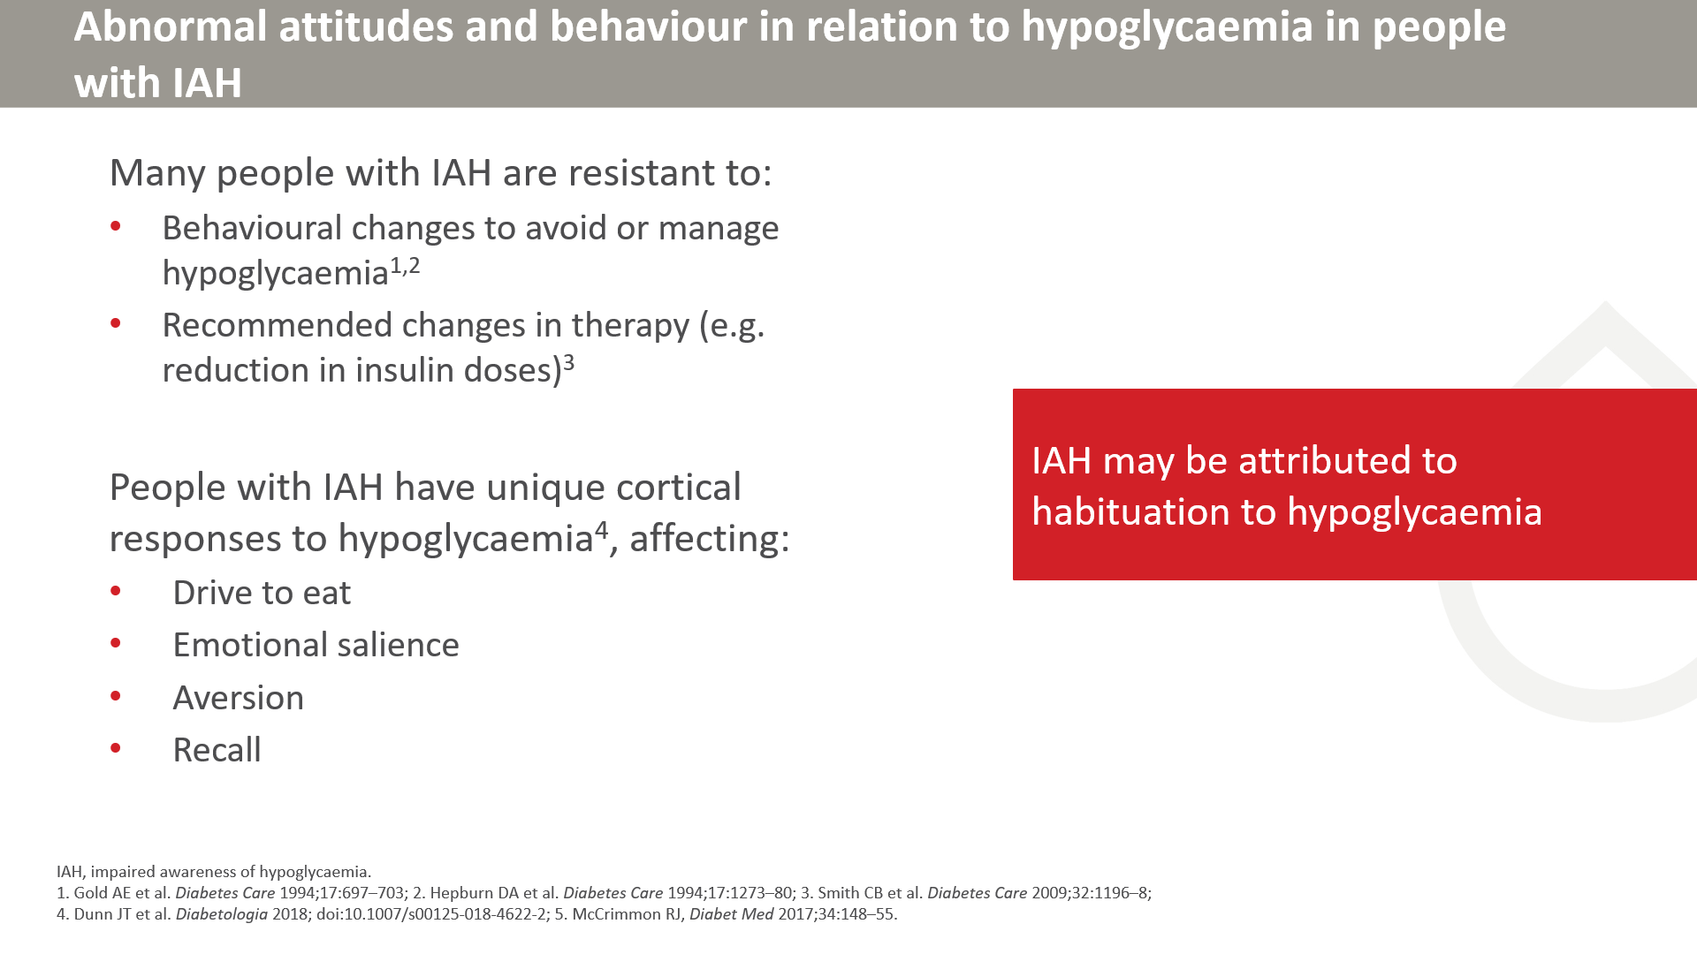

Slide 15
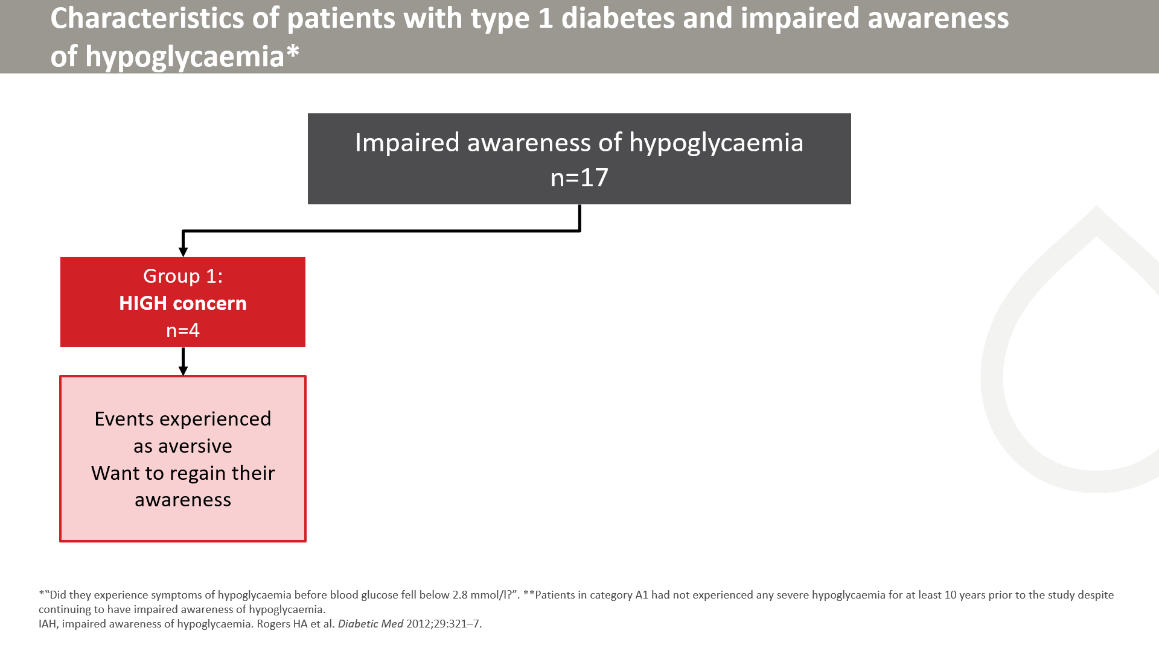
Notes:
People with T1D and impaired awareness of hypoglycaemia gave semi-structured interviews exploring perceptions and experiences of their condition. Responses fell into either high or low concern groups.
Respondents within the high concern group reported hypoglycaemic events as frightening, disabling and socially embarrassing. They realised that action was needed to regain awareness prevent, minimise or eradicate impaired awareness.

Slide 16
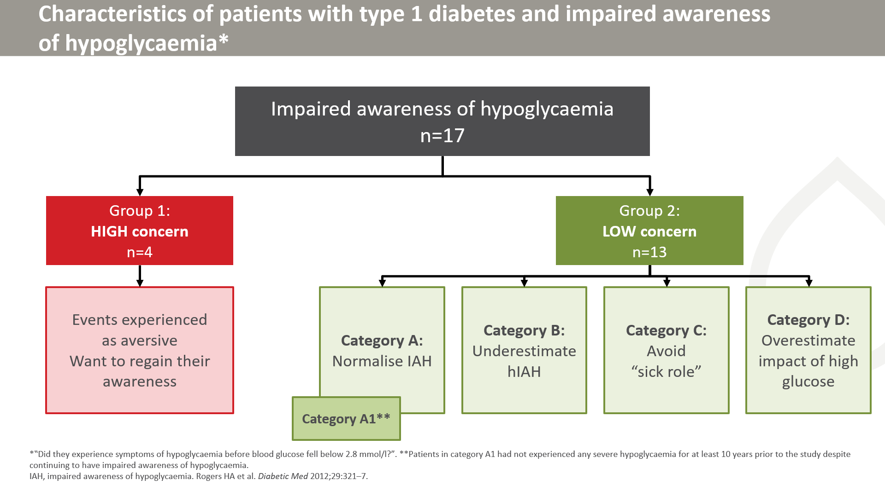
Notes:
The majority of patients were less concerned or motivated address impaired awareness. Reasons for low concern could be grouped into 4 categories.
A: Respondents viewed hypoglycaemia as a normal part of having diabetes. Some respondents had not experienced hypoglycaemia in at least 10 years prior to the survey, so were categorised as A1.
B: Respondents underestimated the effects of hypoglycaemia, felt they could function with blood gluce ‘3 mmol/L, or believed that a severe hypoglycaemic event would not happen to them
C: Respondents believed that treating asymptomatic hypoglycaemia was a bother, and did not want to be overly cautious in managing their diabetes.
D: Respondents were more concerned about being hyperglycaemic, emphasizing anxiety to developing complications associated with hyperglycaemia.

Slide 17
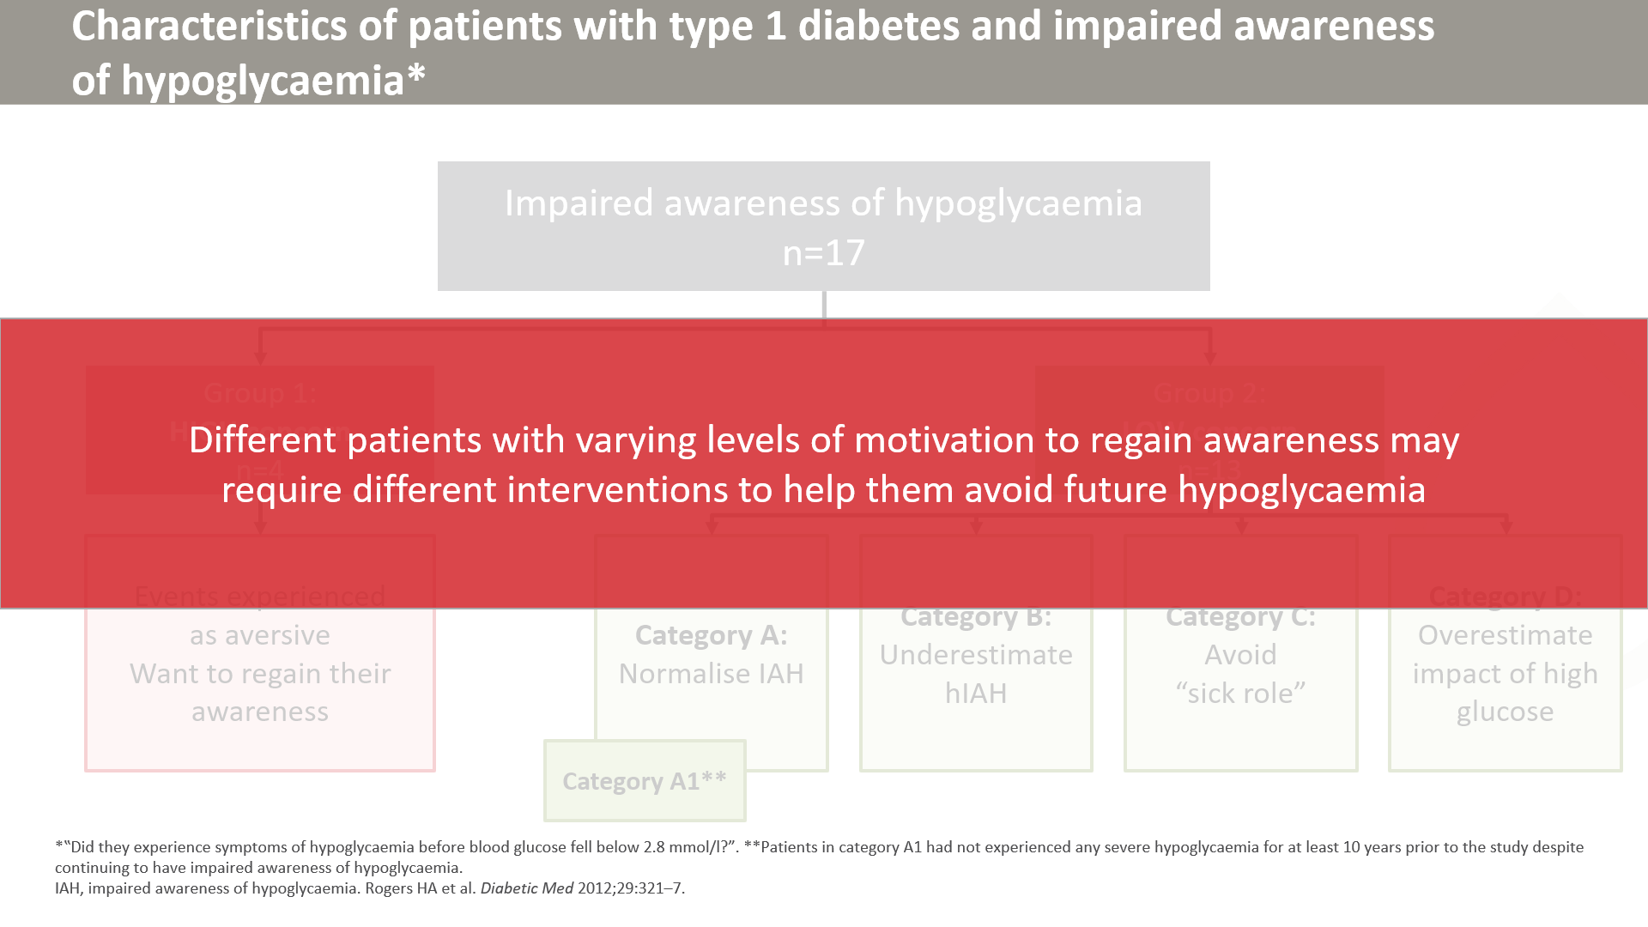

Slide 18
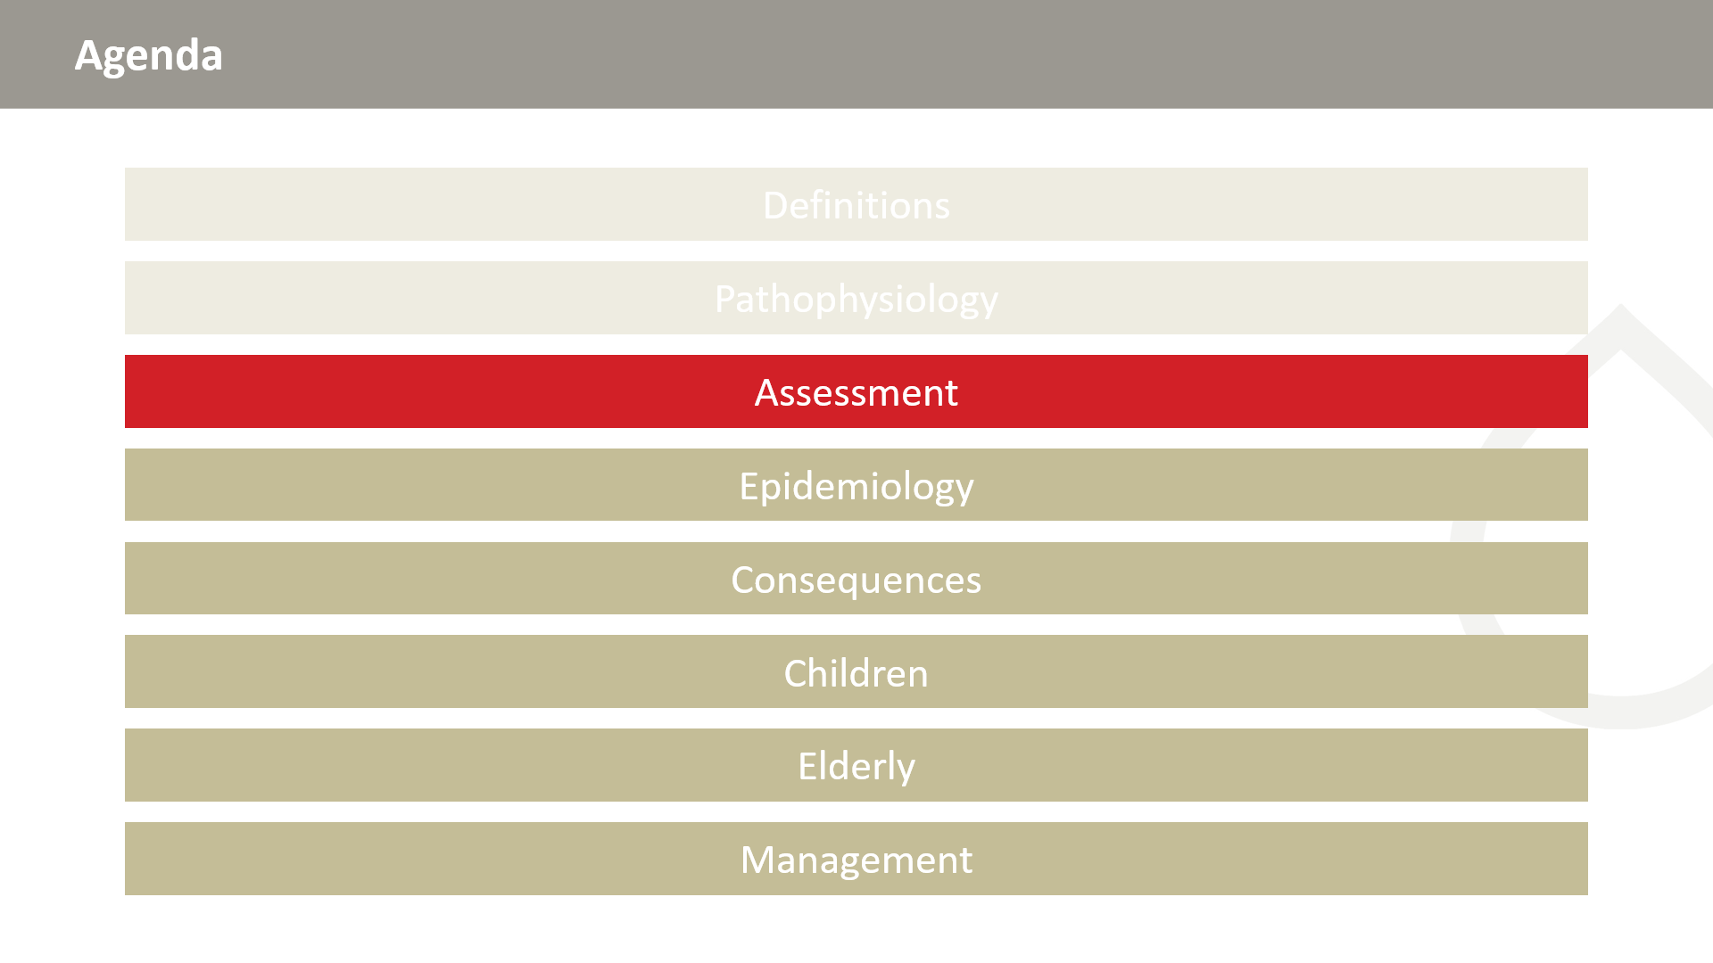

Slide 19
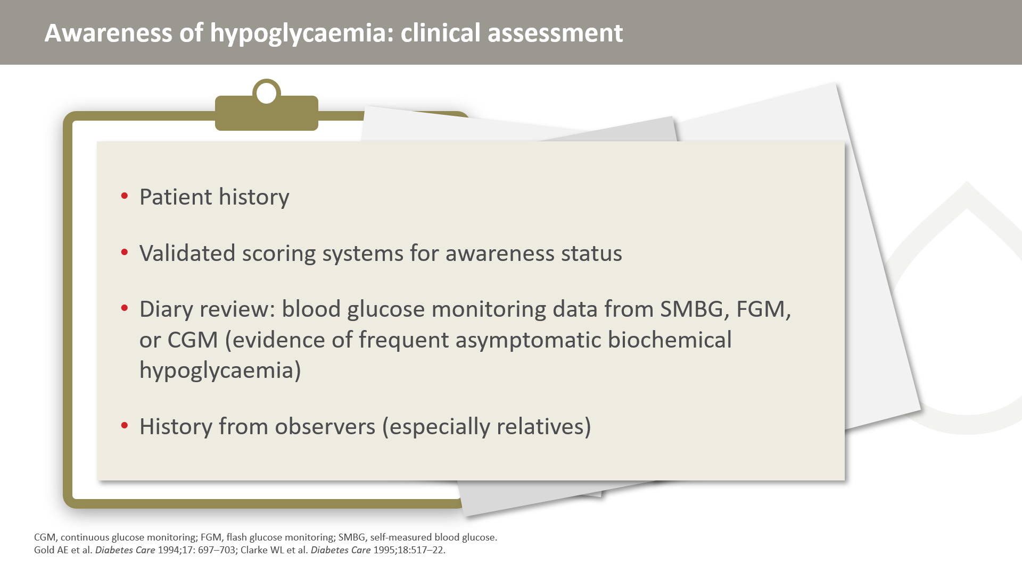
Notes:
These are some of the tools and resources that can be used to gauge awareness of hypoglycaemia.

Slide 20
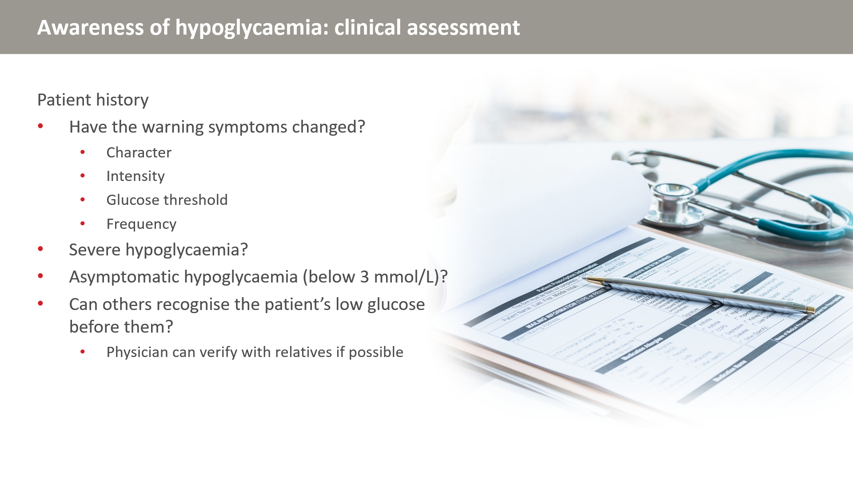

Slide 21
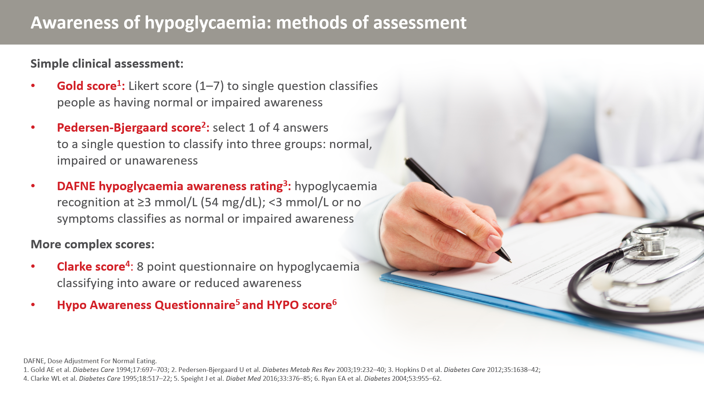
Notes:
The Gold and Pedersen-Bjergaard scores are quick to administer and proven to associate with risk of severe hypoglycaemia, but are subjective.
The DAFNE tool is more objective by asking for a glucose concentration below which the person is aware of hypoglycaemia.
The Clarke score, Hypo Awareness Questoinnaire and HYPO score all require scoring by the health care professional, but give additional information. The Clarke score includes frequency of severe hypoglycaemic episodes and thus measures more than awareness alone.

Slide 22
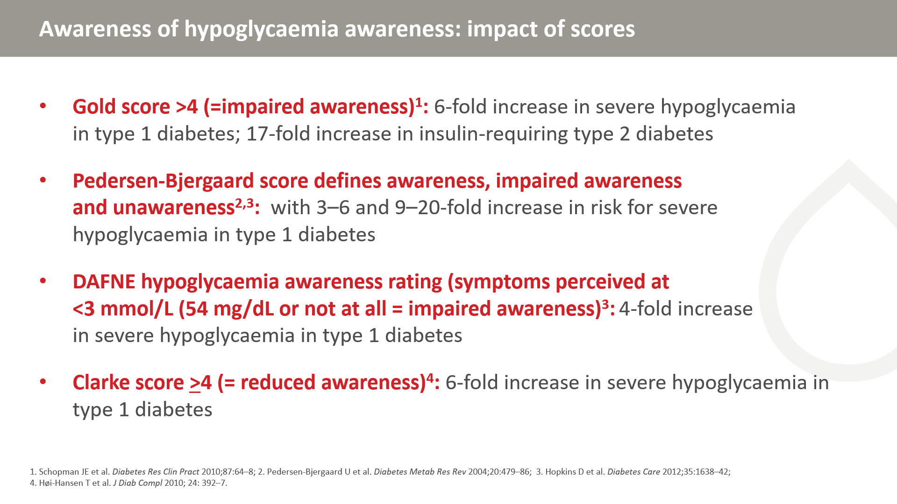
Notes:
Note that the terminology varies between methods. Impaired awareness in the Gold classification is comparable to unawareness in the Pedersen-Bjergaard score and reduced awareness in the Clarke score.

Slide 23
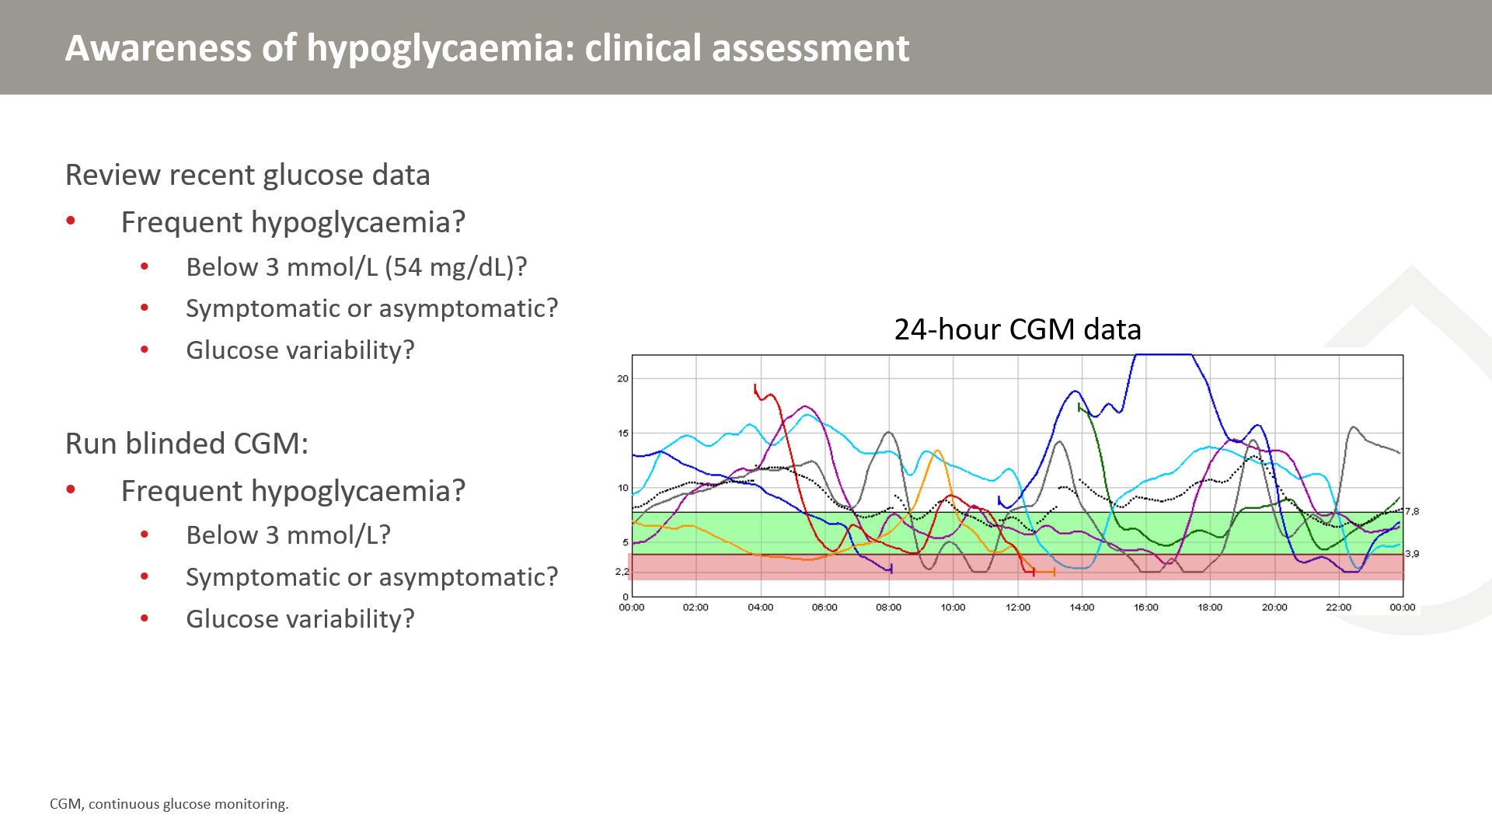
Notes:
The figure shows glucose variability over the course of 24 hours, for one week of CGM. Each line color represents a single day. The green range denotes the normal glycaemic range, while the red area denotes hypoglycaemia. Over the course of the week, multiple hypoglycaemic episodes can be observed.

Slide 24
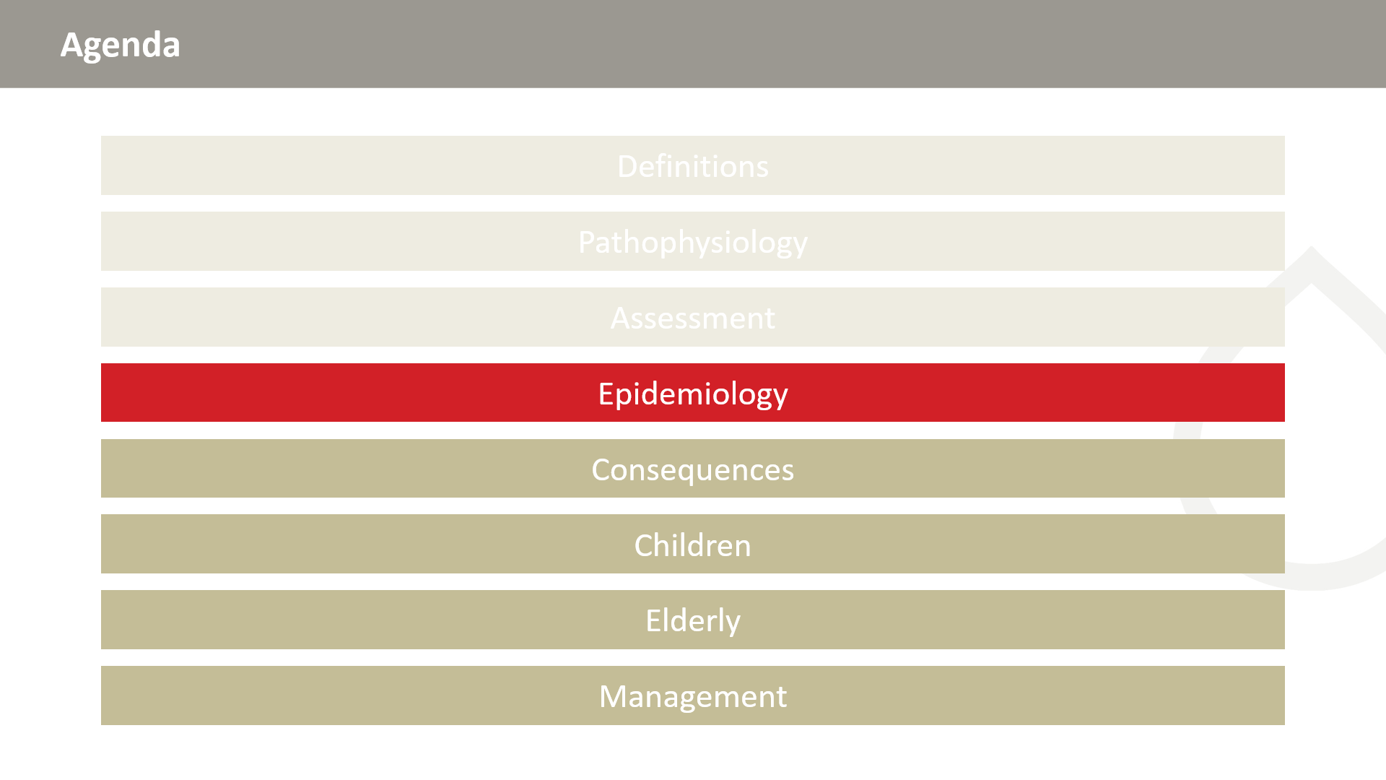

Slide 25
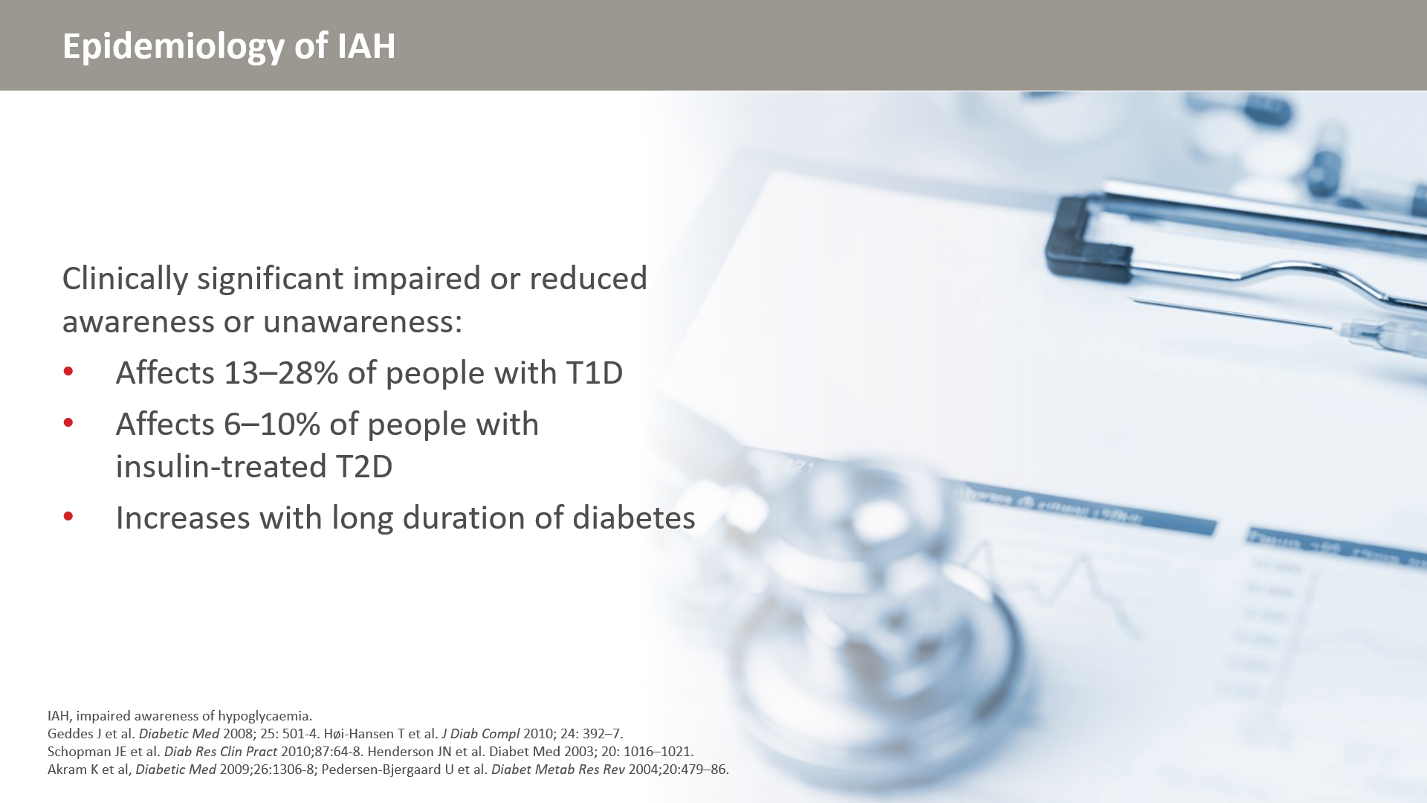

Slide 26
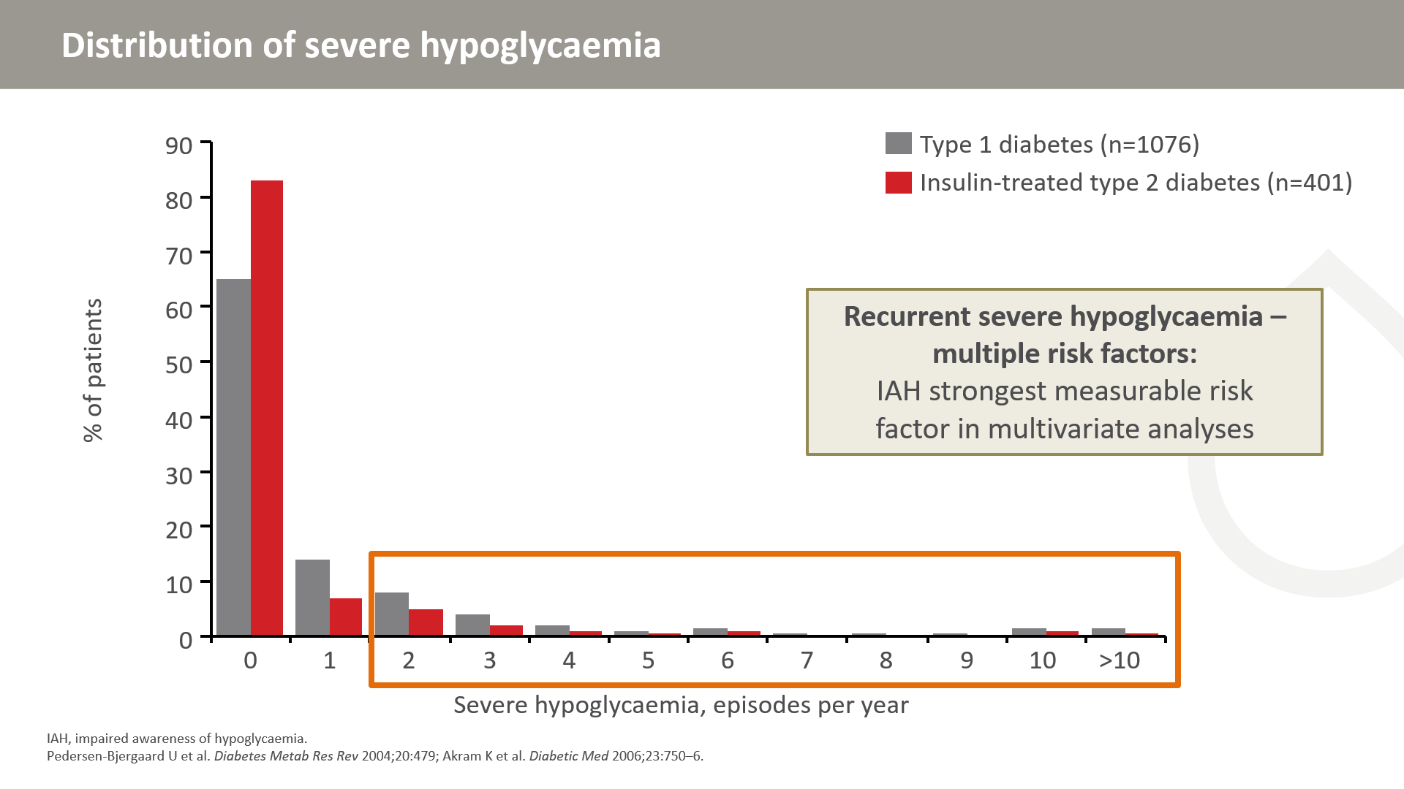
Notes:
The data described a cross-sectional Danish-British multicentre survey of 1076 consecutive adult patients with clinical type 1 diabetes who completed a detailed questionnaire on hypoglycaemia and related issues.
The rate of severe hypoglycaemia in the preceding year was 1.3 episodes/patient-year and episodes were reported by 36.7% of subjects. The distribution was highly skewed with 5% of subjects accounting for 54% of all episodes. Most patients with multiple events of severe hypoglycaemia had impaired awareness. Impaired awareness was the strongest measurable factor predicting risk of recurrent severe hypoglycaemia.

Slide 27
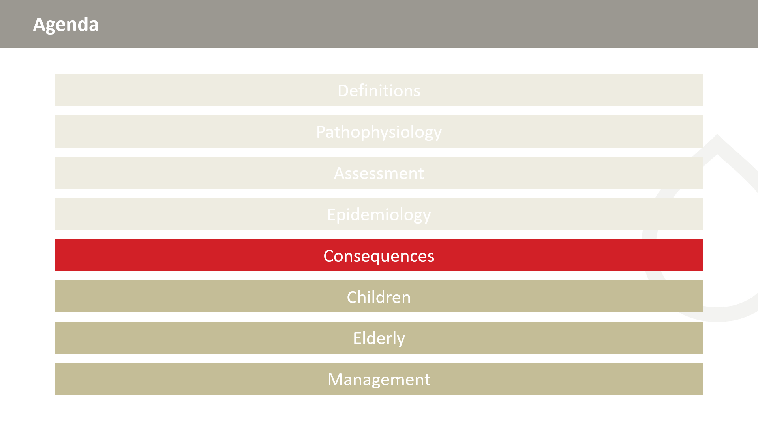

Slide 28
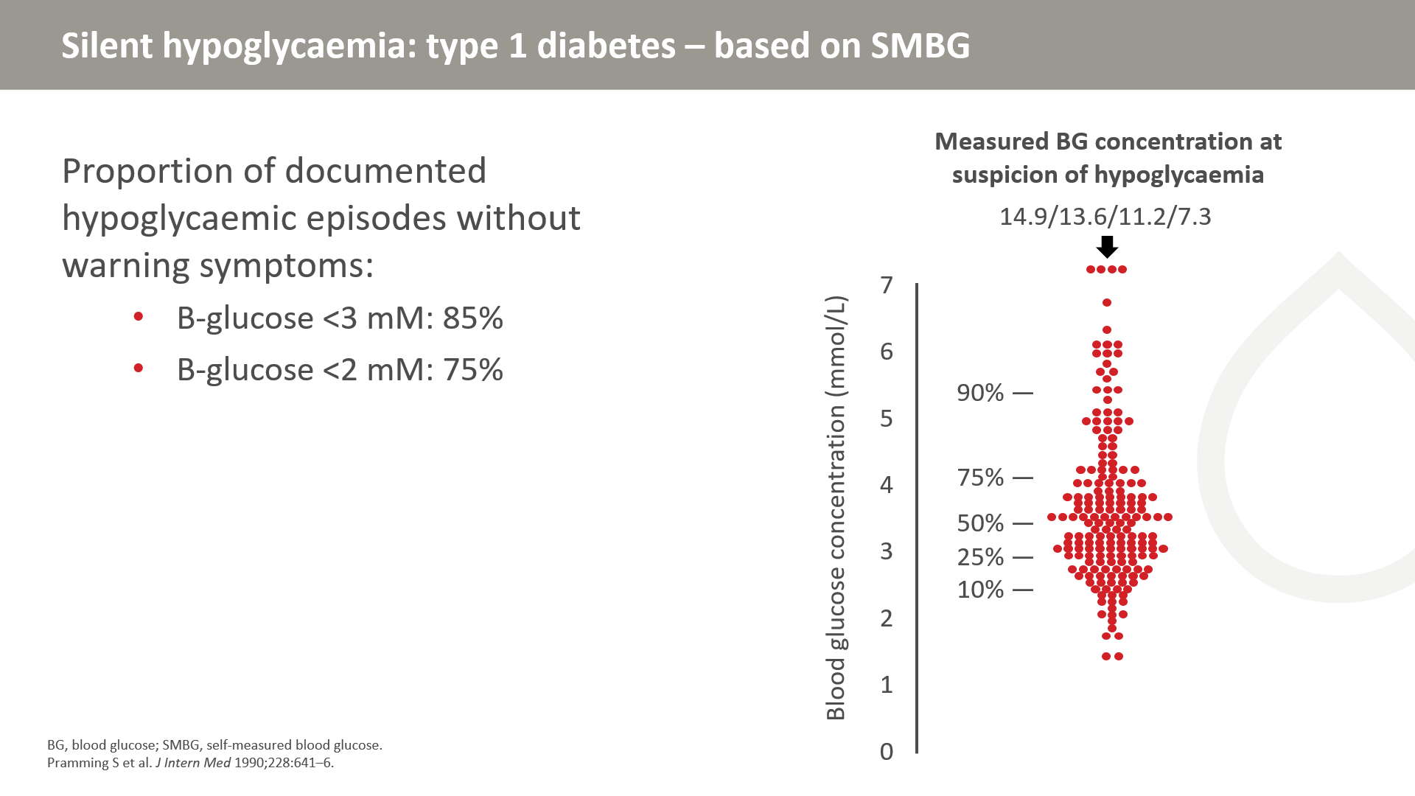
Notes:
66 patients collected 7‐point diurnal blood glucose profiles at home on three consecutive days and then once-weekly for 3 weeks
Patients indicated whether they felt hypoglycaemic at sampling times and collected extra samples if they felt hypoglycaemic at any time during the study period. The graph at right depicts the BG concentration at which the patient felt hypoglycaemic.
At a blood glucose concentration <2mM, 75% of patients did not experience symptoms of hypoglycaemia. At a concentration <3mM, 85% did not experience symptoms, suggesting that symptomatic hypoglycaemia is an unreliable indicator of biochemical hypoglycaemia.

Slide 29
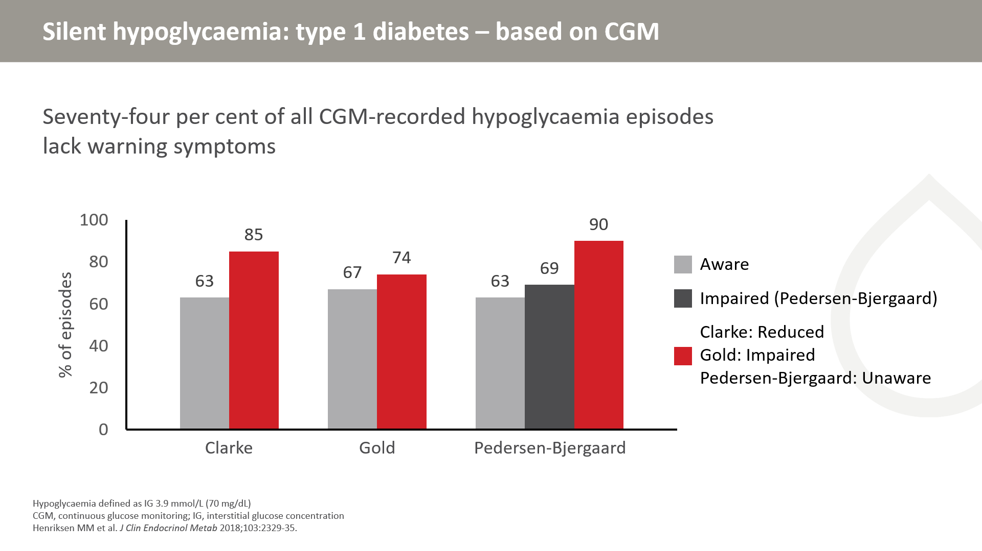
Notes:
153 patients with T1DM were monitored with CGM for 7 days and recorded hypoglycaemic symptoms.
A total of 74% of all episodes were asymptomatic
Higher fractions of asymptomatic hypoglycaemia in patients with impaired awareness

Slide 30
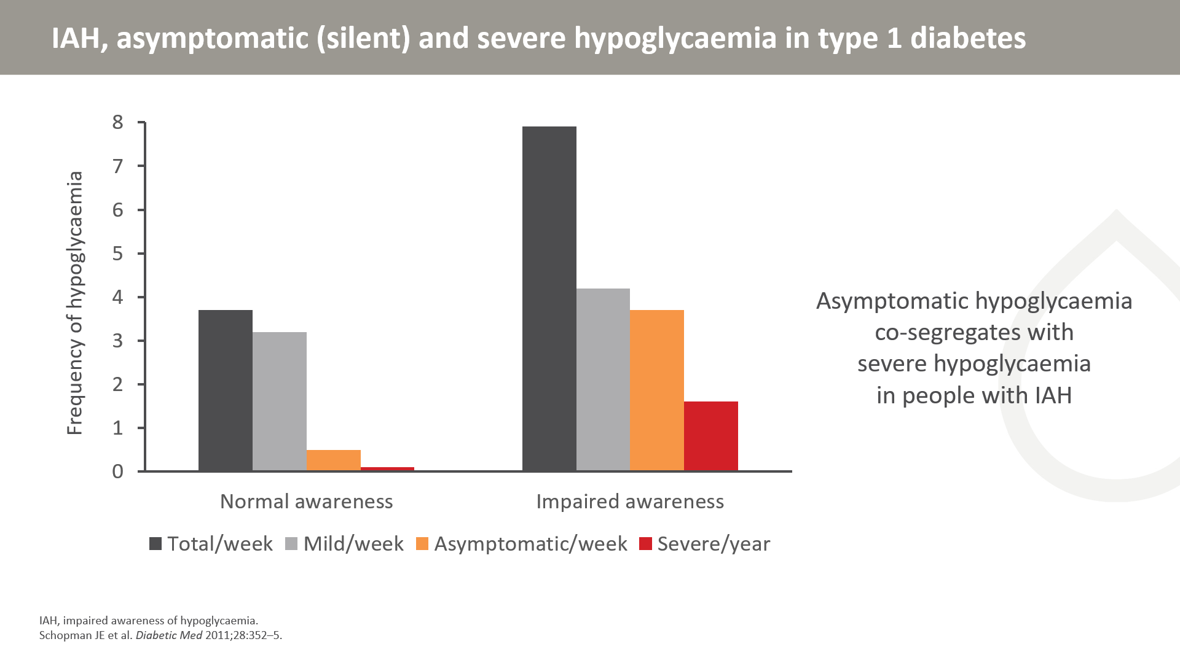
Notes:
19 patients with type 1 diabetes with normal hypoglycaemia awareness were matched for age, sex, duration of diabetes and glycaemic control with 19 patients with impaired awareness of hypoglycaemia
Frequency of severe hypoglycaemia in the preceding year was estimated retrospectively
Capillary blood glucose was monitored prospectively four times daily, over a 4-week period
All blood glucose values <3 mmol/L were recorded and classified by symptom response.

Slide 31
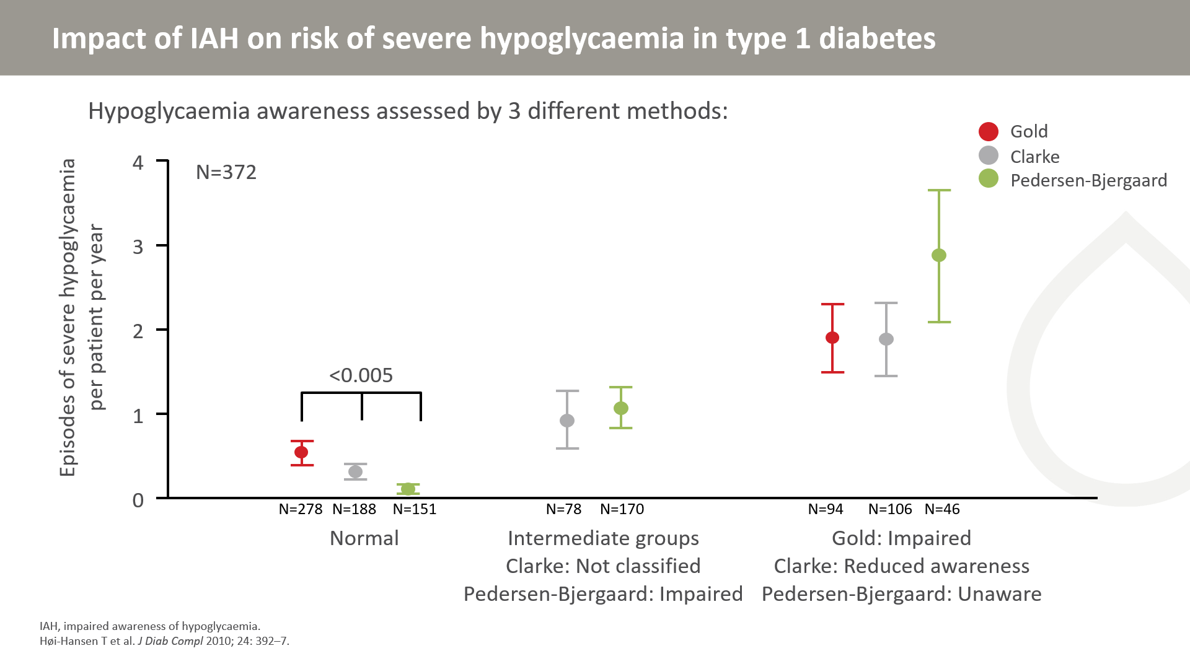
Notes:
A questionnaire including the three methods was filled in by 372 outpatients with type 1 diabetes [43% women, age 51±14 years (mean±SD)], duration of diabetes 24±13 years, and HbA_{1c}8.2±1.0%).
All three methods for assessment of hypoglycaemia awareness are feasible in clinical practice since the degree of awareness is associated with risk of severe hypoglycaemia.

Slide 32
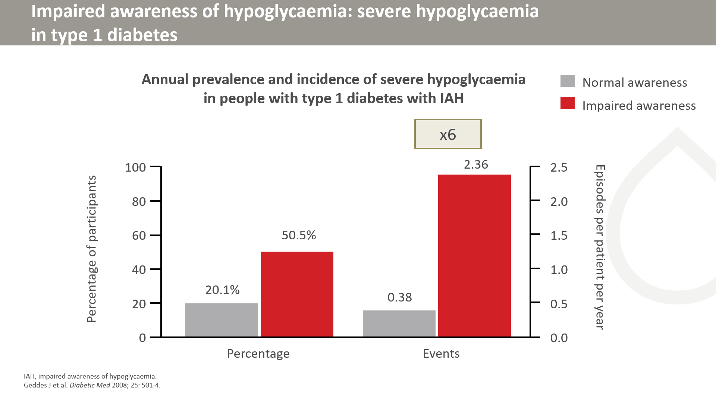
Notes:
518 people with type 1 diabetes were recruited by random selection over a 2-year period. Participants completed a questionnaire documenting baseline characteristics and assessment of their awareness status using the Gold scoring method. The number of episodes of severe hypoglycaemia they had experienced in the preceding year was recorded retrospectively.

Slide 33
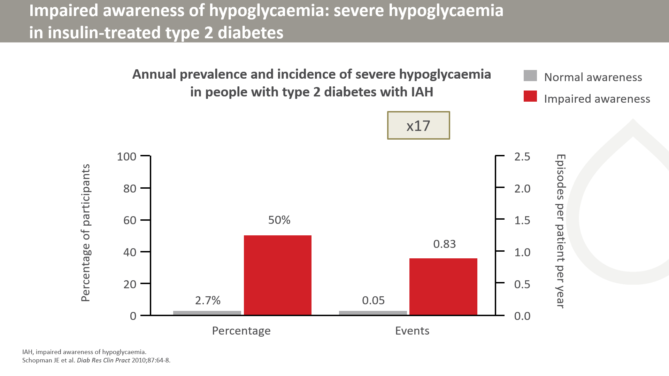
Notes:
Data were obtained from 122 people with insulin-treated T2D. IAH was assessed using the Gold scoring system. Previous exposure to severe hypoglycaemia (events requiring external assistance) was estimated retrospectively for the year preceding the study

Slide 34
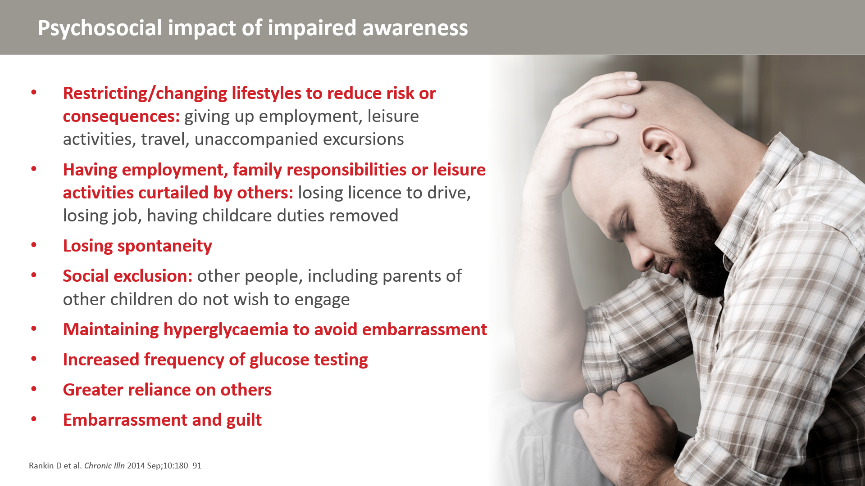
Notes:
It can be difficult to dissociate the impact of impaired awareness of hypoglycaemia from that of having had severe episodes.
This study involved 38 people with type 1 diabetes who had a Gold Score>4, three or more episodes of blood glucose levels of <3mmol/L (54 mg/dl) without detecting symptoms in 2 weeks of blood glucose results and at least one episode of severe hypoglycaemia, deﬁned as requiring third party assistance in the last 2 years.

Slide 35
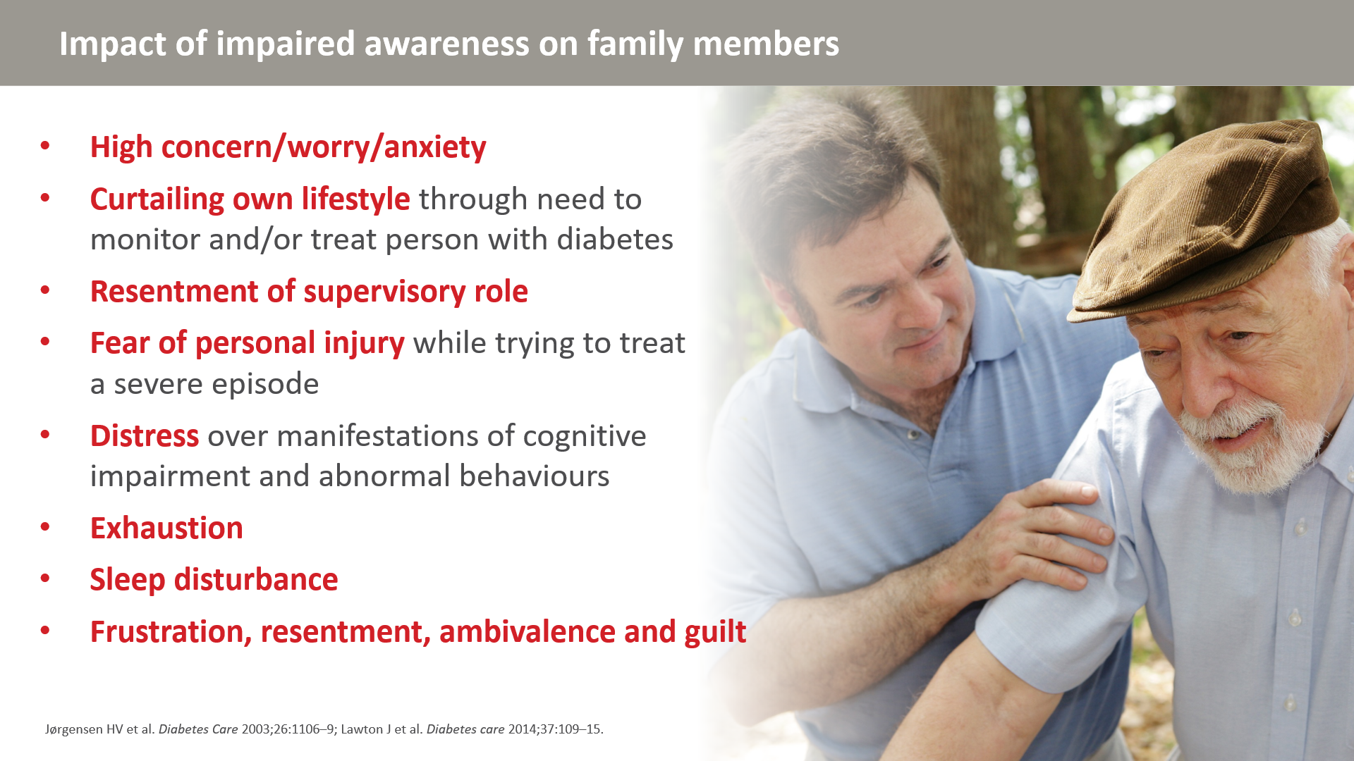
Notes:
It is often not easy to distinguish the impact of impaired awareness of hypoglycaemia on the family from that of severe episodes of hypoglycaemia but in the above study, researchers spoke to family members of people who had been recruited into a study by virtue of having type 1 diabetes and impaired awareness and Gold score ≥4.

Slide 36
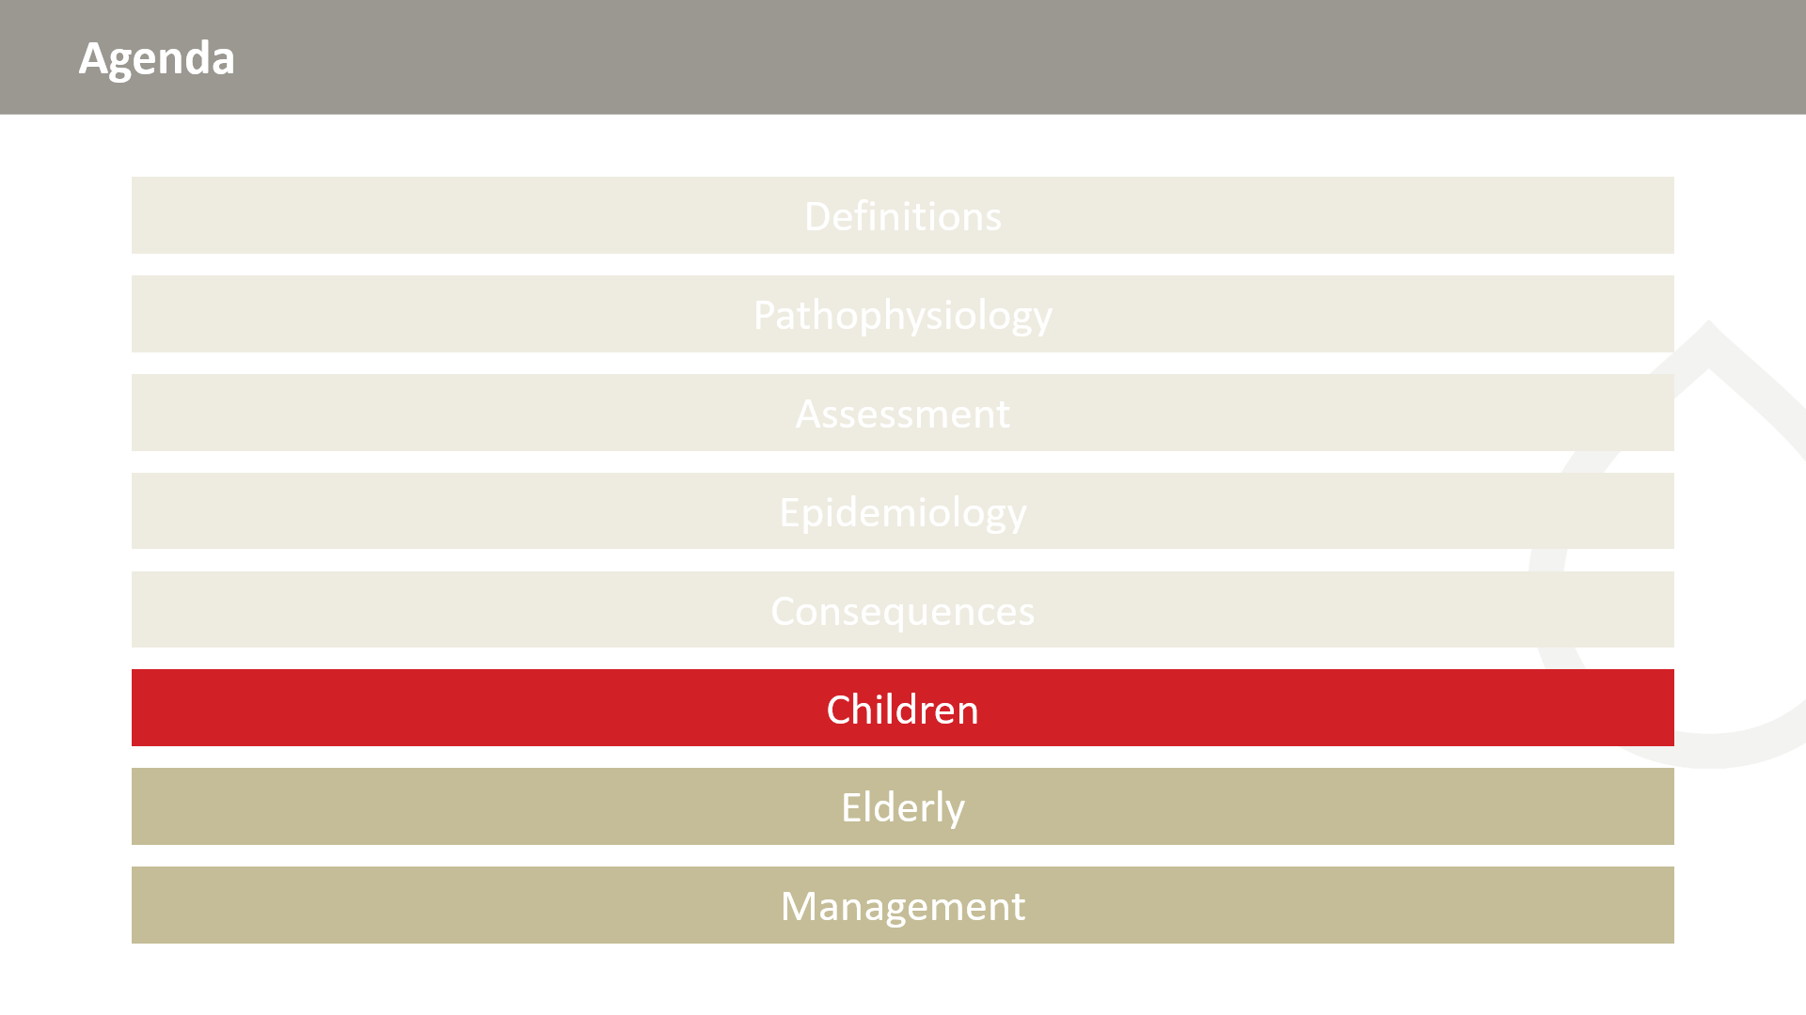

Slide 37
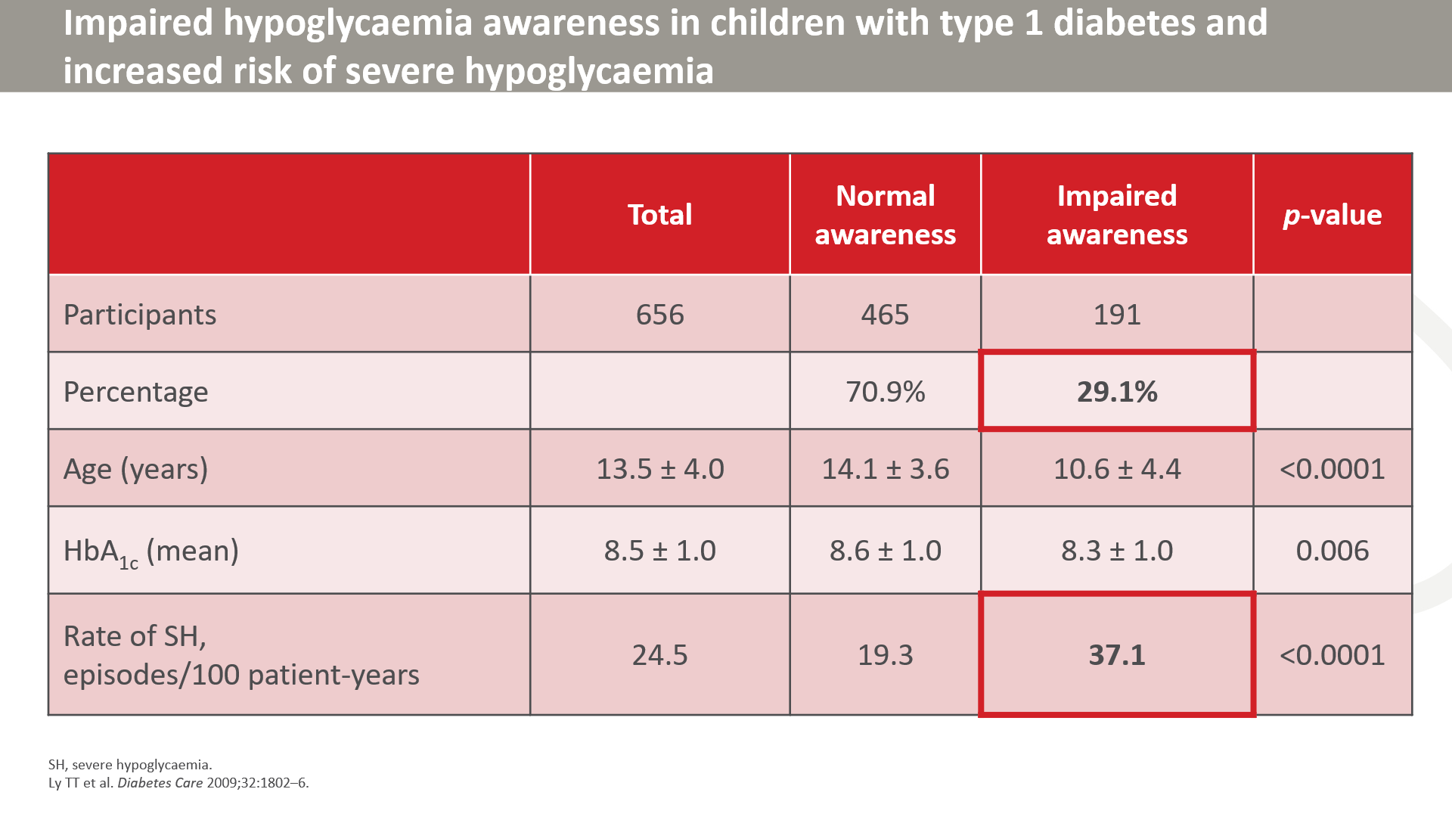
Notes:
37
The incidence of IAH in children with T1DM in Western Australia was determined via a questionnaire in a study conducted by Dr. Patricia Gallego.
Children and adolescents with type 1 diabetes aged between 6 months and 19 years and diabetes duration of at least 6 months, attending paediatric diabetes clinics at Princess Margaret Hospital were eligible to participate in the study.
IAH was defined as patients having a Clarke score ≥4.
The incidence of hypoglycaemia unawareness was very high at 29% in this population and in this group. The rate of severe hypoglycaemic events was almost double compared to children with normal awareness.

Slide 38
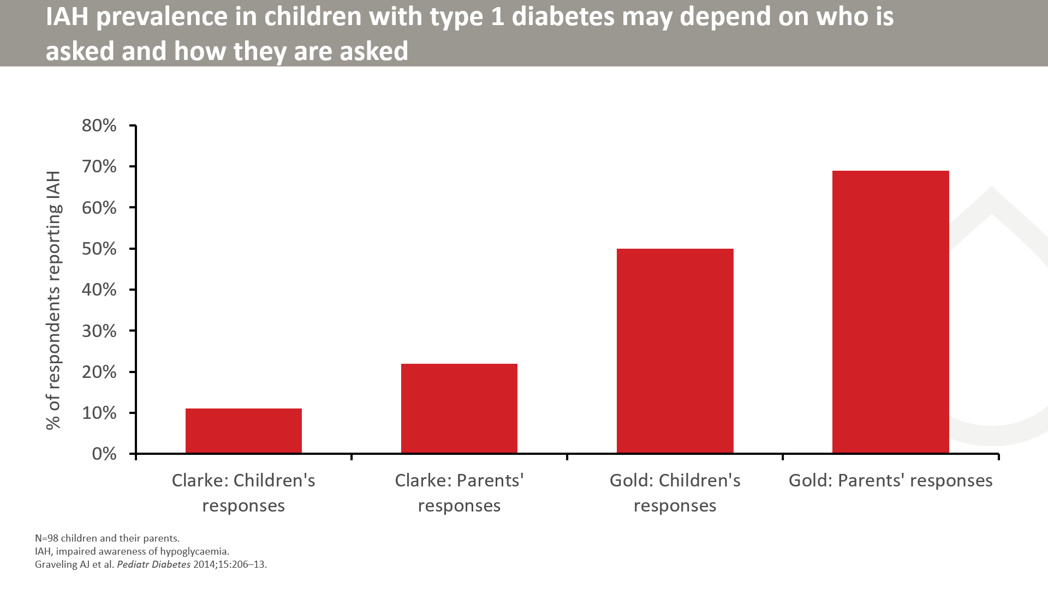
Notes:
Questionnaires were completed by 98 children with T1D (mean age 10.6 years) and their parent(s), and hospital admission data for the previous year were collected. Awareness of hypoglycaemia was assessed using ‘Clarke’ or ‘Gold’ scoring systems. For 4 weeks, participants performed routine blood glucose measurements and completed questionnaires after each episode of hypoglycaemia.
The Gold questionnaire classified a greater proportion of the participants as having IAH than the 'Clarke' questionnaire.

Slide 39
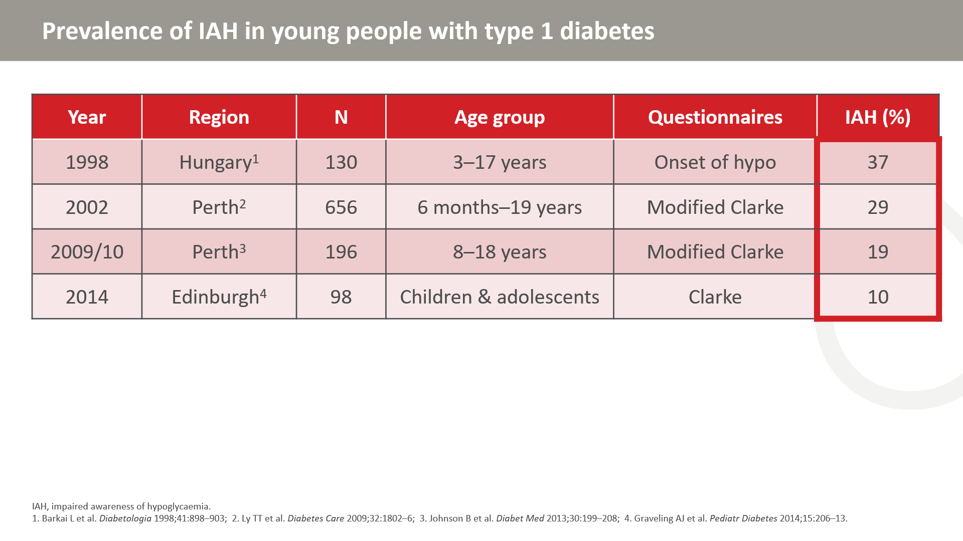

Slide 40
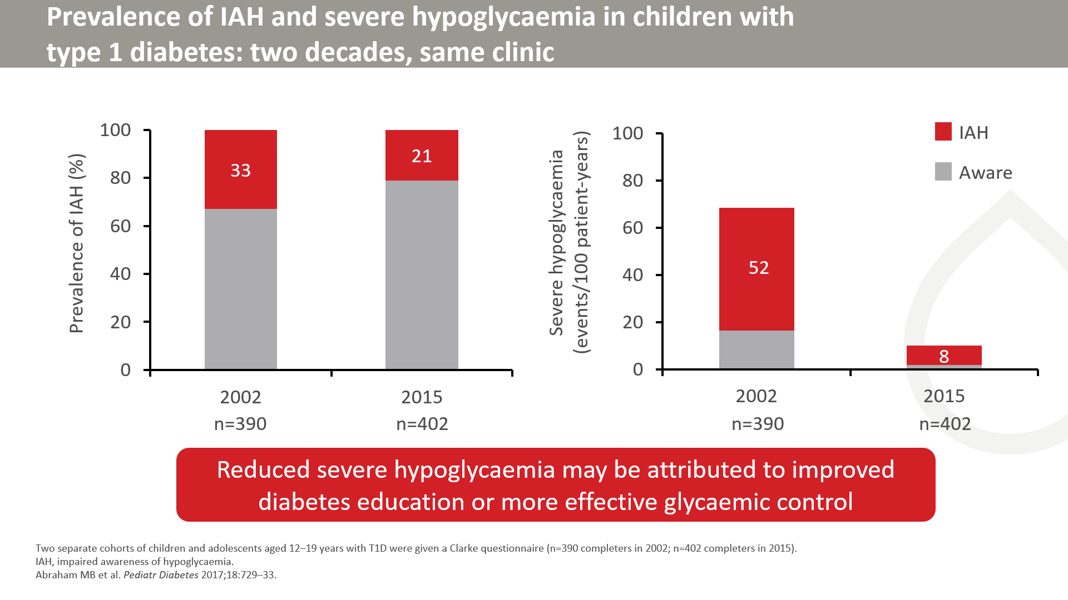
Notes:
Prevalence of IAH was significantly lower in the 2015 cohort compared to 2002.
Note that the reduction in severe hypoglycaemia may be attributed to increased use of insulin analogues, insulin pump therapy, improved diabetes education, or more effective glycaemic control

Slide 41
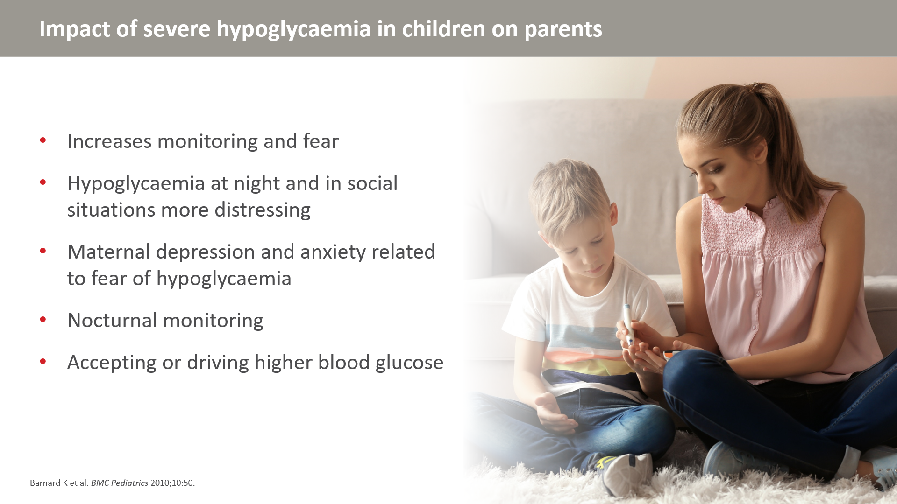
Notes:
Severe hypoglycaemia in children has consequences in their parents or caregivers.

Slide 42
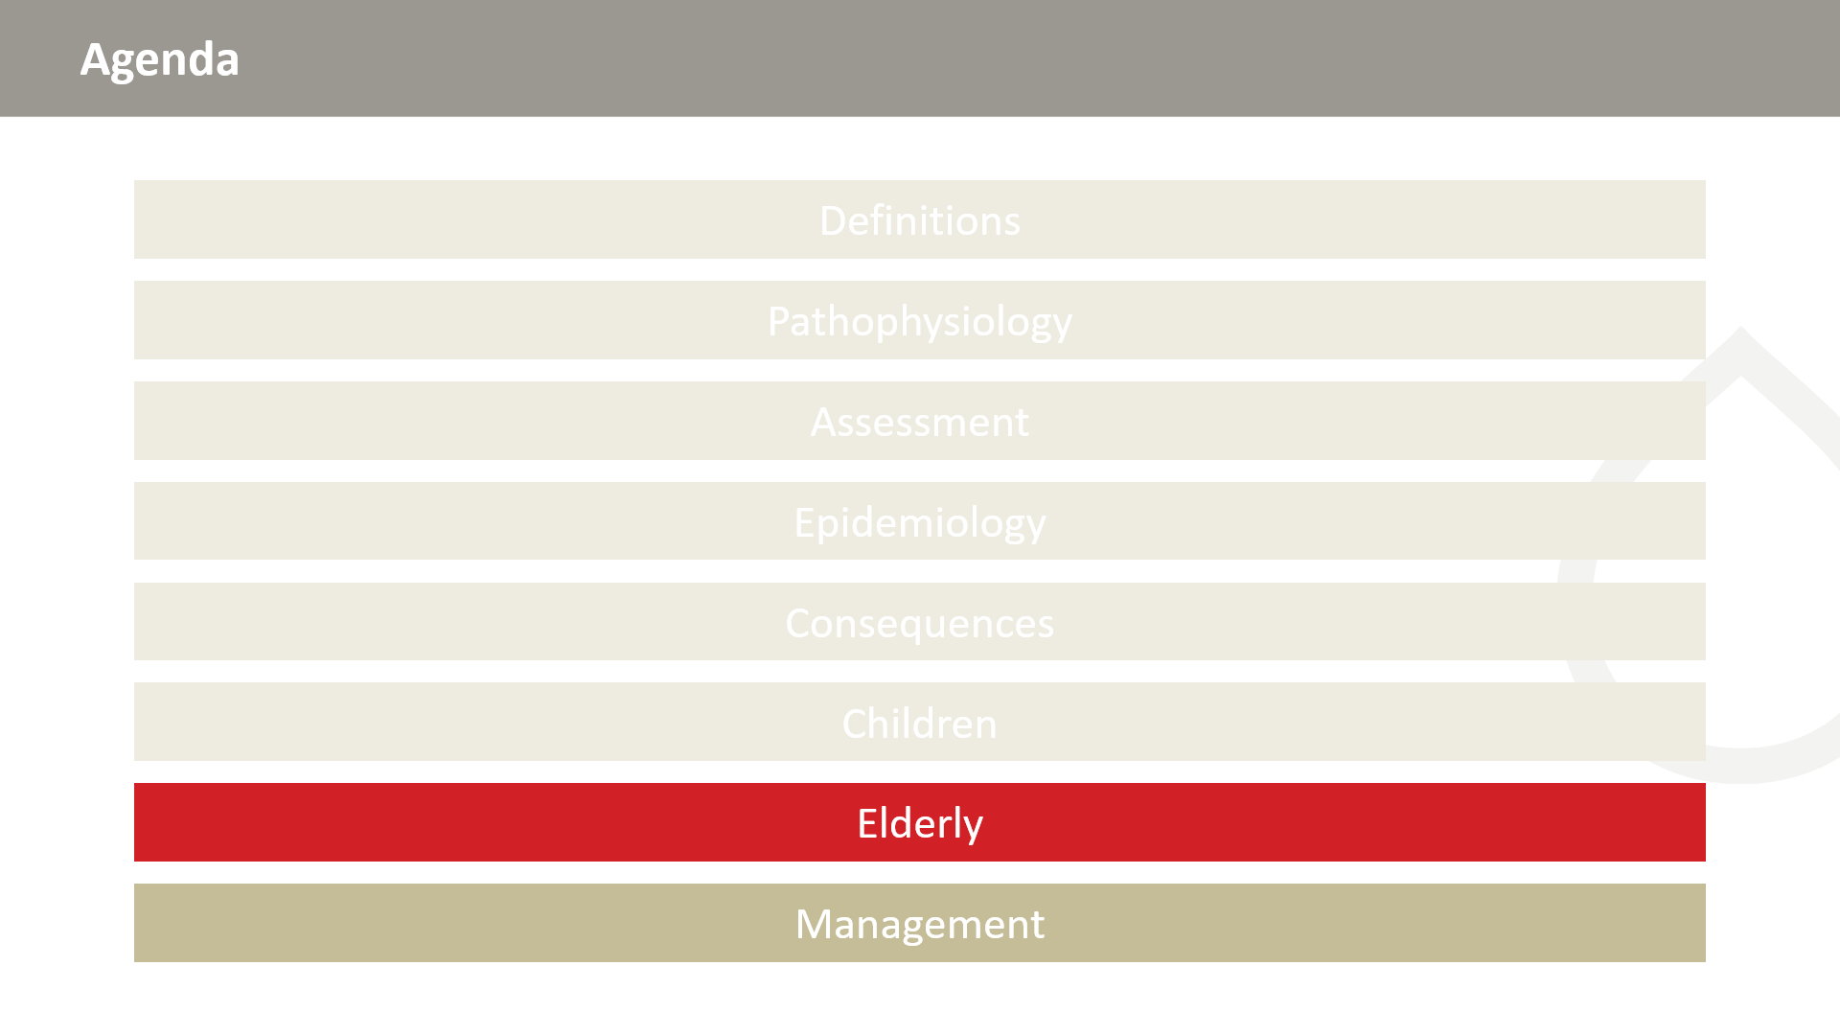

Slide 43
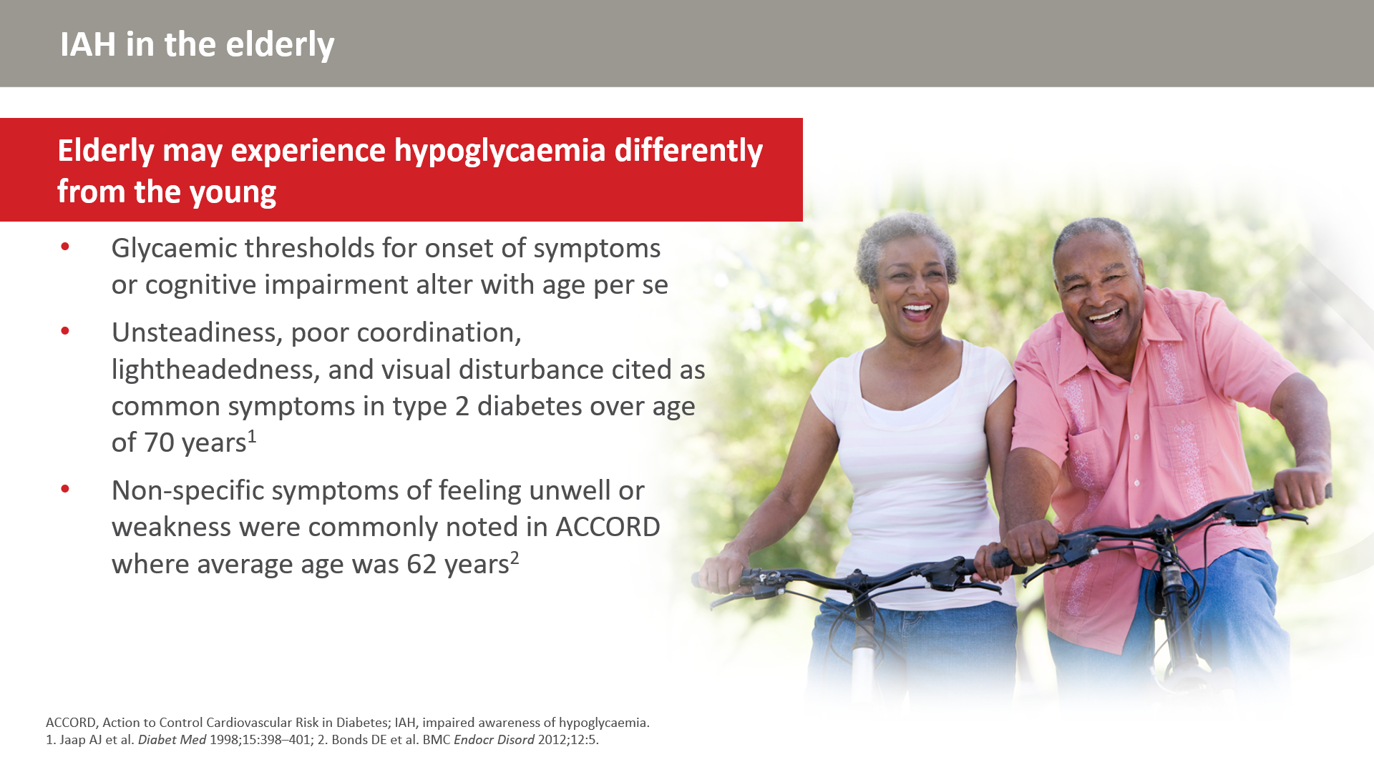
Notes:
Previous studies have shown that the symptoms associated with hypoglycaemia are common in the elderly population. Additionally, normal glycaemic thresholds for symptom generation or cognitive impairment in the younger population are shifted downwards in the elderly.

Slide 44
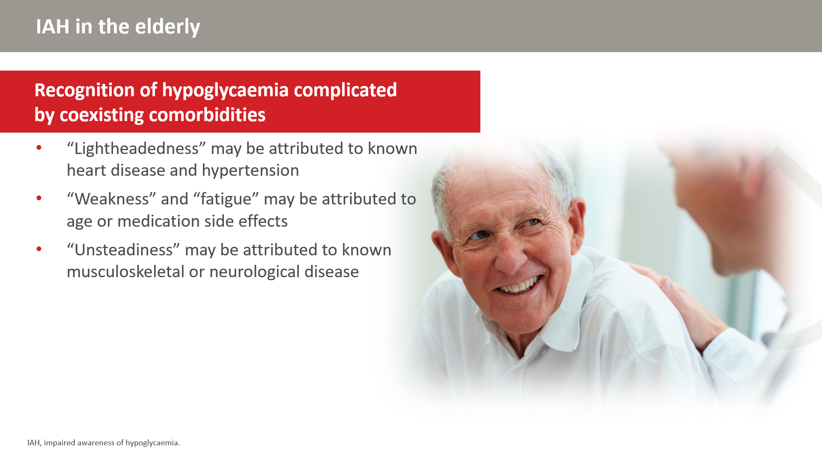
Notes:
Comorbidities from other diseases associated with the elderly population increase the difficulty in recognizing hypoglycaemia in elderly populations due to overlapping symptoms.

Slide 45
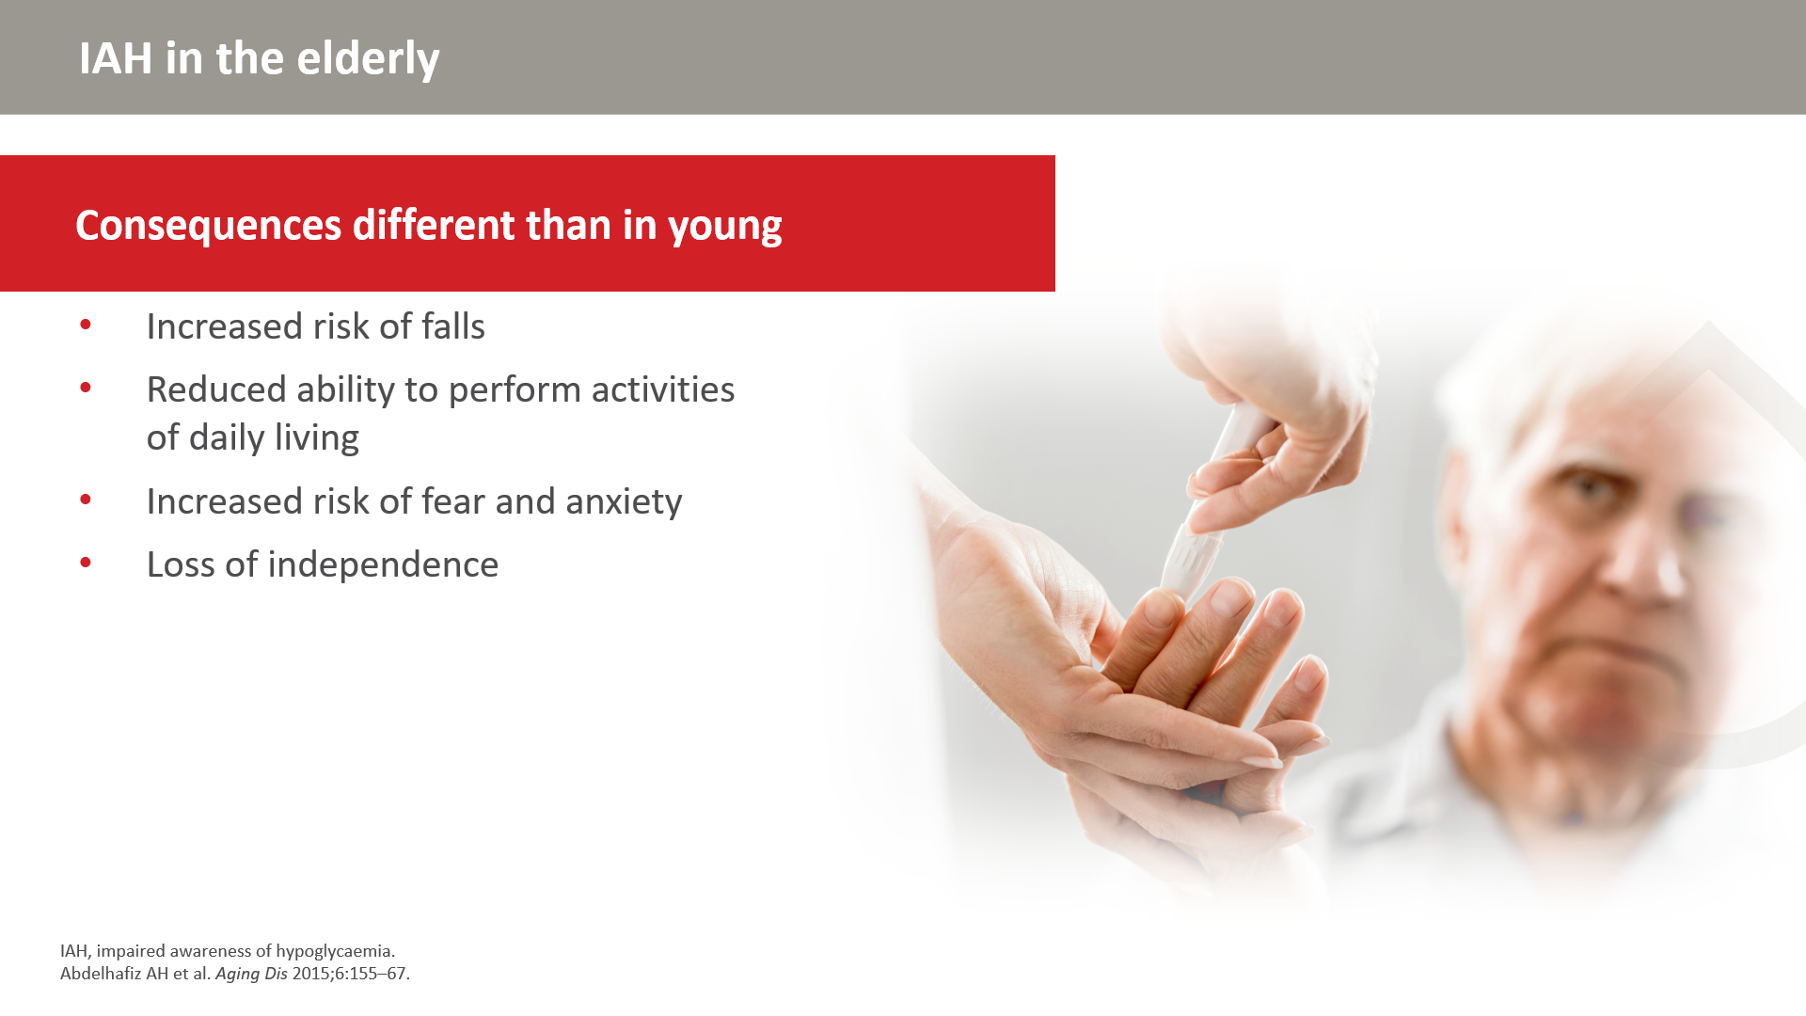
Notes:
The elderly population faces different consequences of hypoglycaemia than in the younger population.

Slide 46
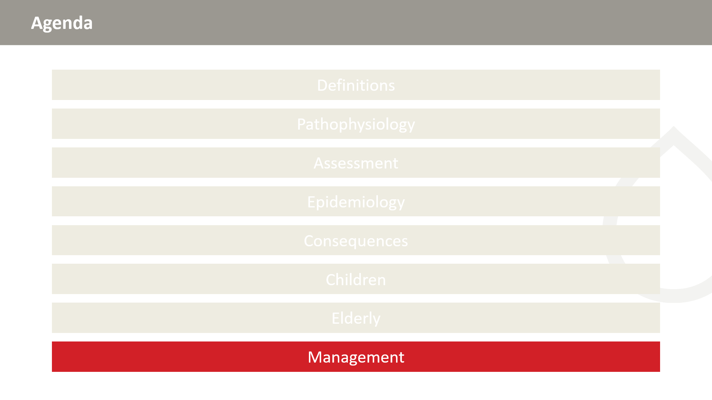

Slide 47
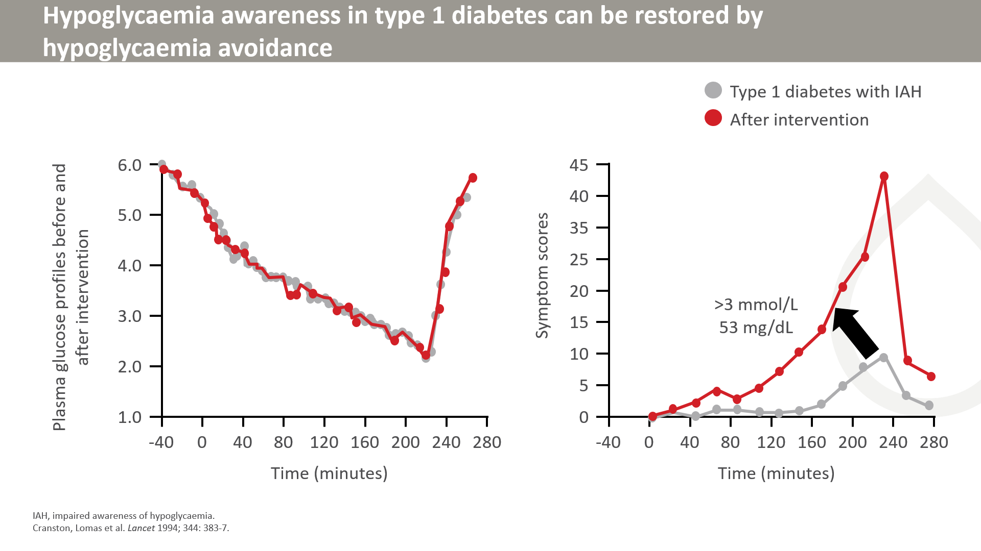
Notes:
In this study, responses to experimentally induced hypoglycaemia (left) were measured in 12 people with type 1 diabetes and recurrent severe hypoglycaemia before and after avoidance of exposure to measured plasma glucose of under 3 mmol/L for at least 3 weeks. In all, adrenaline and symptom responses were restored. Six had intensively treated type 1 diabetes, six had problematic hypoglycaemia as part of genreally looser diabetes self-maangement but all showed the improvement. Outside the setting of research, not all were able to maintain the benefit, achieved by investigator-driven insuin dose adjusments during the trial. This study was conducted in the pre-DAFNE era in the UK.

Slide 48
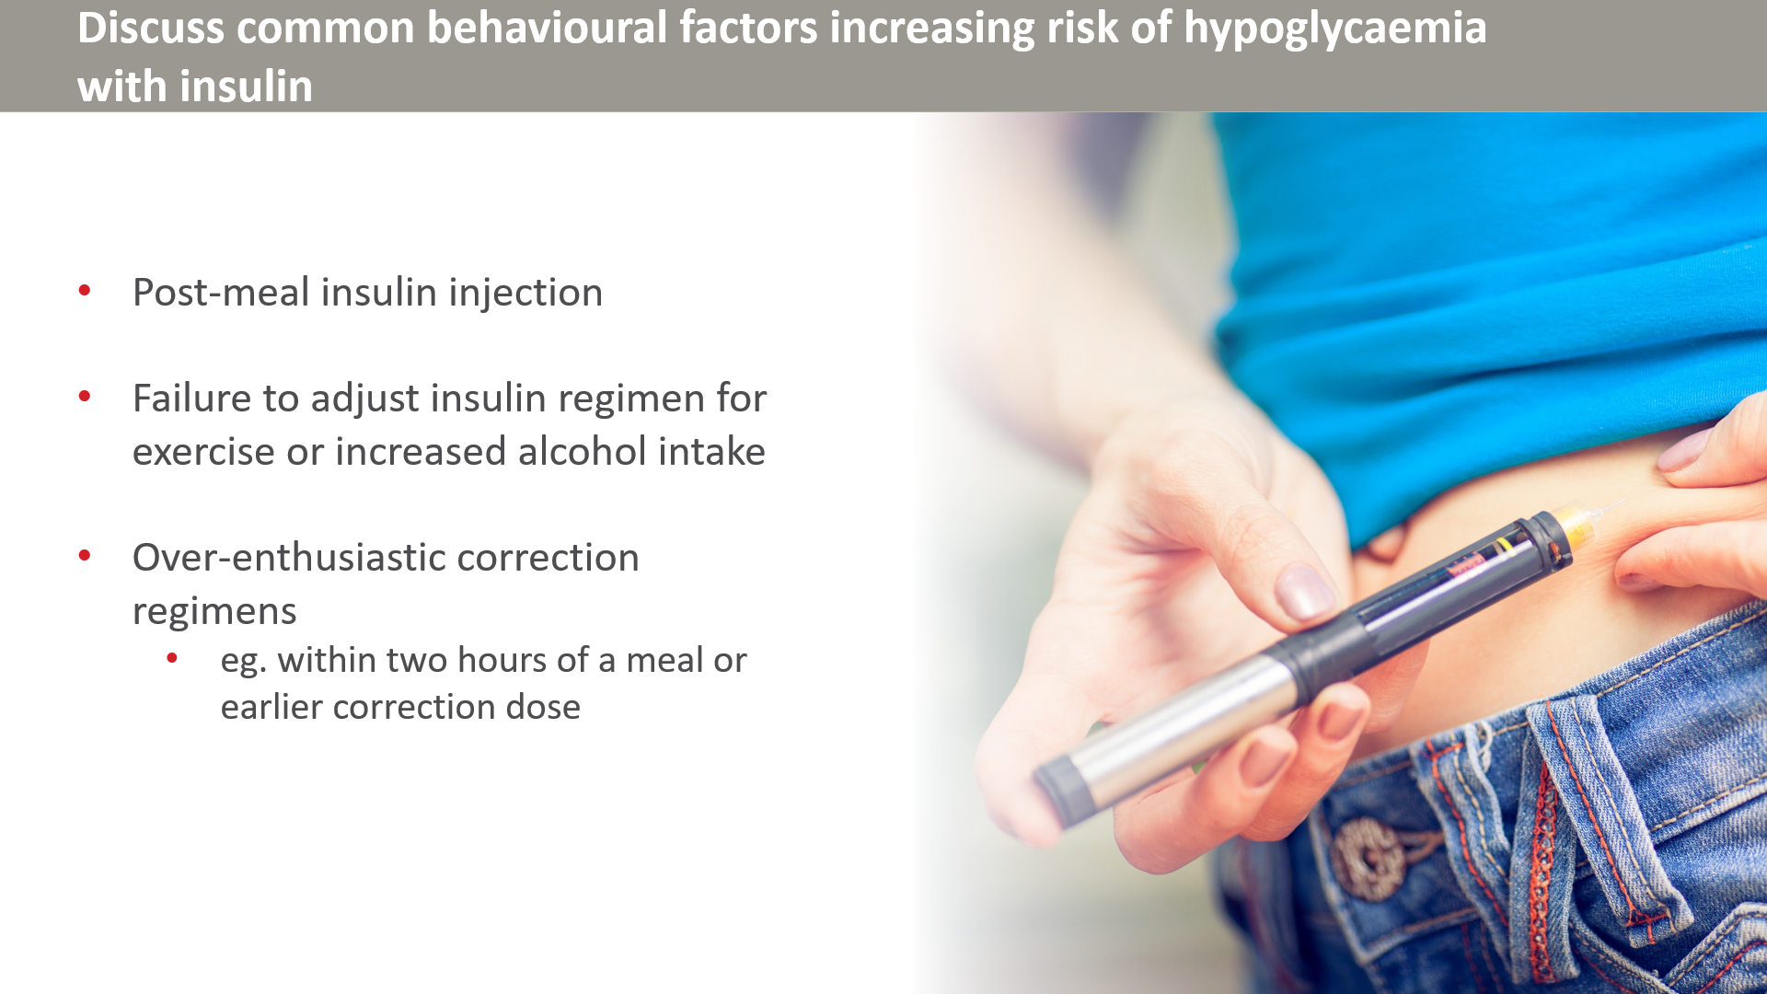
Notes:
Proper management is required to balance avoidance of hypoglycaemia and risk of future episodes. Improper management techniques can promote an increase in hypoglycaemia risk.

Slide 49
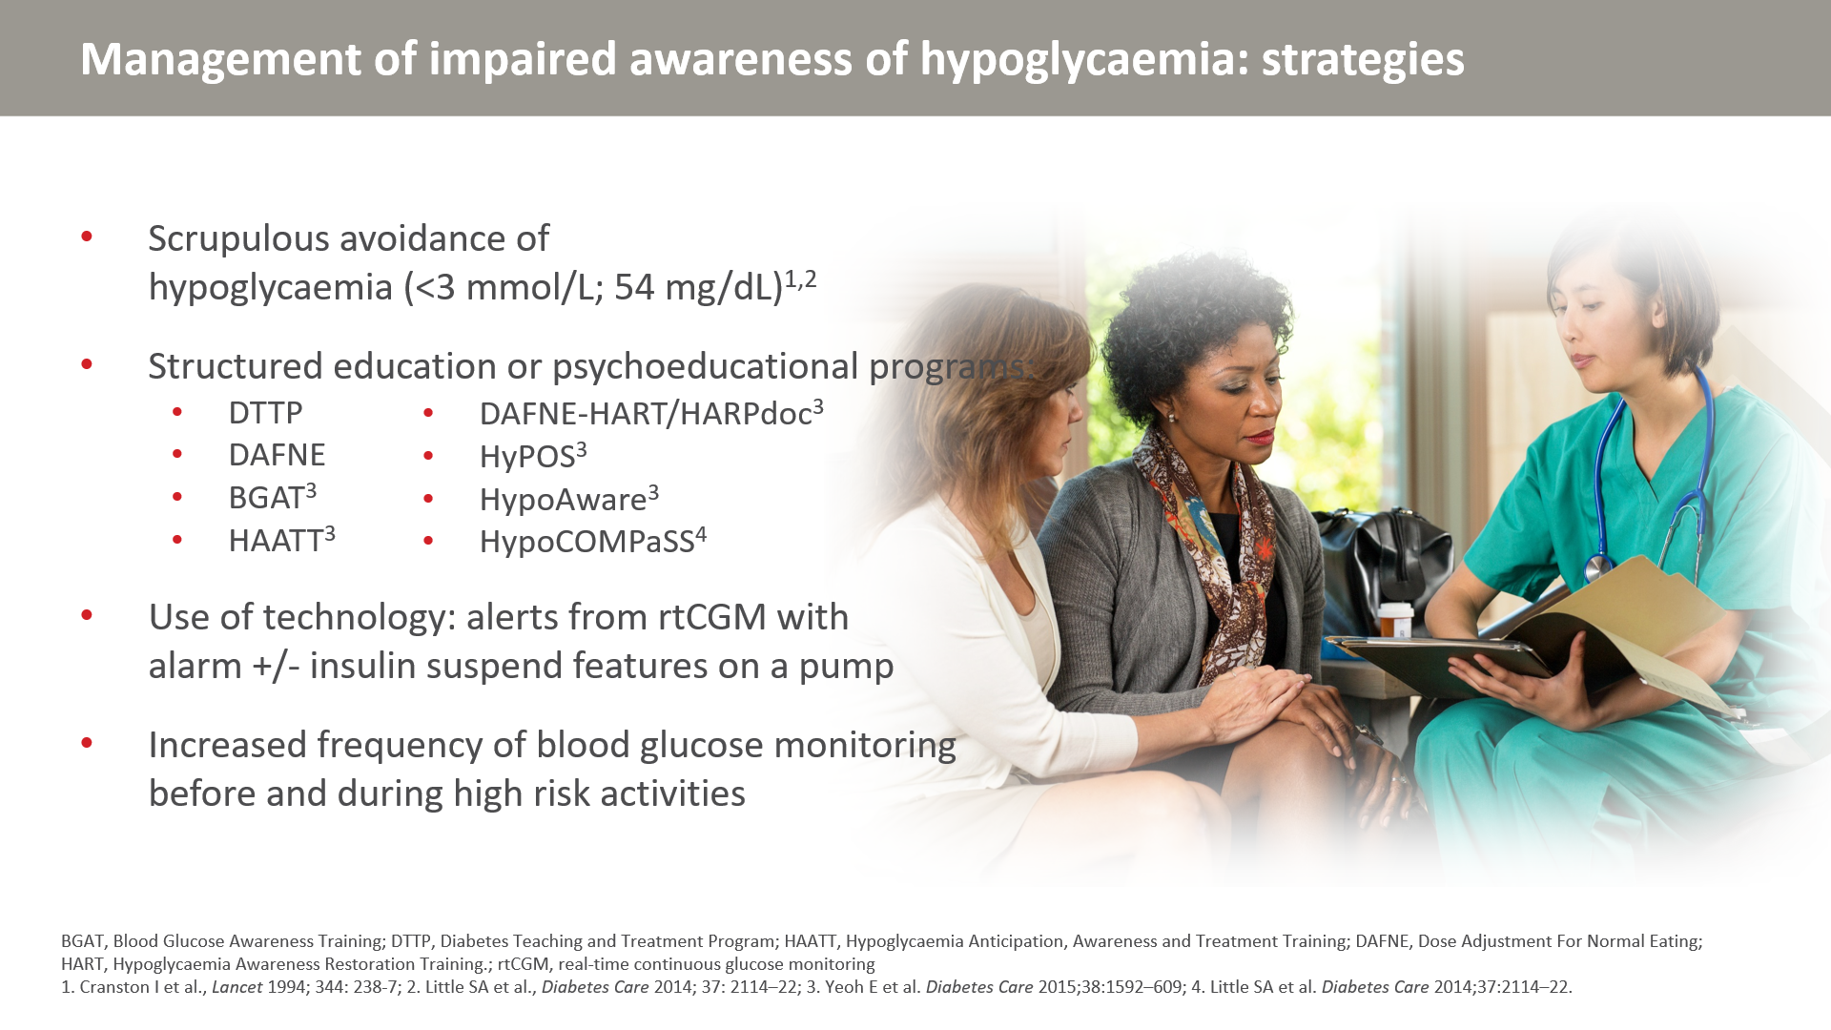
Notes:
A number of strategies can be employed to manage IAH and hypoglycaemia. Frequent episodes of hypoglycaemia are associated with IAH. Thus, reversal or avoidance of hypoglycaemia can reduce IAH.
Educational programs including those listed can also improve IAH.
Careful monitoring of blood glucose, especially during high-risk activities, can be employed and bolstered through the use of technology such as CGM.

Slide 50
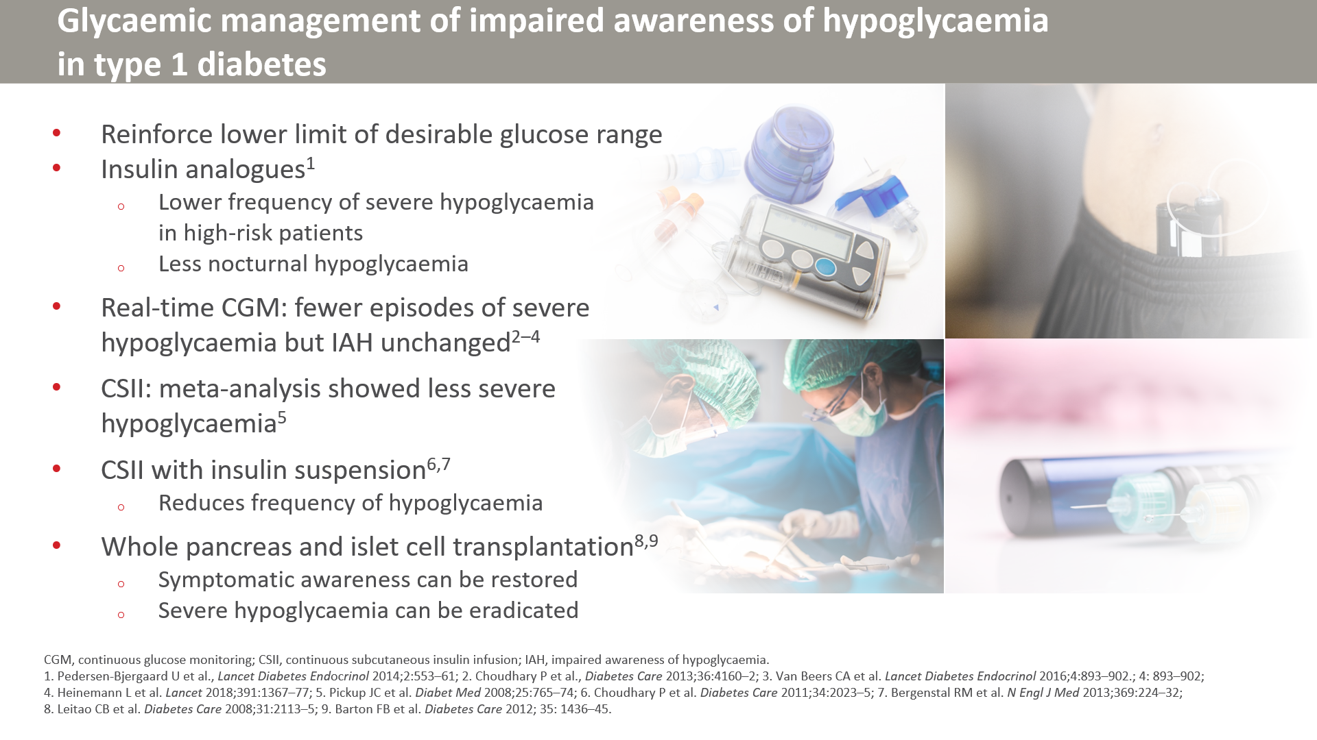

Slide 51


Slide 52


Slide 53


Slide 54

Notes:
All participants wore a masked rtCGM system for 28 days and were randomly assigned to 26 weeks of unmasked rtCGM or to the control group (continuing SMBG)
Block randomisation with 1:1 allocation was done centrally, with the study site as the stratifying variable
Masking of participants and study sites was not possible. Control participants wore a masked rtCGM system during the follow-up phase (weeks 22–26).
149 participants were randomly assigned (n=74 to the control group; n=75 to the rtCGM group) and 141 completed the follow-up phase (n=66 in the control group, n=75 in the rtCGM group)
54

Slide 55

Notes:
The mean number of hypoglycaemic events per 28 days among participants in the rtCGM group was reduced from 10.8 (SD 10.0) to 3.5 (4.7)
Reductions among control participants were negligible (from 14.4 (12.4) to 13.7 (11.6))
Incidence of hypoglycaemic events decreased by 72% for participants in the rtCGM group (incidence rate ratio 0.28 [95% CI 0.20–0.39], p<0.0001

Slide 56

Notes:
Patients were randomly assigned to either 16 weeks of CGM followed by 12 weeks of washout and 16 weeks of SMBG, or 16 weeks of SMBG followed by 12 weeks of washout and 16 weeks of CGM (where the SMBG phase was the control).
56

Slide 57

Notes:
During the CGM phase, patients used a real-time CGM system consisting of a Paradigm Veo system with a MiniLink transmitter and an Enlite glucose sensor (Medtronic, CA, USA).
During the SMBG phase, patients were equipped with a masked CGM device, consisting of an iPro 2 continuous glucose monitor and an Enlite glucose sensor, which does not display real-time glucose values.
The number of SMBG measurements per day and SMBG systems were not standardised between patients, to mimic real-life conditions.

Slide 58


