Slide 1
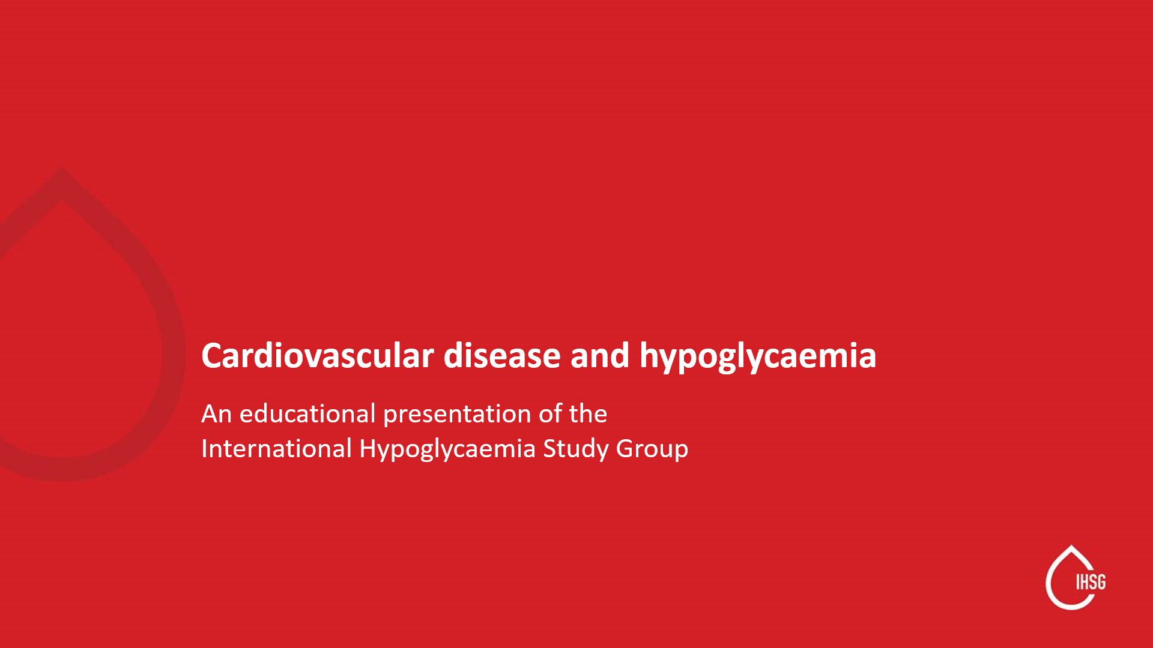
Notes:
Purpose of this tool presented by: HCP to HPCs
NOTE: Not all slides need to be used. Please pick and choose slides based on depth, duration, audience for presentation. Suggested slides for shorter presentation can be found at the end of this slide deck.

Slide 2
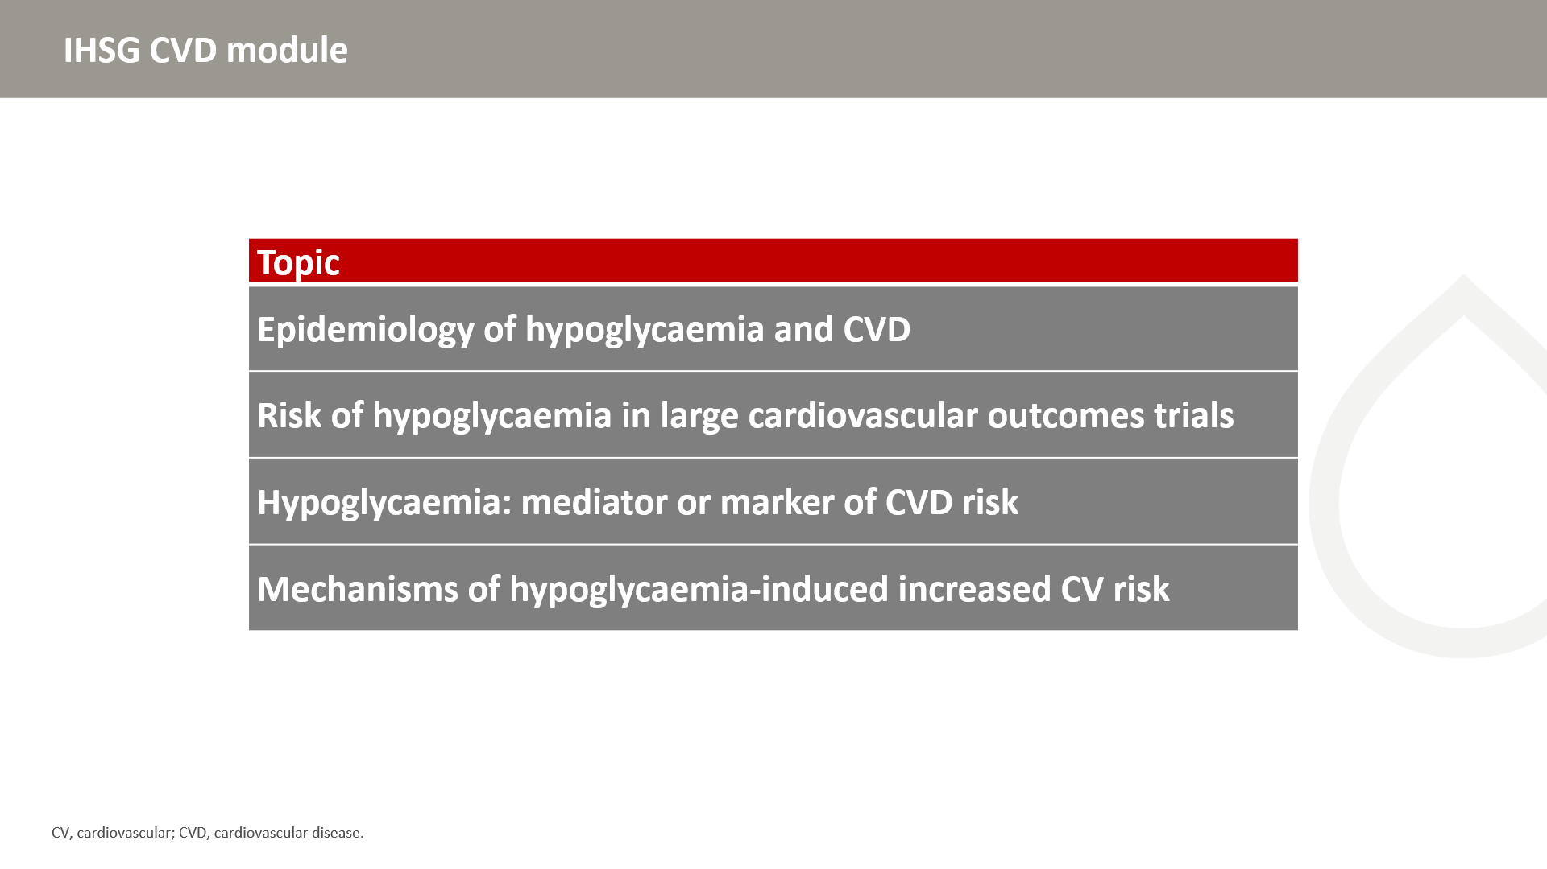

Slide 3
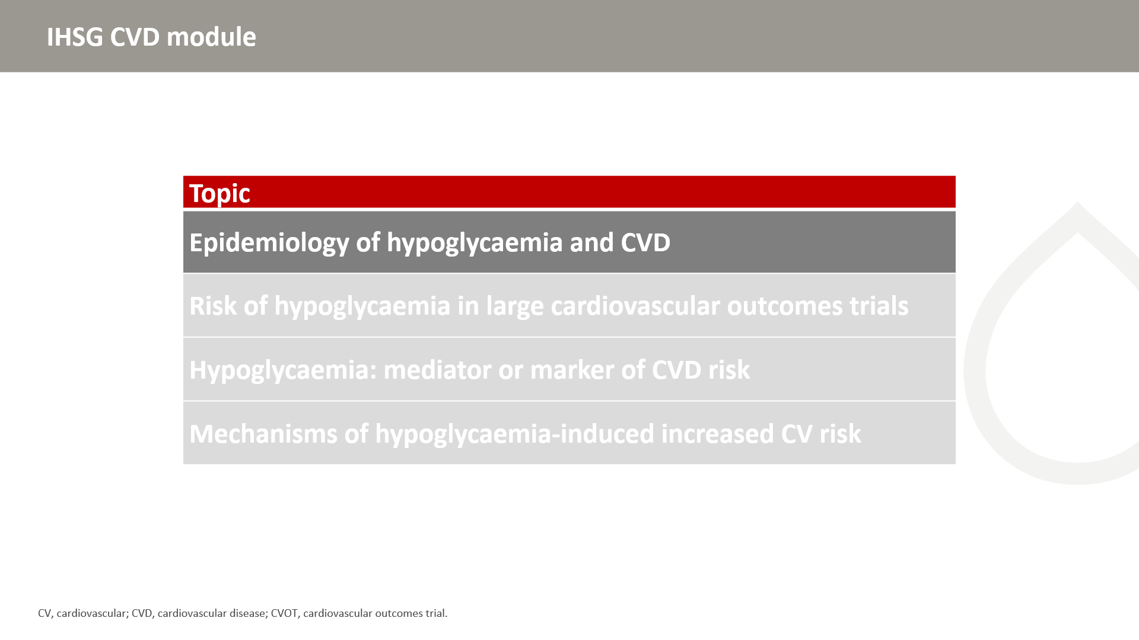

Slide 4
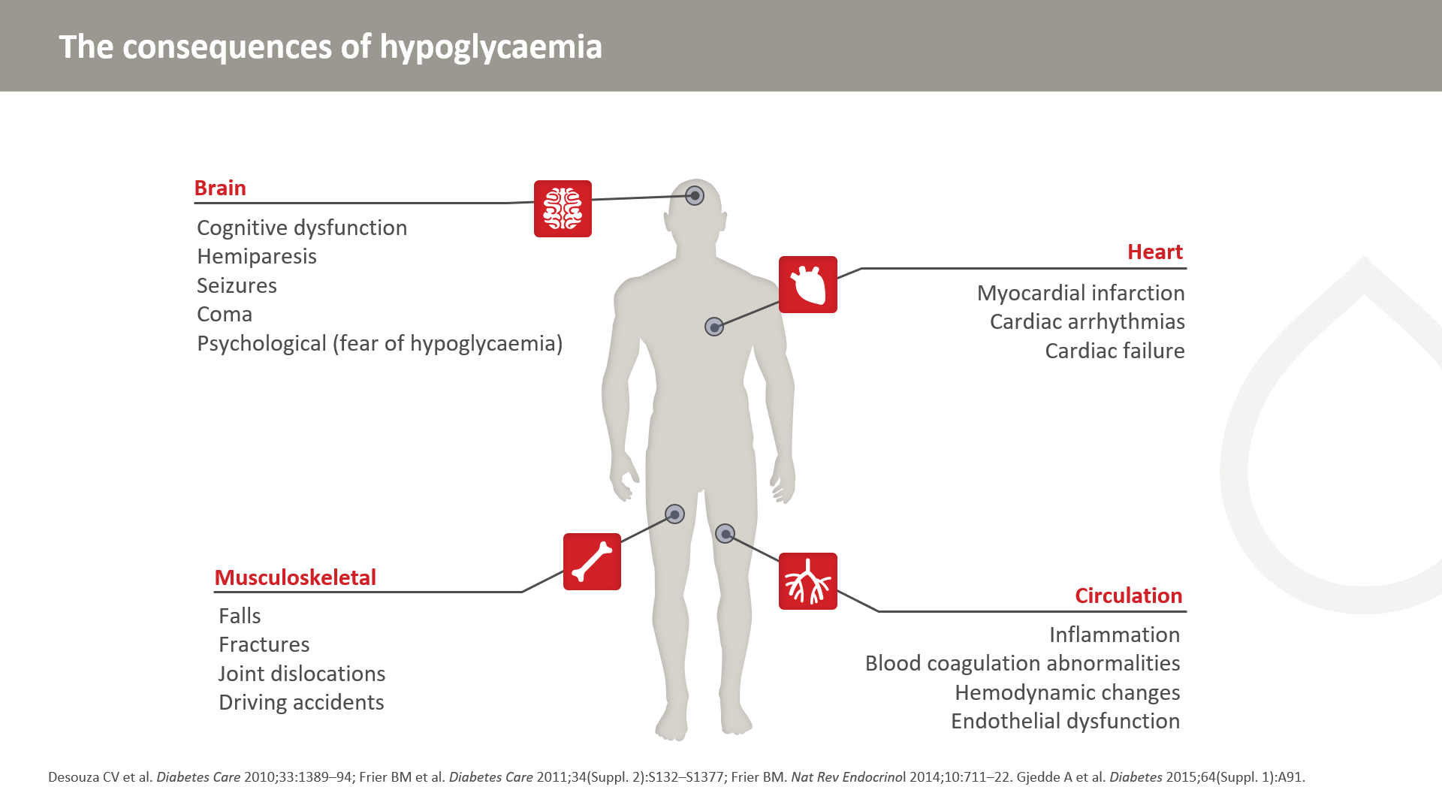
Notes:
Hypoglycaemia results in numerous complications that affect the entire body.

Slide 5
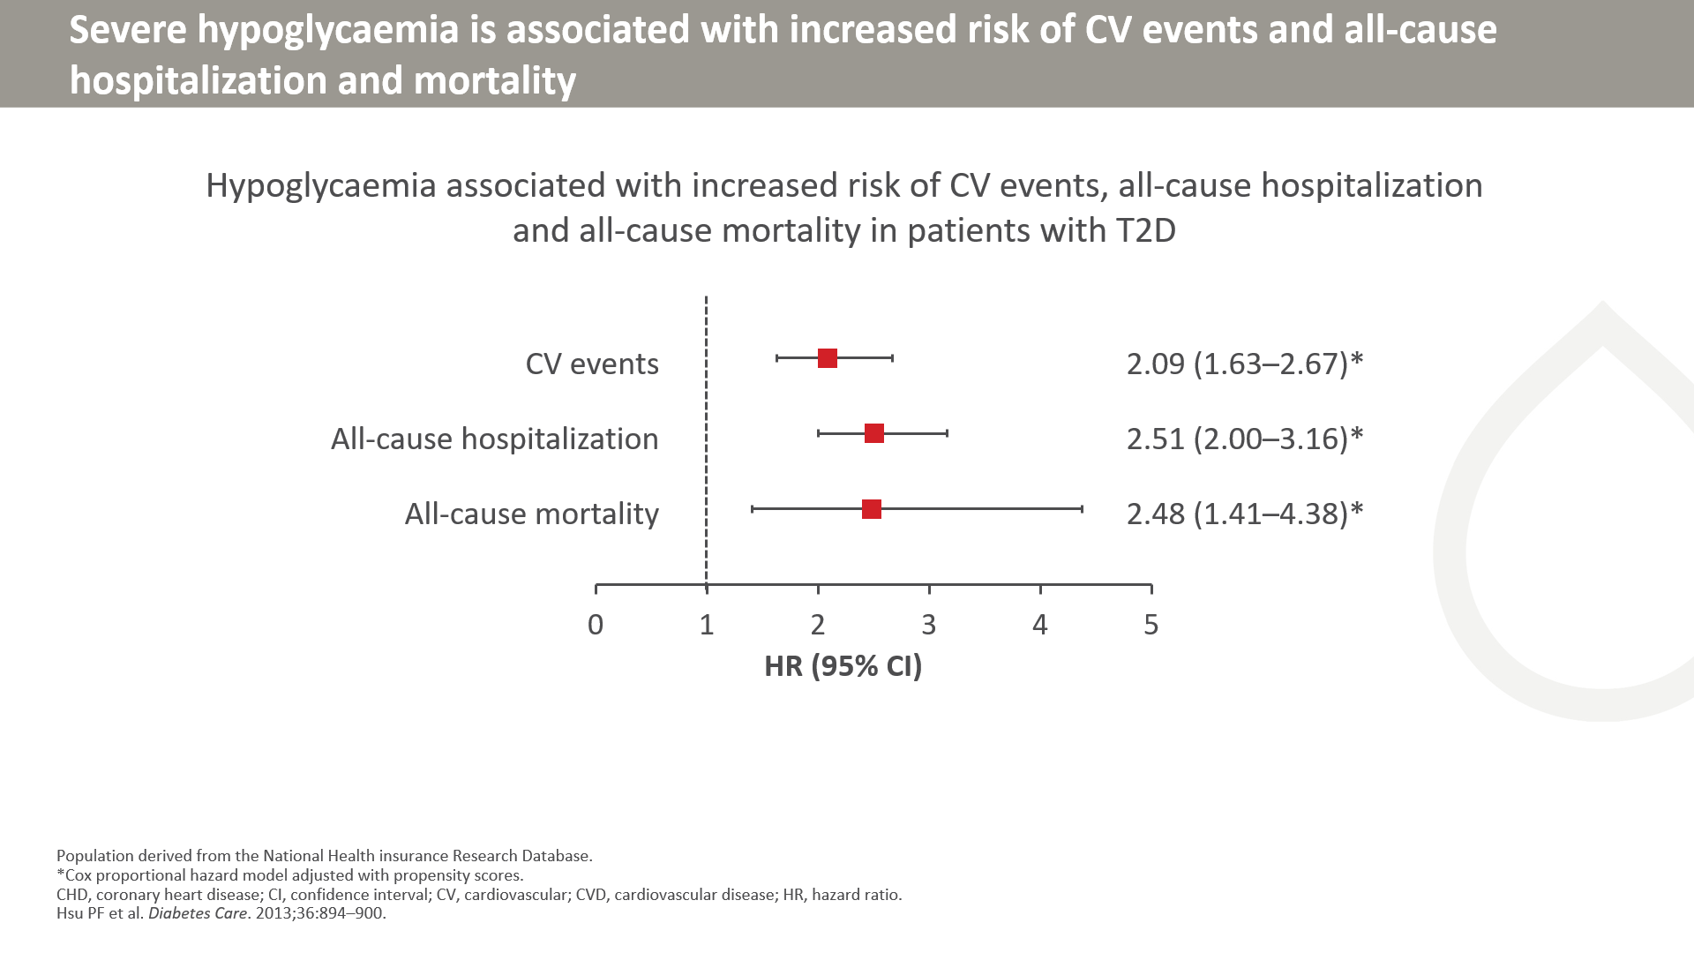
Notes:
The study population, derived from the National Health Insurance Research Database released by the Taiwan National Health Research Institutes during 1998–2009, comprised 77,611 patients with newly diagnosed type 2 diabetes. Relationships of hypoglycemia with total mortality and cardiovascular events, including stroke, coronary heart disease, cardiovascular diseases, and all-cause hospitalization, were investigated.
Symptomatic hypoglycemia, whether clinically mild or severe, is associated with an increased risk of cardiovascular events, all-cause hospitalization, and all-cause mortality.

Slide 6
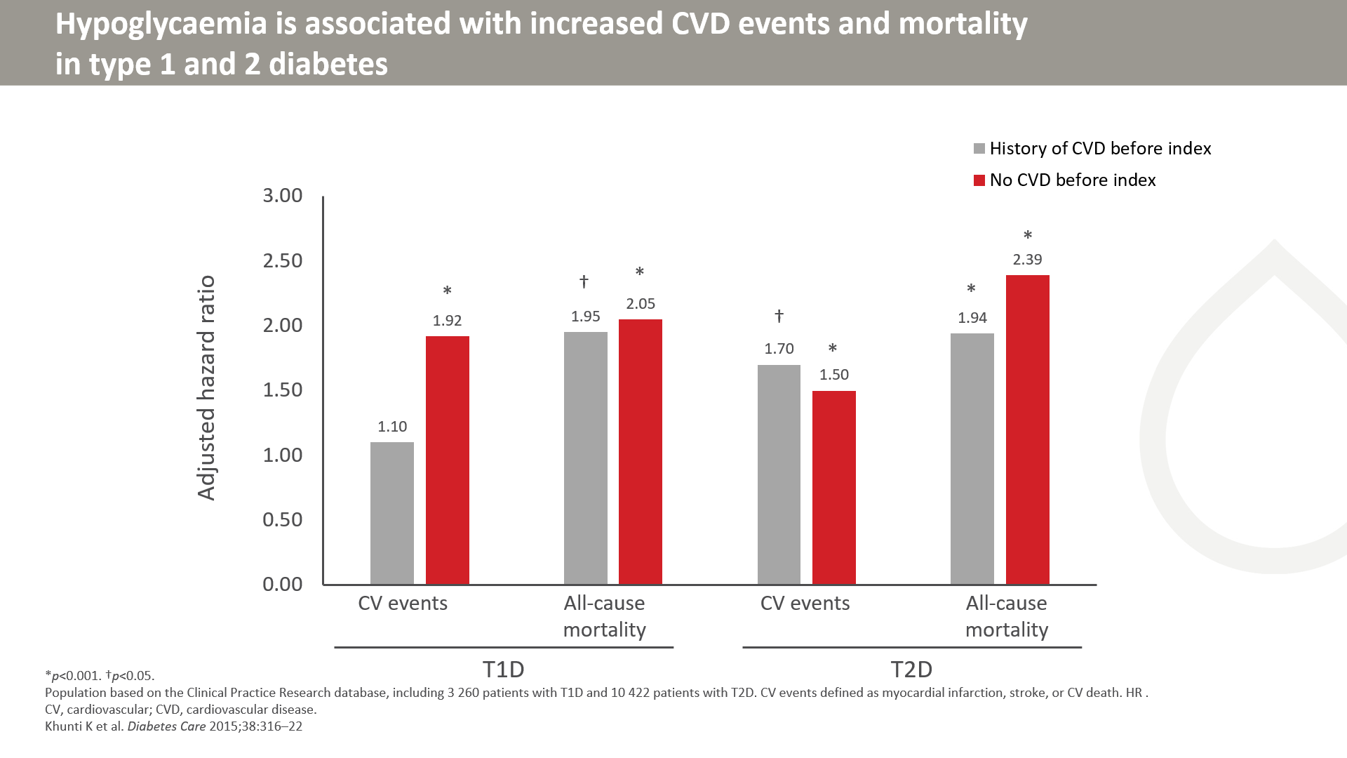
Notes:
This retrospective cohort study used data from the Clinical Practice Research Database, including all insulin-treated patients aged ≥30 years and diagnosed with diabetes between 1 January 2001 and 31 December 2007. Only patients from England and eligible for linkage to the Hospital Episode Statistics database were included in the study. Hypoglycaemia data included both severe (requiring hospital admission) and non-severe episodes. The patient index date was the start of insulin treatment, with the last follow-up date set for December 31, 2010. CV events were counted at follow-up and only factored into the hazard ratio if patients experienced at least one hypoglycaemic episode before the event.

Slide 7
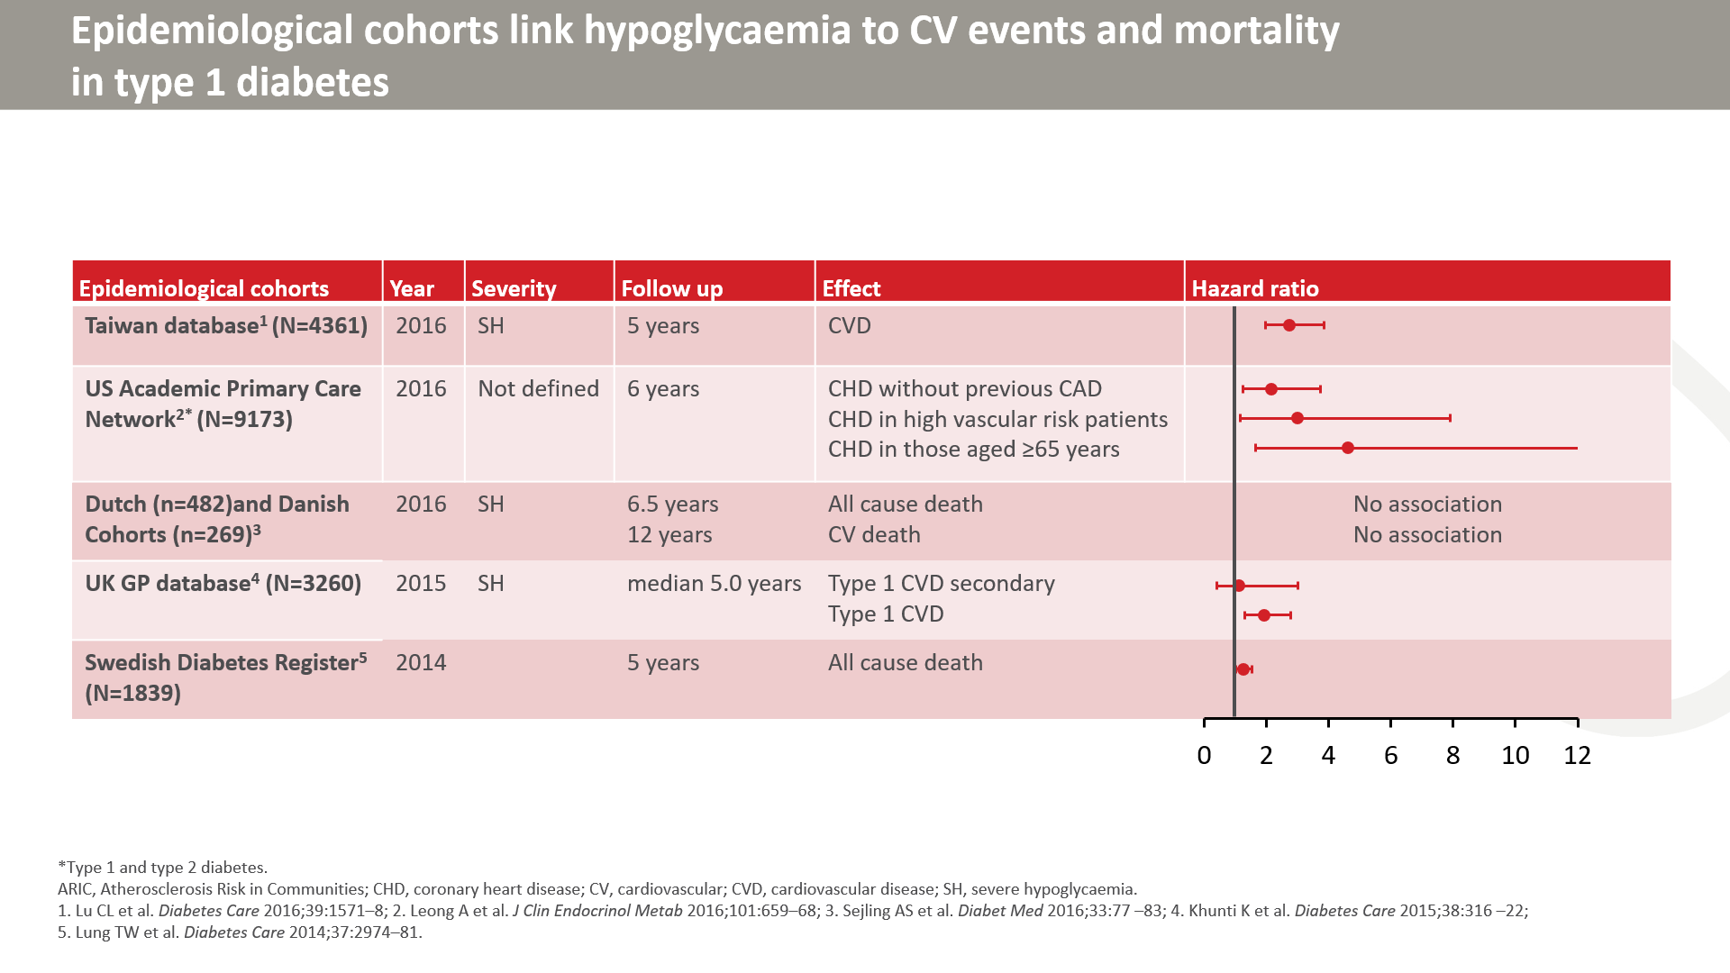

Slide 8
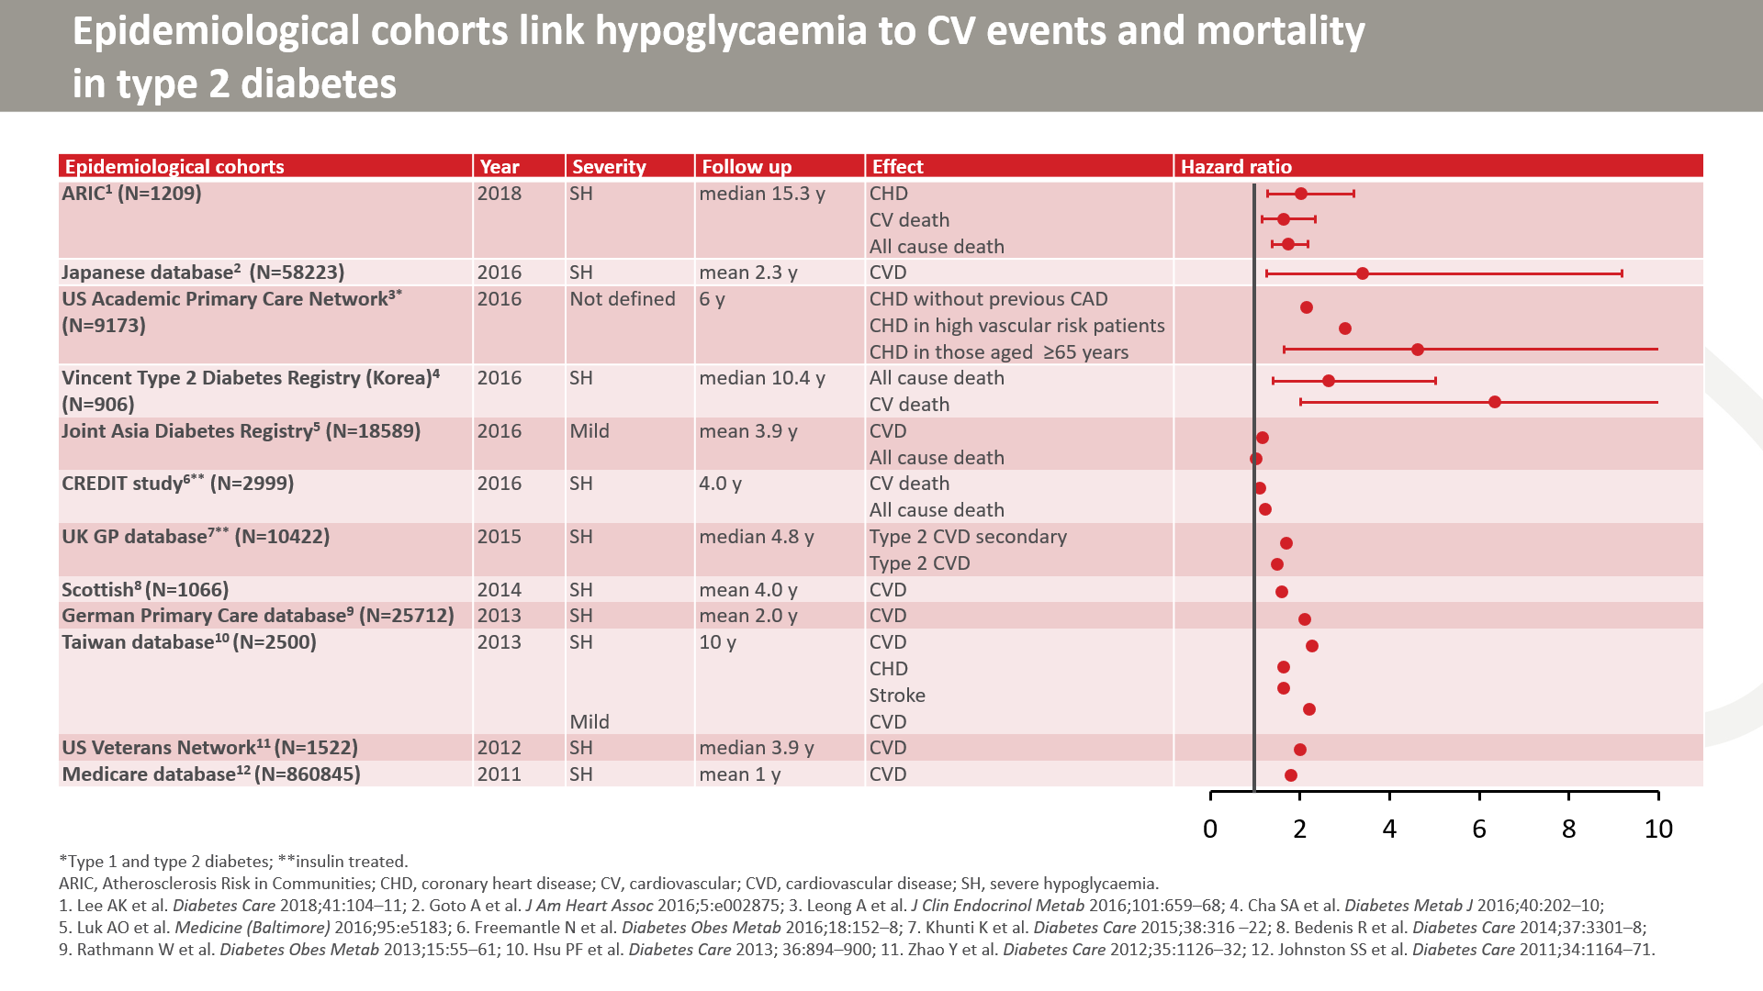

Slide 9
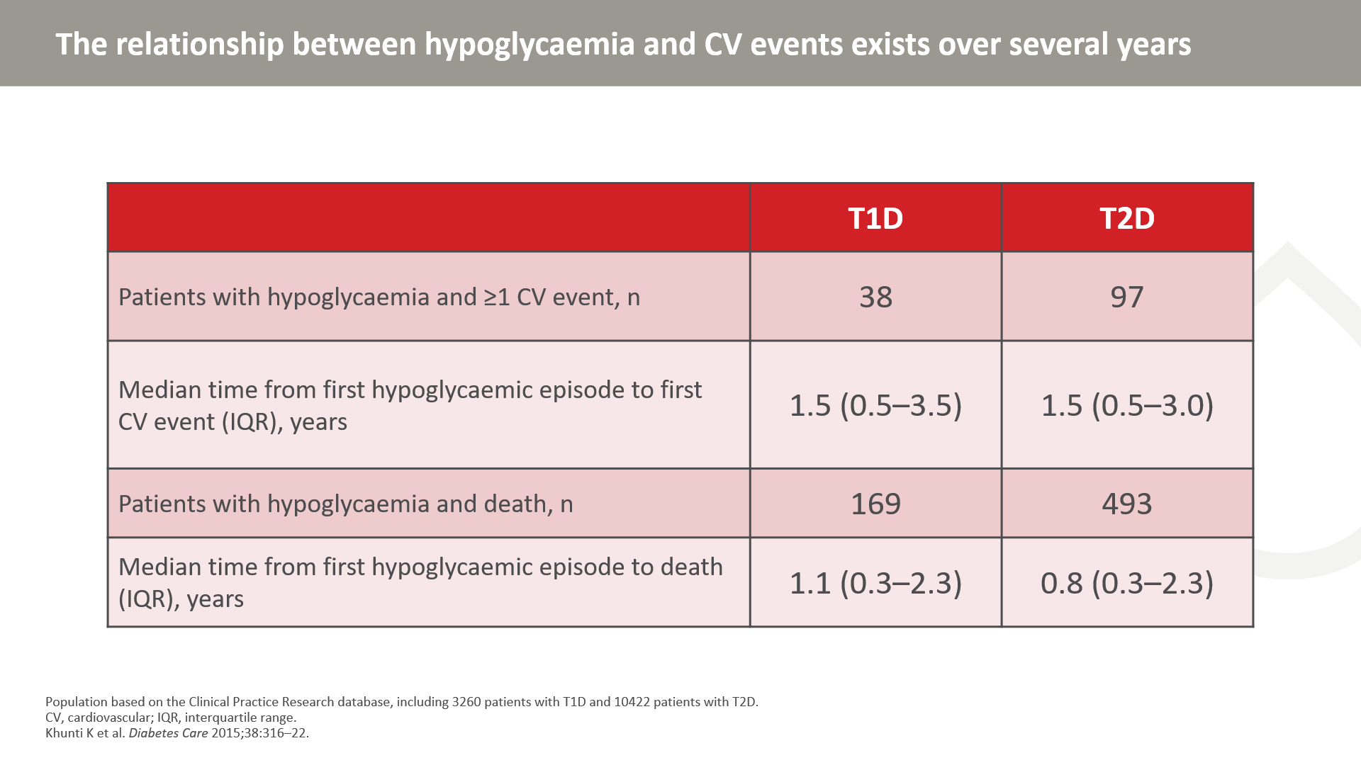
Notes:
Data are from results text.

Slide 10
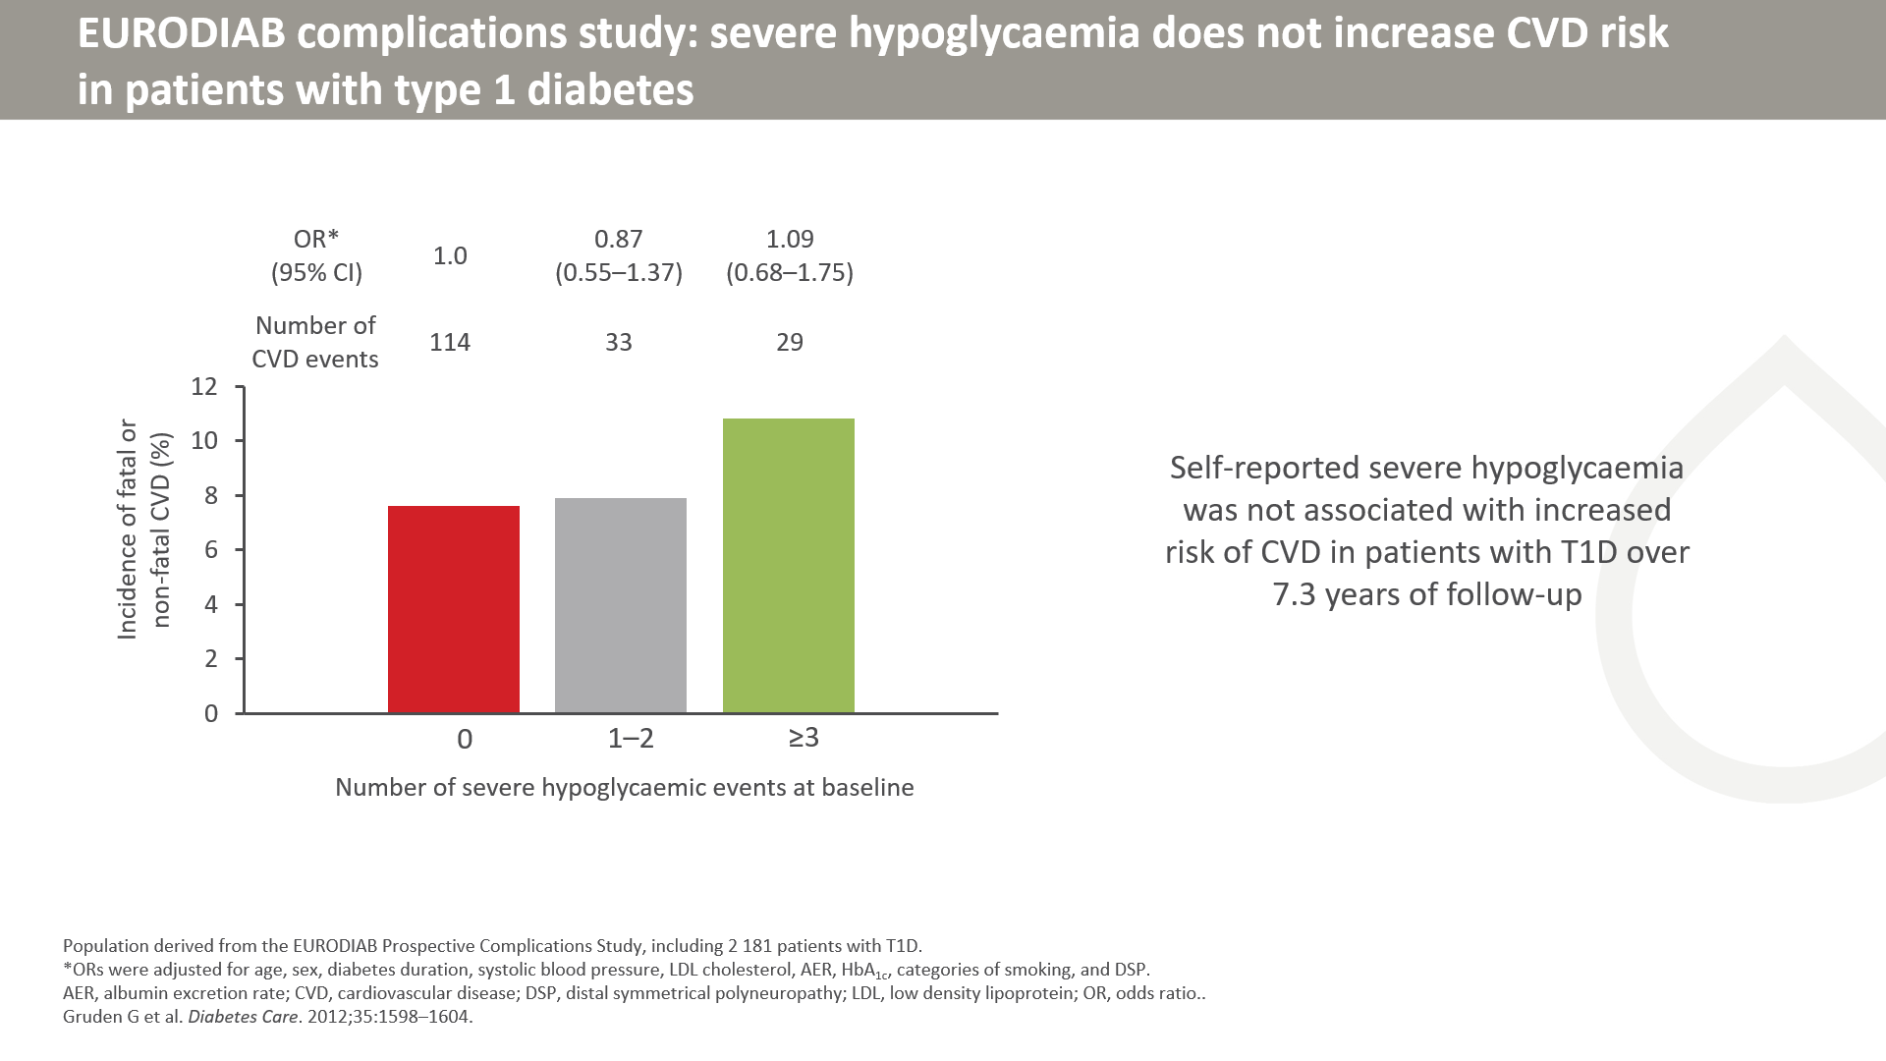
Notes:
The study included 2181 patients with T1D from the EURODIAB Prospective Complications Study. At baseline, frequency of self-reported severe hypoglycaemia (requiring help of a third party) was assessed by patient questionnaire. Fatal/nonfatal CVD was assessed 7.3 years after baseline examination. At follow-up, data on severe and non-severe hypoglycaemia episodes in the preceding year were collected by questionnaire.
Unlike some of the other cohort studies, these data did not suggest that severe hypoglycaemia increases CVD risk. The discrepancy compared to other studies may reflect contributions of both causality and confounding to the observed data.

Slide 11
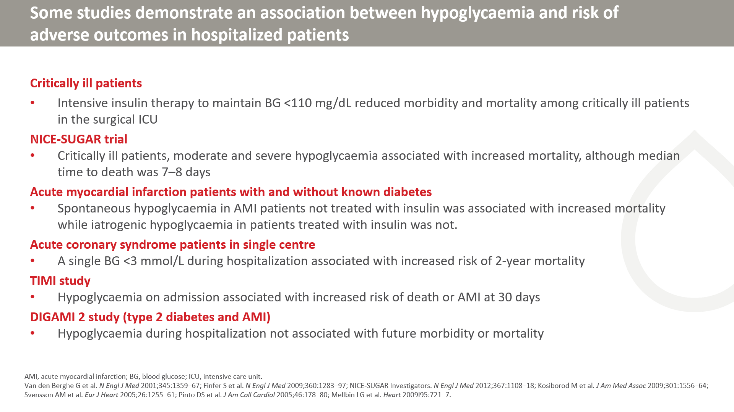

Slide 12
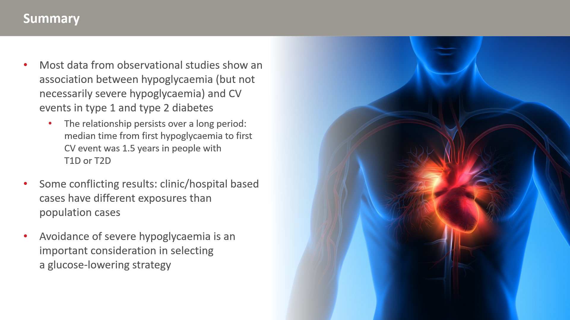

Slide 13
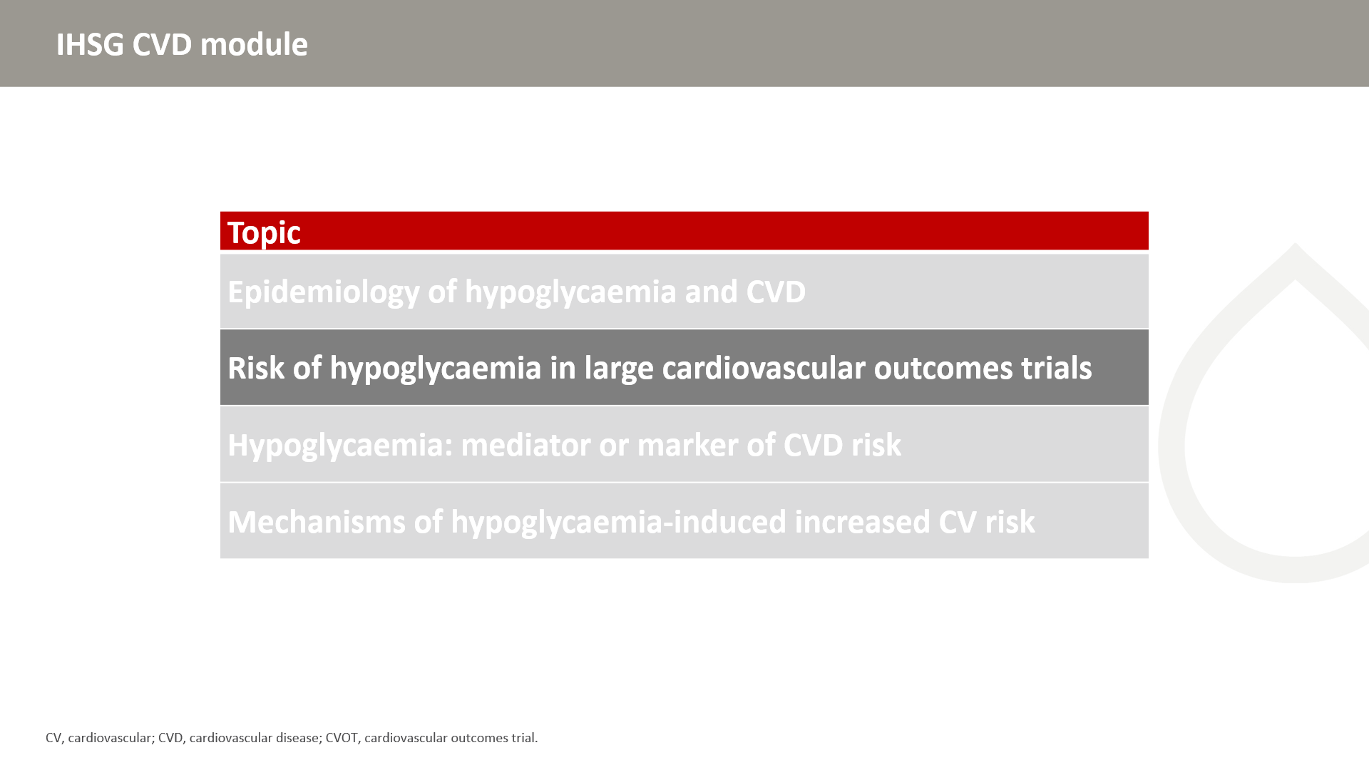

Slide 14
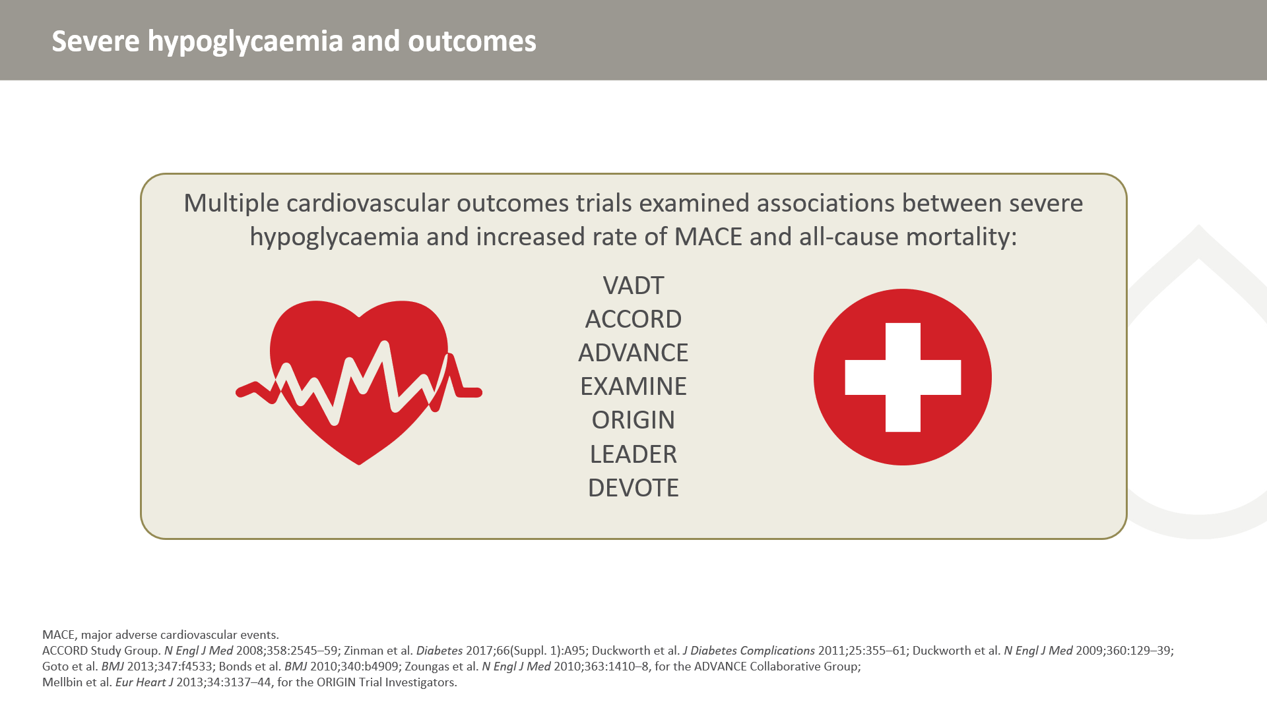
Notes:
A number of CVOTs examined associations between severe hypoglycaemia and MACE and all-cause mortality. Data are conflicting with not all studies showing an association. The following sets of slides demonstrate the conflicting data.

Slide 15
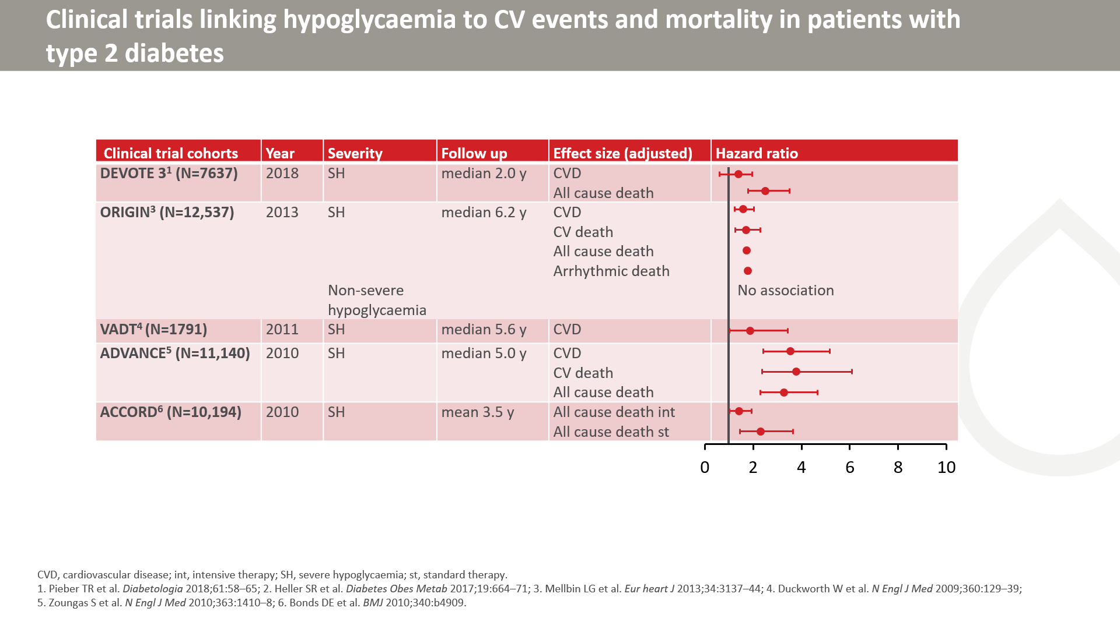

Slide 16
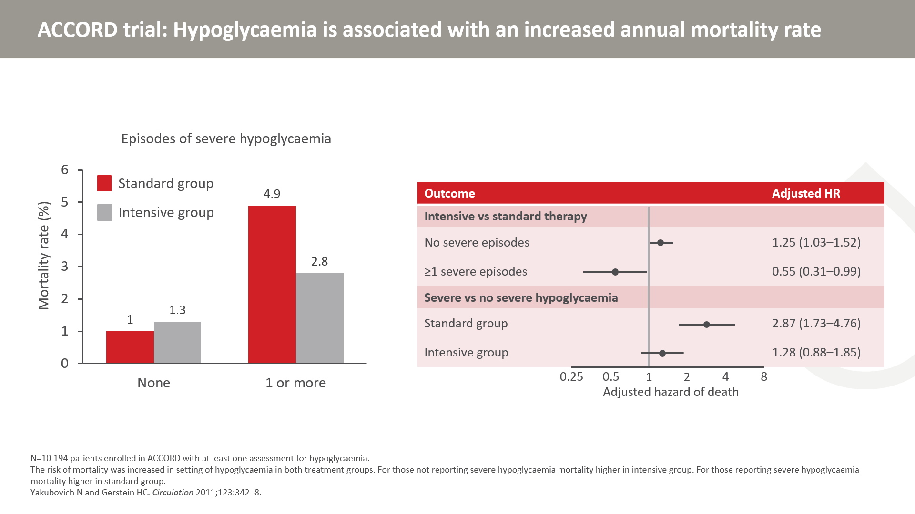
Notes:
Severe hypoglycaemia is associated with increased mortality rate with both standard and intensive therapy. Notably, although severe hypoglycaemia was more common in the intensive group, its impact on mortality is lower. Recurrent hypoglycaemia in this group may be reducing the sympathoadrenal response. Paradoxically, the haemodynamic effects of hypoglycaemia may be less profound in individuals at high risk of severe hypoglycaemia.
Right, Hazard of death in the intensive-therapy group versus the standard-therapy group among those with no severe hypoglycaemic episodes and in those with at least 1 such episode; Left, Hazard of death associated with at least 1 such episode (vs none) in the intensive-therapy group and in the standard-therapy group.

Slide 17
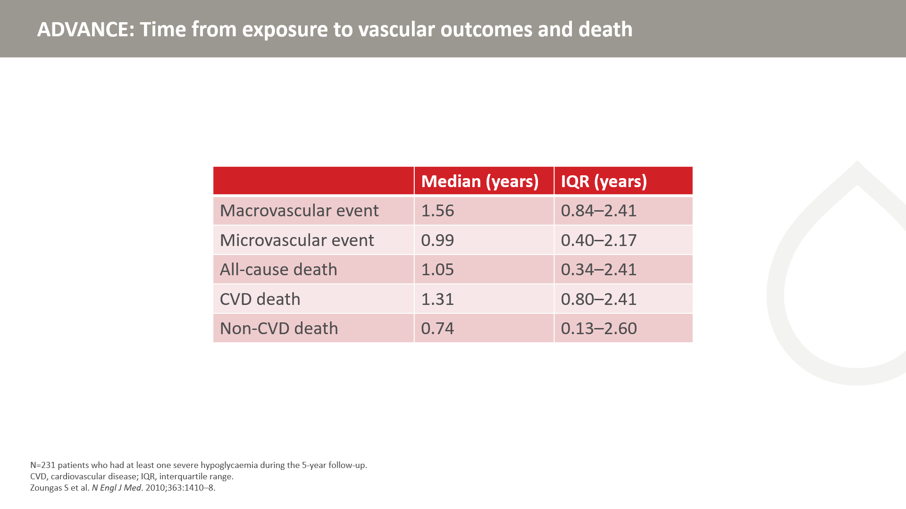
Notes:
The associations between severe hypoglycemia and the risks of macrovascular or microvascular events and death among 11,140 patients with type 2 diabetes was investigated. During a median follow-up period of 5 years, 231 patients (2.1%) had at least one severe hypoglycemic episode.
Severe hypoglycemia was strongly associated with increased risks of a range of adverse clinical outcomes. It is possible that severe hypoglycemia contributes to adverse outcomes, but these analyses indicate that hypoglycemia is just as likely to be a marker of vulnerability to such events.

Slide 18
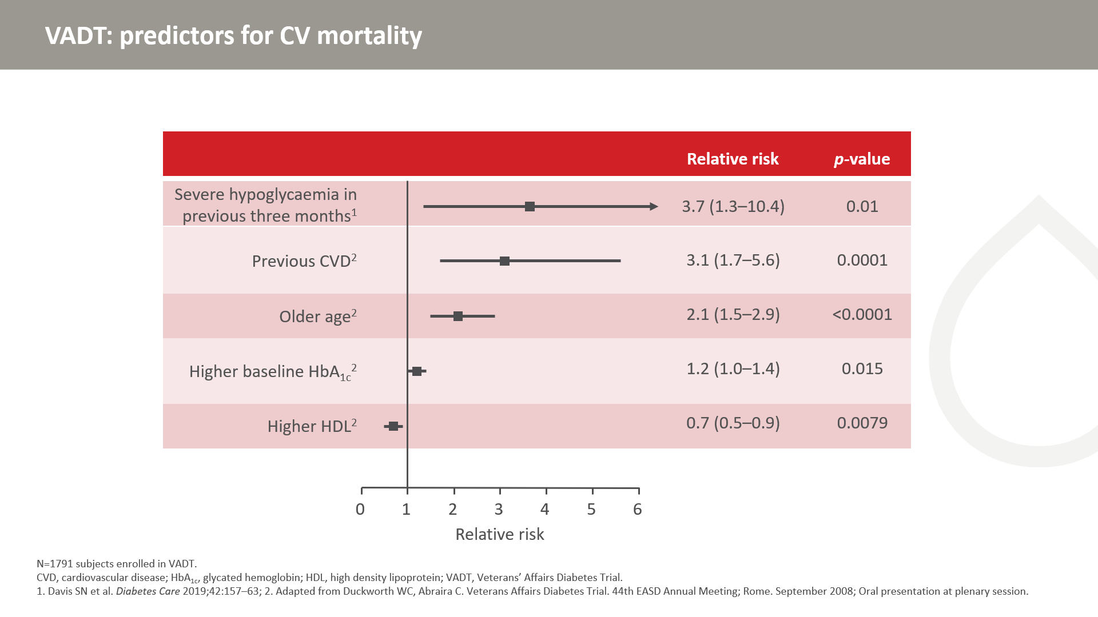
Notes:
18
The Veterans Affairs Diabetes Trial (VADT) was conducted in 1791 male veterans comparing intensive vs. conventional glucose control.
A post-hoc analysis of the VADT identified a number of factors which predicted CV mortality during the course of the study. Of the identified factors, occurrence of a severe hypoglycaemic episode within the previous 3-month period was strongly associated with CV mortality, increasing the risk 4-fold as compared to not having a severe hypoglycaemic episode within the previous 3 months. Other risk factors included previous cardiovascular disease, older age (per 10 years), and higher baseline HbA_{1c}. Having a higher HDL-cholesterol level appeared to have a cardioprotective effect.

Slide 19
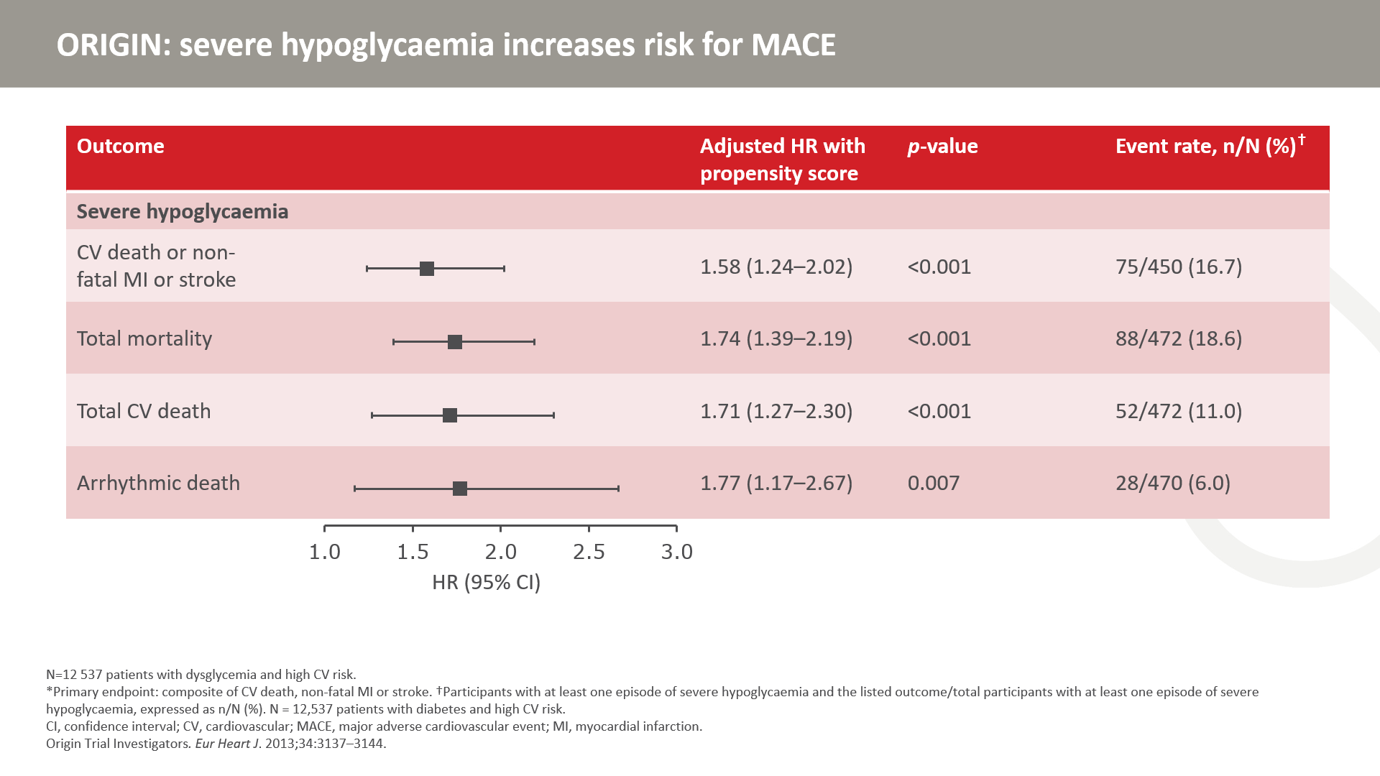
Notes:
A total of 12,537 participants with dysglycaemia and high CV-risk were randomized to basal insulin glargine titrated to a fasting glucose of ≤5.3 mmol/L (95 mg/dL) or standard glycaemic care.
Severe hypoglycaemia was associated with an increased risk for CV outcomes in people at high CV risk and dysglycaemia. Although allocation to insulin glargine vs. standard care was associated with an increased risk of severe and non-severe hypoglycaemia, the relative risk of CV outcomes with hypoglycaemia was lower with insulin glargine-based glucose-lowering therapy vs. standard glycaemic control.

Slide 20
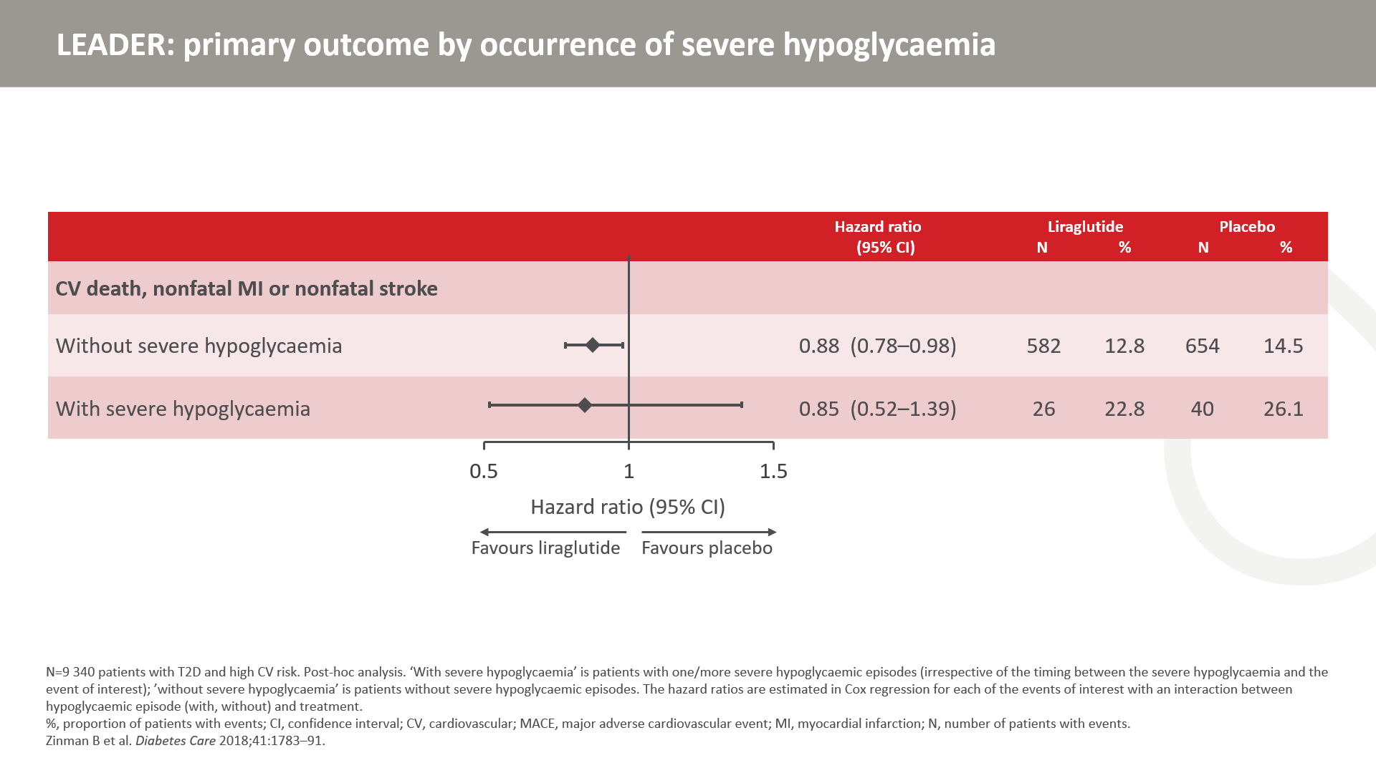
Notes:
A subgroup analysis of the primary composite endpoints stratified subjects by experience of severe hypoglycaemia (yes or no). There was no significant interaction (ie. no difference) between the subgroups and the treatment effect in each subgroup was consistent with observations from the primary analysis. Note that the vast majority of subjects did not experience severe hypoglycaemia in LEADER. In conclusion, reduction in CV events with liraglutide seems to be independent of the lower incidence of severe hypoglycaemia compared to placebo.

Slide 21
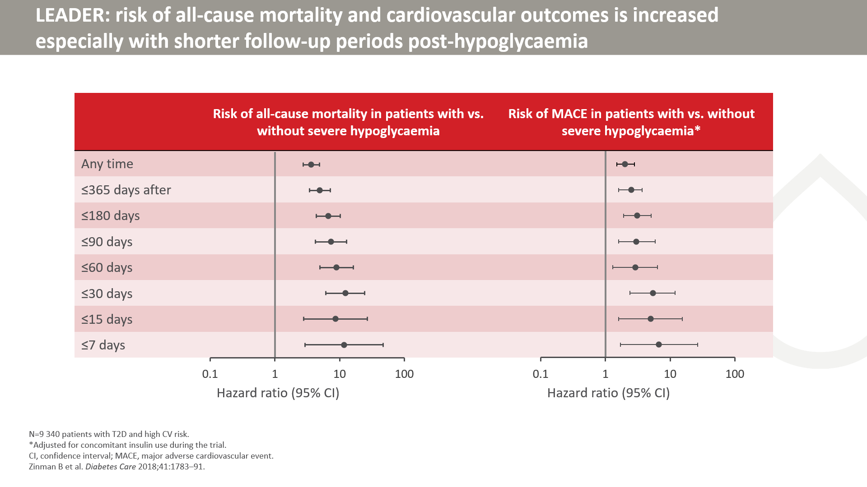
Notes:
A temporal association was observed between severe hypoglycaemia and subsequent risk of MACE or all-cause death.
There was a plateau effect in the trend for increasing risk when the hypoglycaemic episode was observed fewer than 30 days from follow-up.

Slide 22
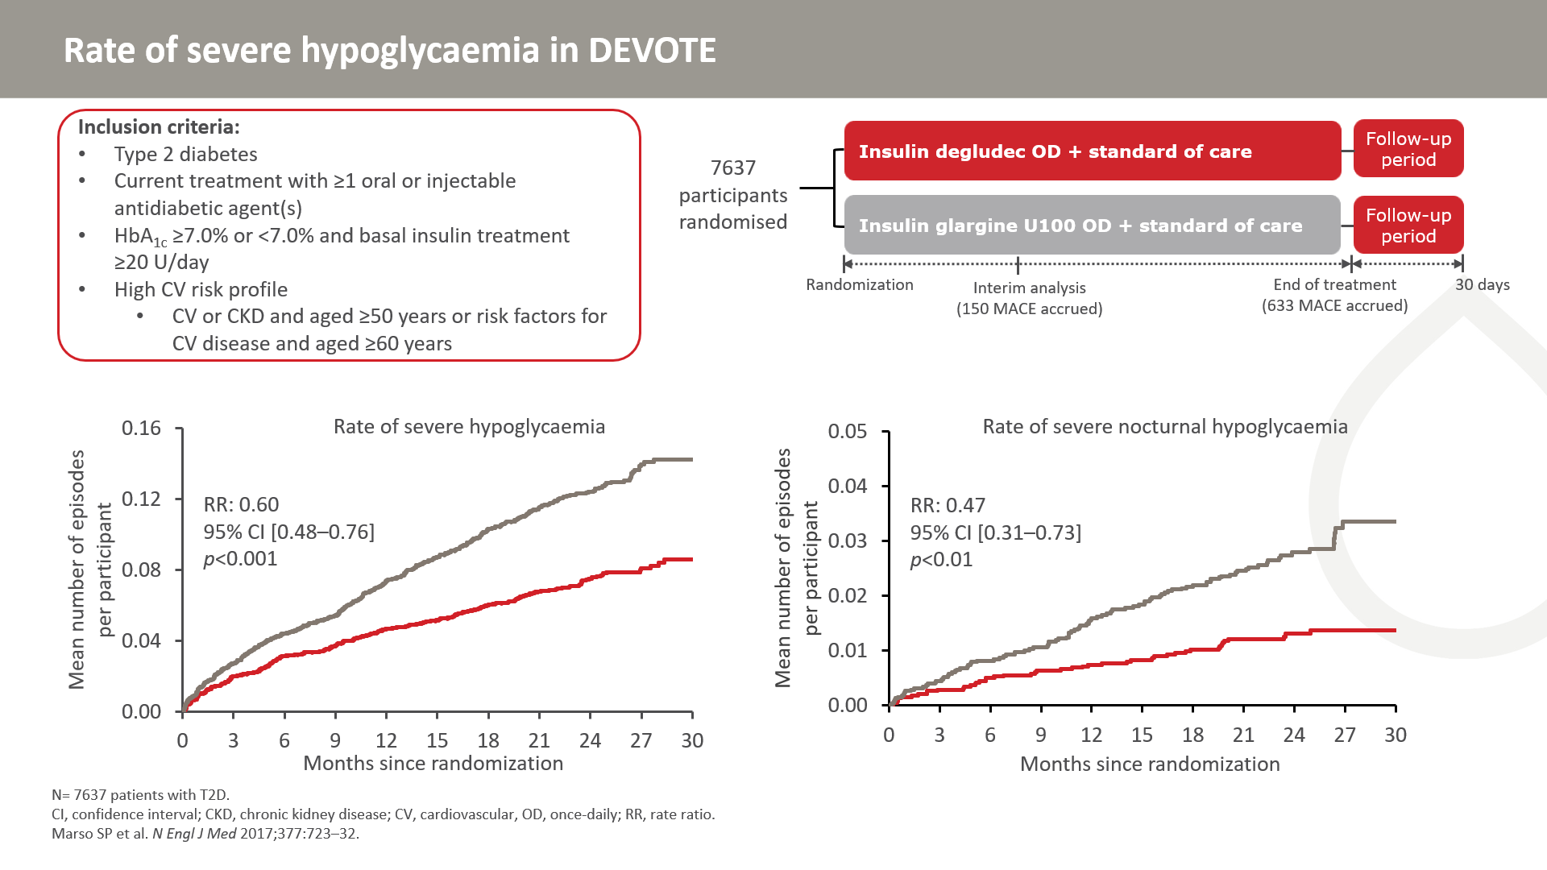
Notes:
In this study, 7637 patients with T2D were randomly assigned to receive either degludec (n=3818) or glargine U100 (n=3819), once daily between dinner and bedtime.
A total of 752 severe hypoglycaemic events occurred (280 events in 187 patients with degludec, 472 events in 252 patients with glargine U100). In the degludec group, there were 3.7 events per 100 patient years, compared to 6.25 events per 100 patient years with glargine U100.
The rate of severe nocturnal hypoglycaemia was lower in the degludec group (0.65 events per 100 patient-years) vs the glargine U100-treated group (1.40 events per 199 patient-years).

Slide 23
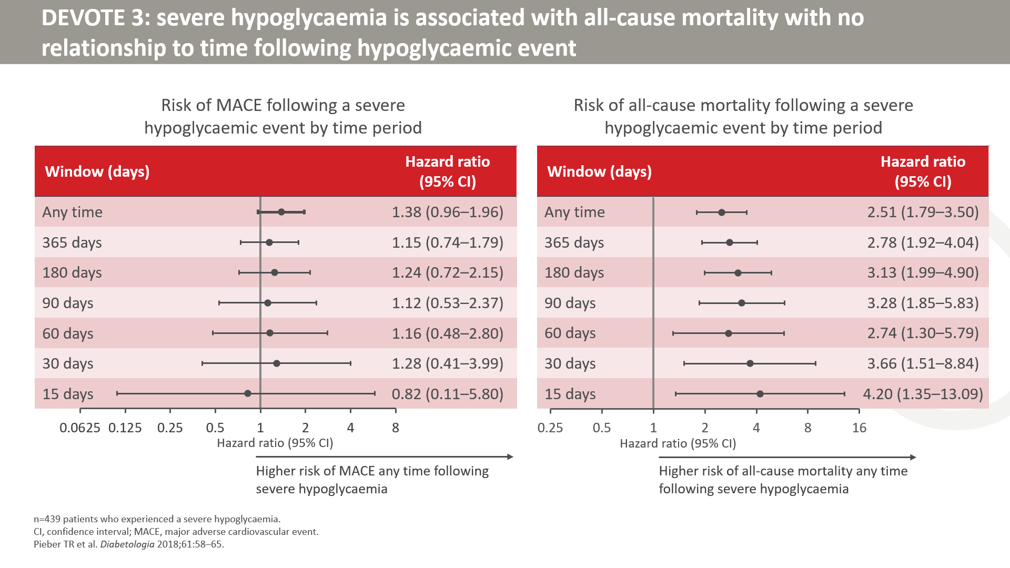
Notes:
Unlike in LEADER, DEVOTE 3 did not demonstrate a temporal relationship between MACE and hypoglycaemia.
The evidence for a temporal relationship is conflicting. Both confounding and causality are likely to contribute to the observed data.
Patients who experienced severe hypoglycaemia were particularly at greater risk of all-cause death in the short term after the hypoglycaemic episode.
Findings indicate that severe hypoglycaemia is associated with higher subsequent mortality; however, they cannot answer the question as to whether severe hypoglycaemia serves as a risk marker for adverse outcomes or whether there is a direct causal effect.

Slide 24
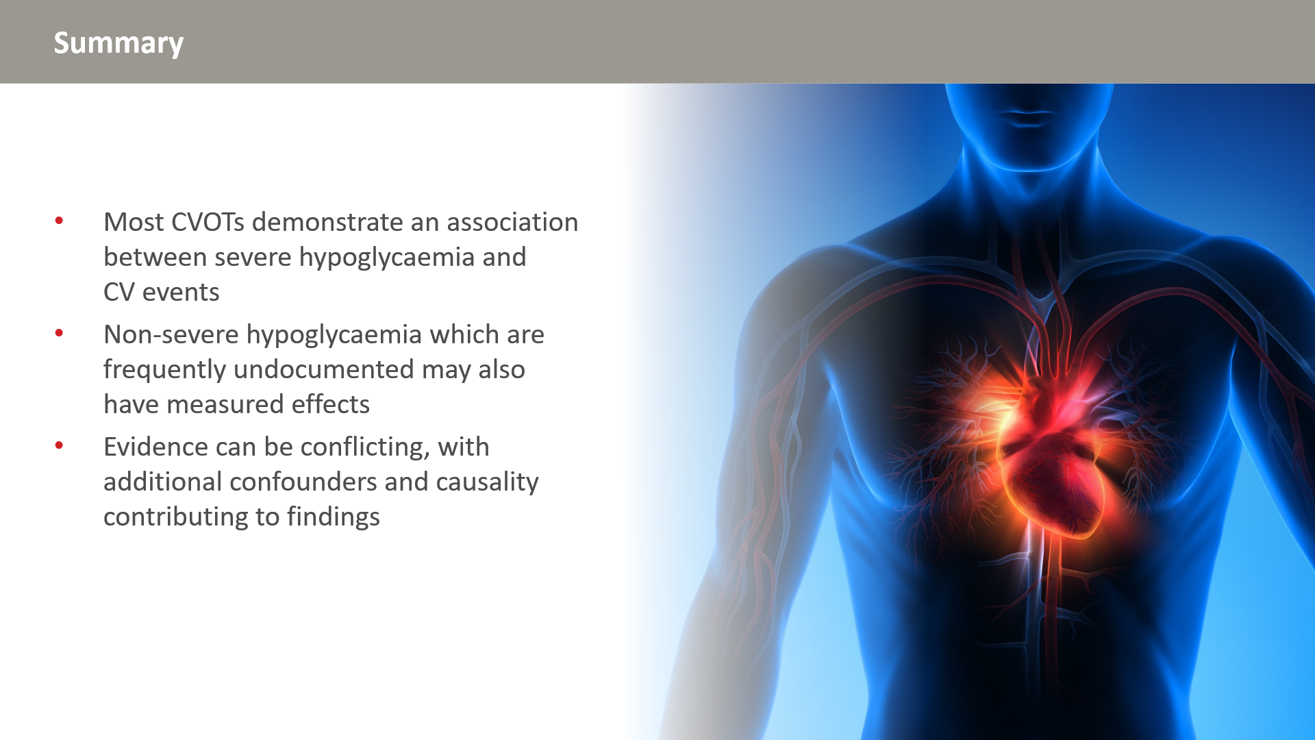

Slide 25
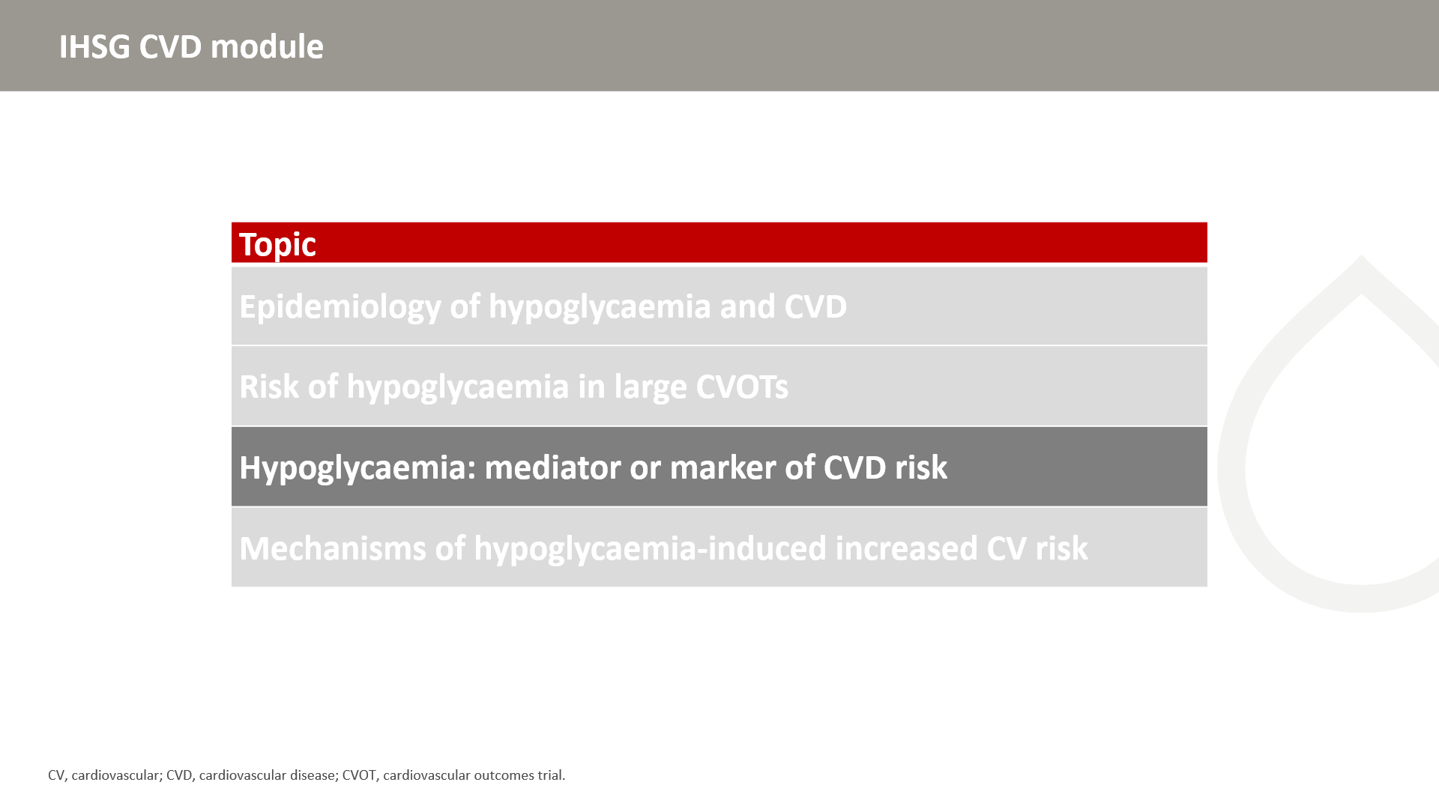

Slide 26
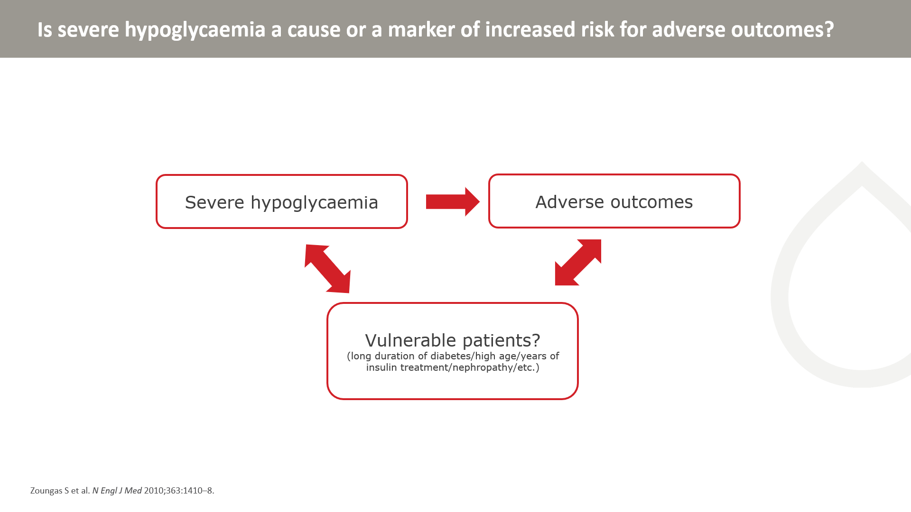
Notes:
Plausible mechanisms by which hypoglycaemia might cause cardiovascular disease or lead to death from cardiovascular disease include sympathoadrenal activation, abnormal cardiac repolarization, increased thrombogenesis, inflammation, and vasoconstriction. Although it is unclear whether such effects persist, impaired cardiac autonomic function is associated with increased mortality among patients at high cardiovascular risk. In this study, autonomic function was not measured and therefore it could not examine its contributory effects.
It is possible that severe hypoglycaemia reflects the effects of coexisting conditions and unmeasured or incompletely quantified confounding variables and is a marker of an increased risk of adverse clinical outcomes rather than a direct cause. The marked attenuation of the risk estimates after adjustment for a number of baseline and time-dependent characteristics of the patients suggests that effects of confounding were substantial. The presence of coexisting conditions could increase a patient's vulnerability to both severe hypoglycaemia and adverse events without one necessarily causing the other. For example, a patient may suffer from retinopathy and severe hypoglycaemia because of the presence of common risk factors such as age and duration of diabetes.
Zoungas et al. N Engl J Med 2010;363:1410–8

Slide 27
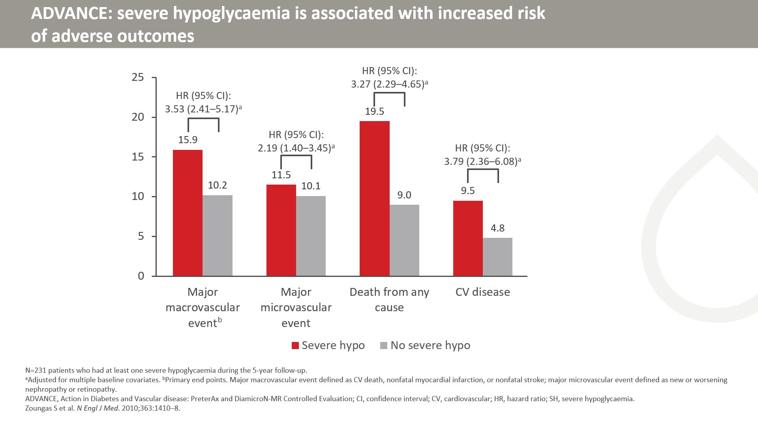

Slide 28
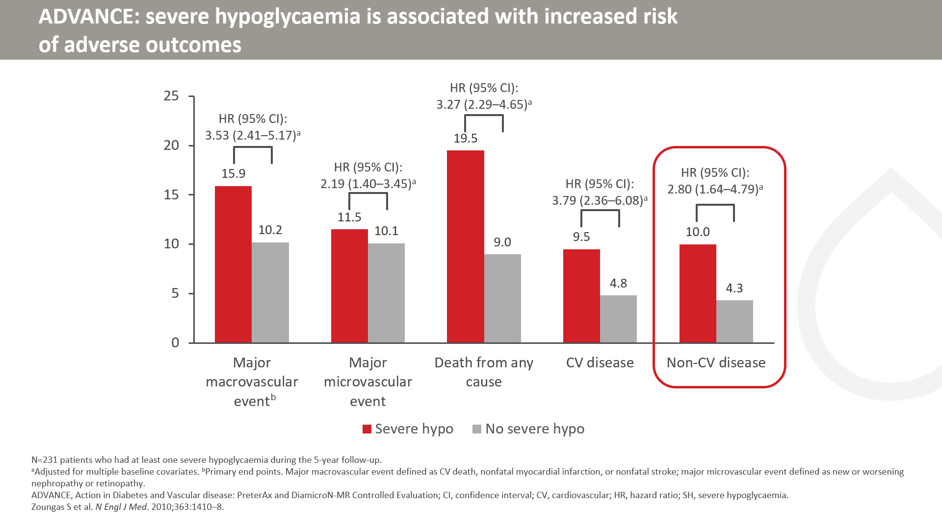

Slide 29
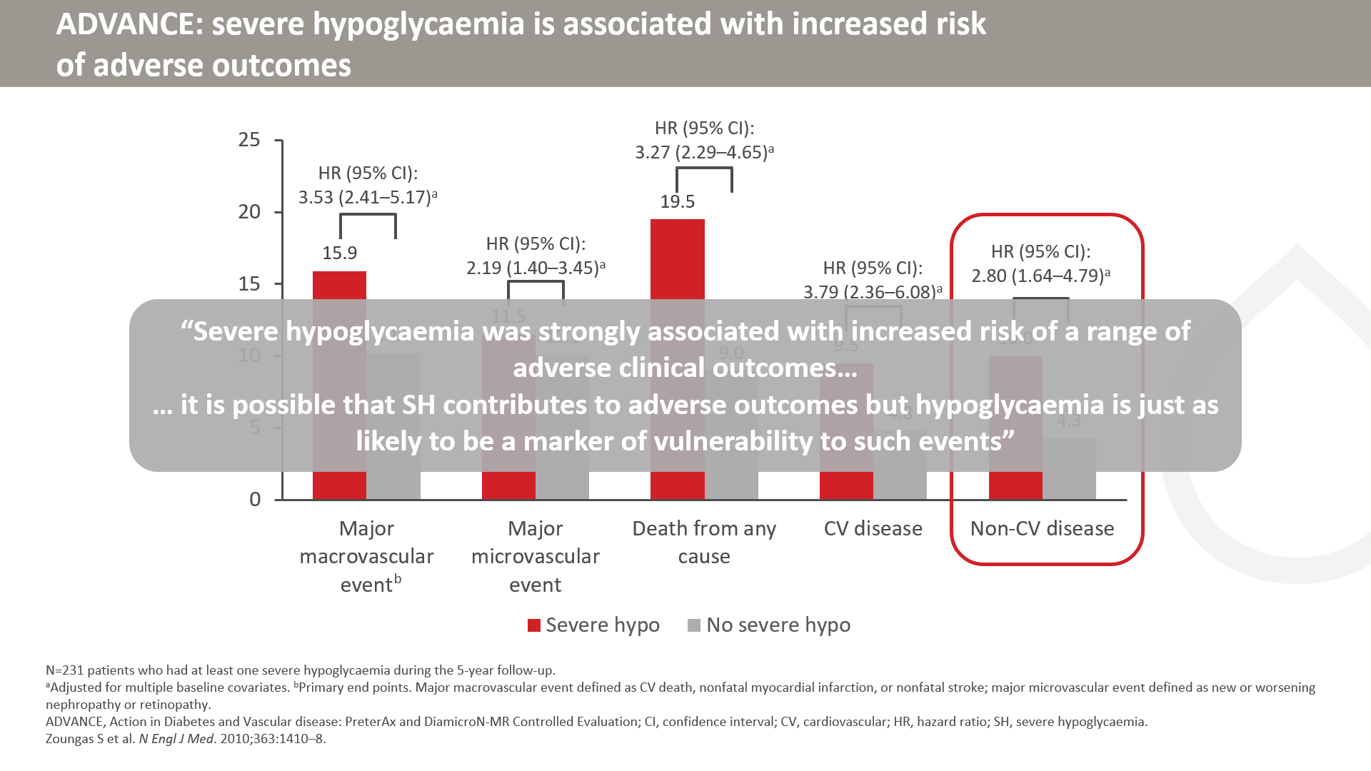
Notes:
[SLIDE IS ANIMATED]
Severe hypoglycaemia had an observed associated with major macro- and microvascular events, all-cause death, and CVD.
Note that although the risk of non-CV disease is increased in the severe hypoglycaemia group, these outcomes are unlikely to be due to hypoglycaemia but may suggest a contribution from confounding.

Slide 30
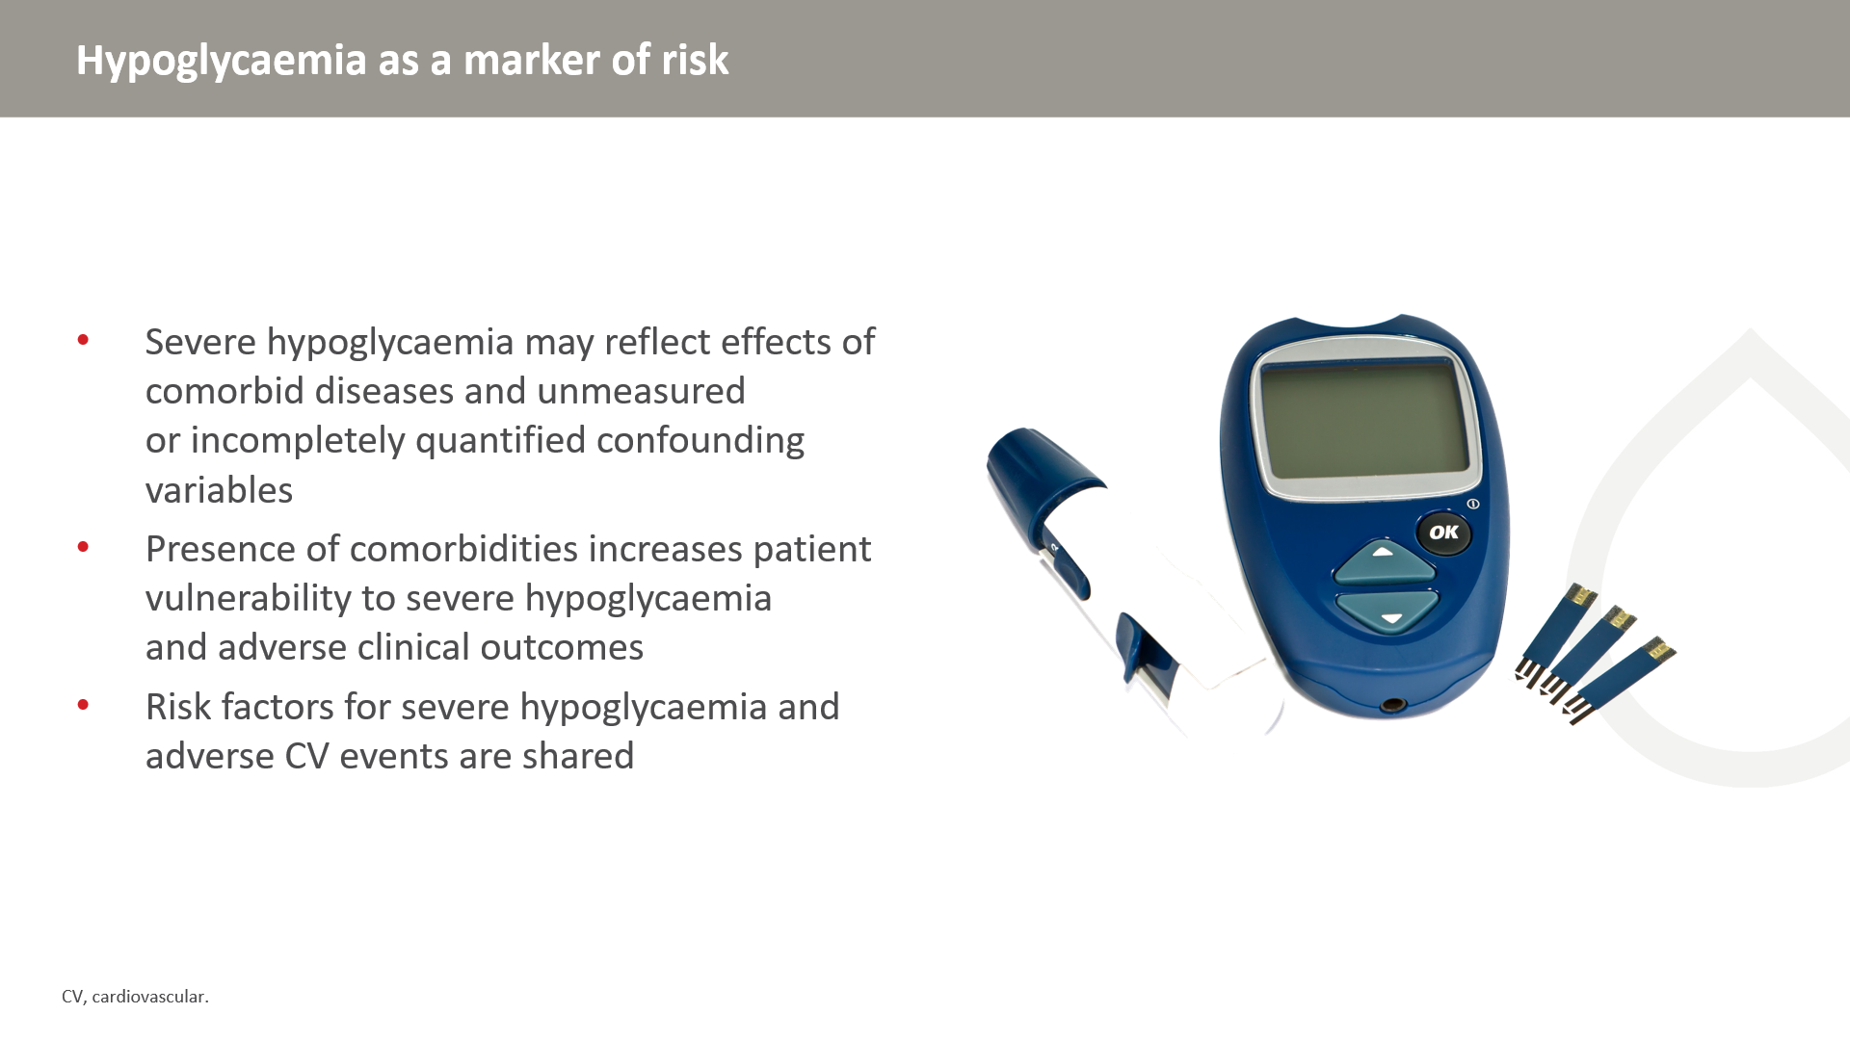

Slide 31
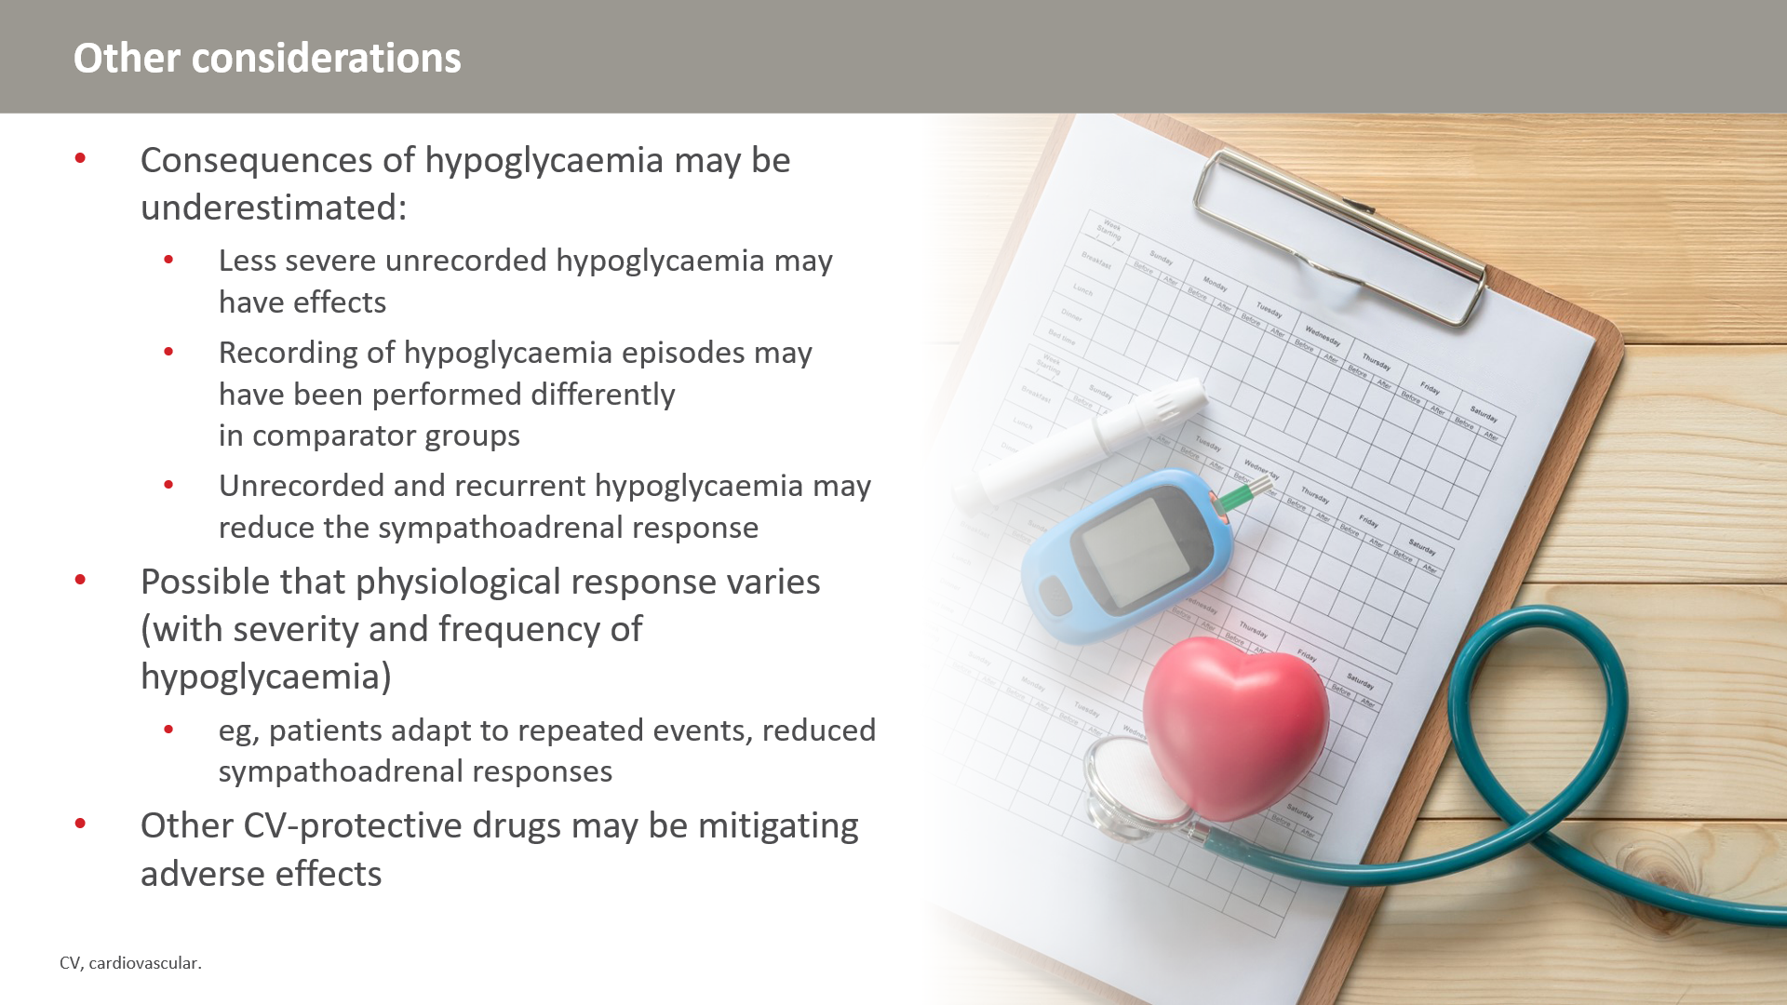

Slide 32
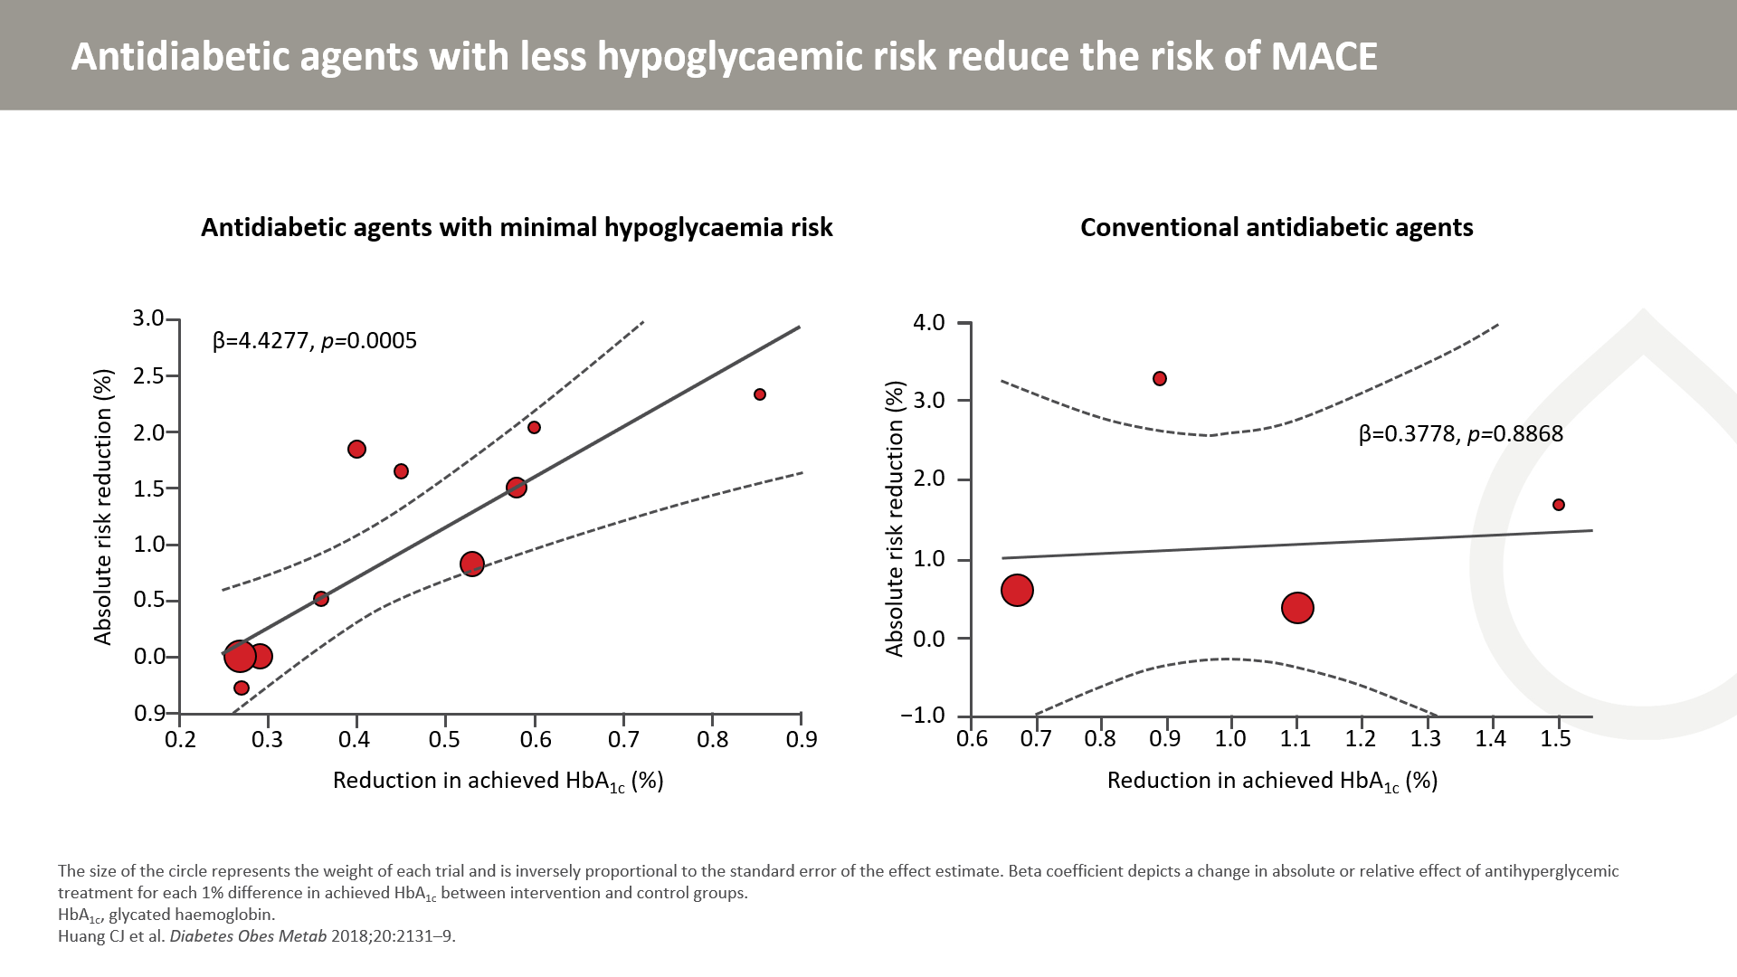
Notes:
Randomized controlled trials (RCTs) comparing the relative efficacy and safety of antidiabetic drugs with less hypoglycaemia risk were comprehensively researched in MEDLINE, Embase and the Cochrane Library up to January 27, 2018. Mixed-effects meta-regression analysis was conducted to explore the relationship between HbA1c reduction and the risk of major adverse cardiovascular events.
Compared with placebo, newer T2D agents with less hypoglycaemic hazard significantly reduced the risk of MACE. The MACE reduction appears to be associated with HbA1c reduction in a linear relationship.

Slide 33


Slide 34
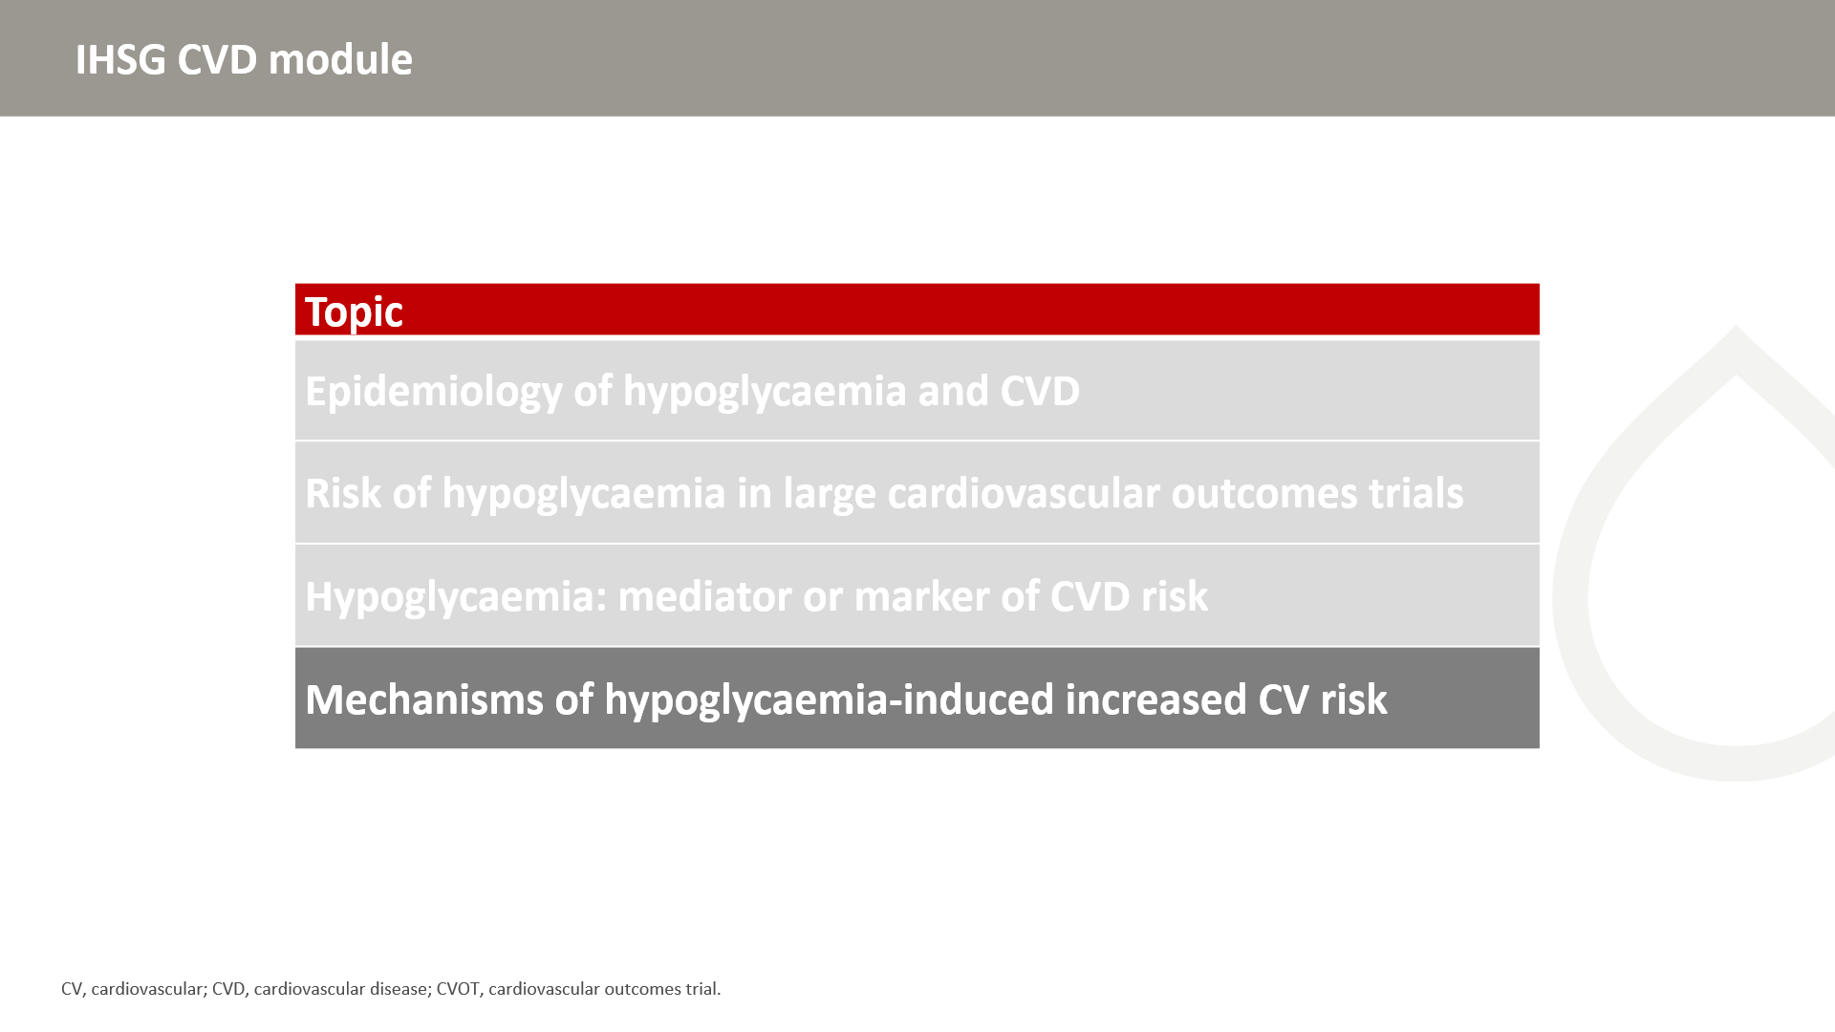

Slide 35
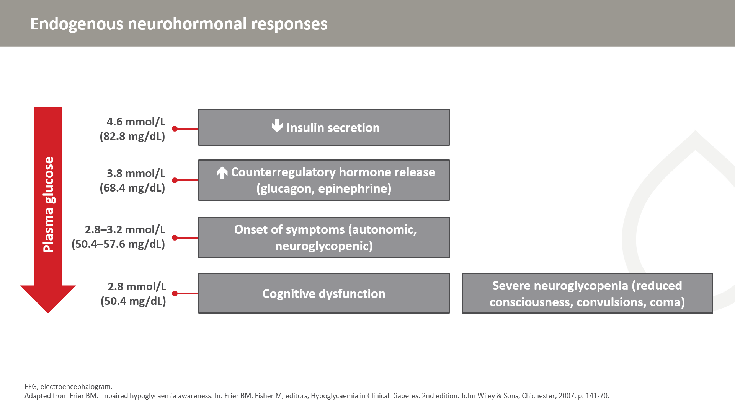
Notes:
Hypoglycaemia is associated with a surge of sympathetic activity and a release of catecholamines resulting in tachycardia and increased blood pressure.

Slide 36
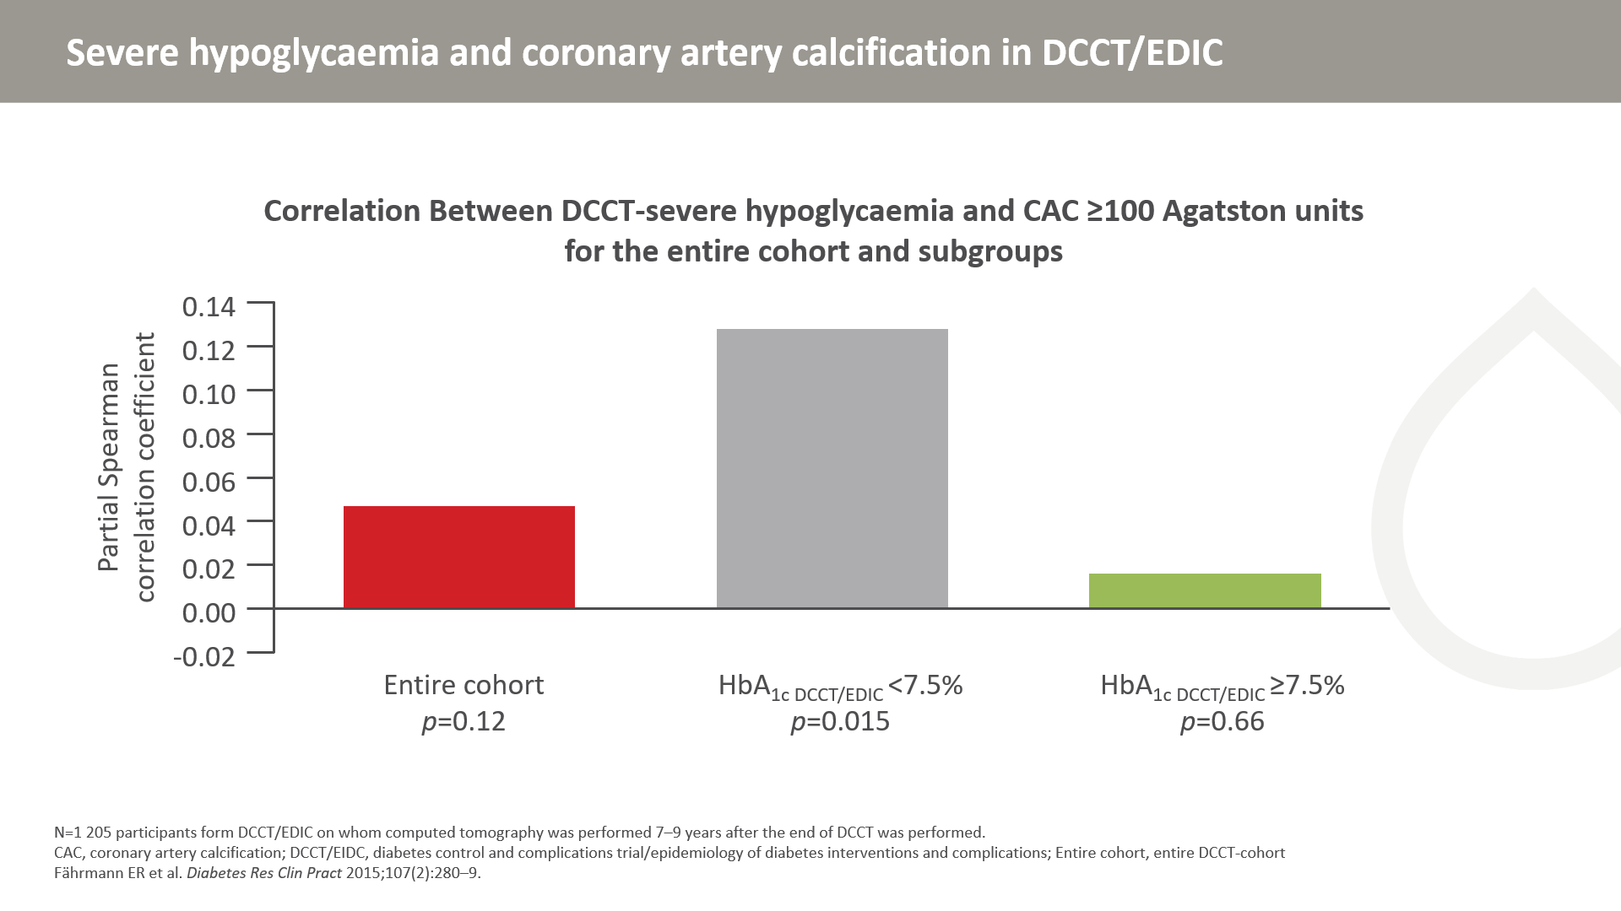

Slide 37
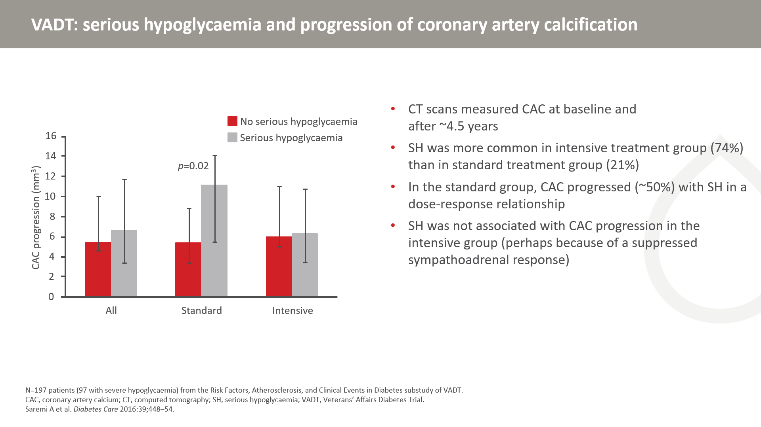
Notes:
While the DDCT/EDIC study showed that the association between severe hypoglycaemia and with coronary artery calcification was most apparent in patients with better glycaemic control, this study only demonstrated an association in the standard therapy group. The discrepancy between the studies may be due to differences in patient types and other cohort characteristics.

Slide 38
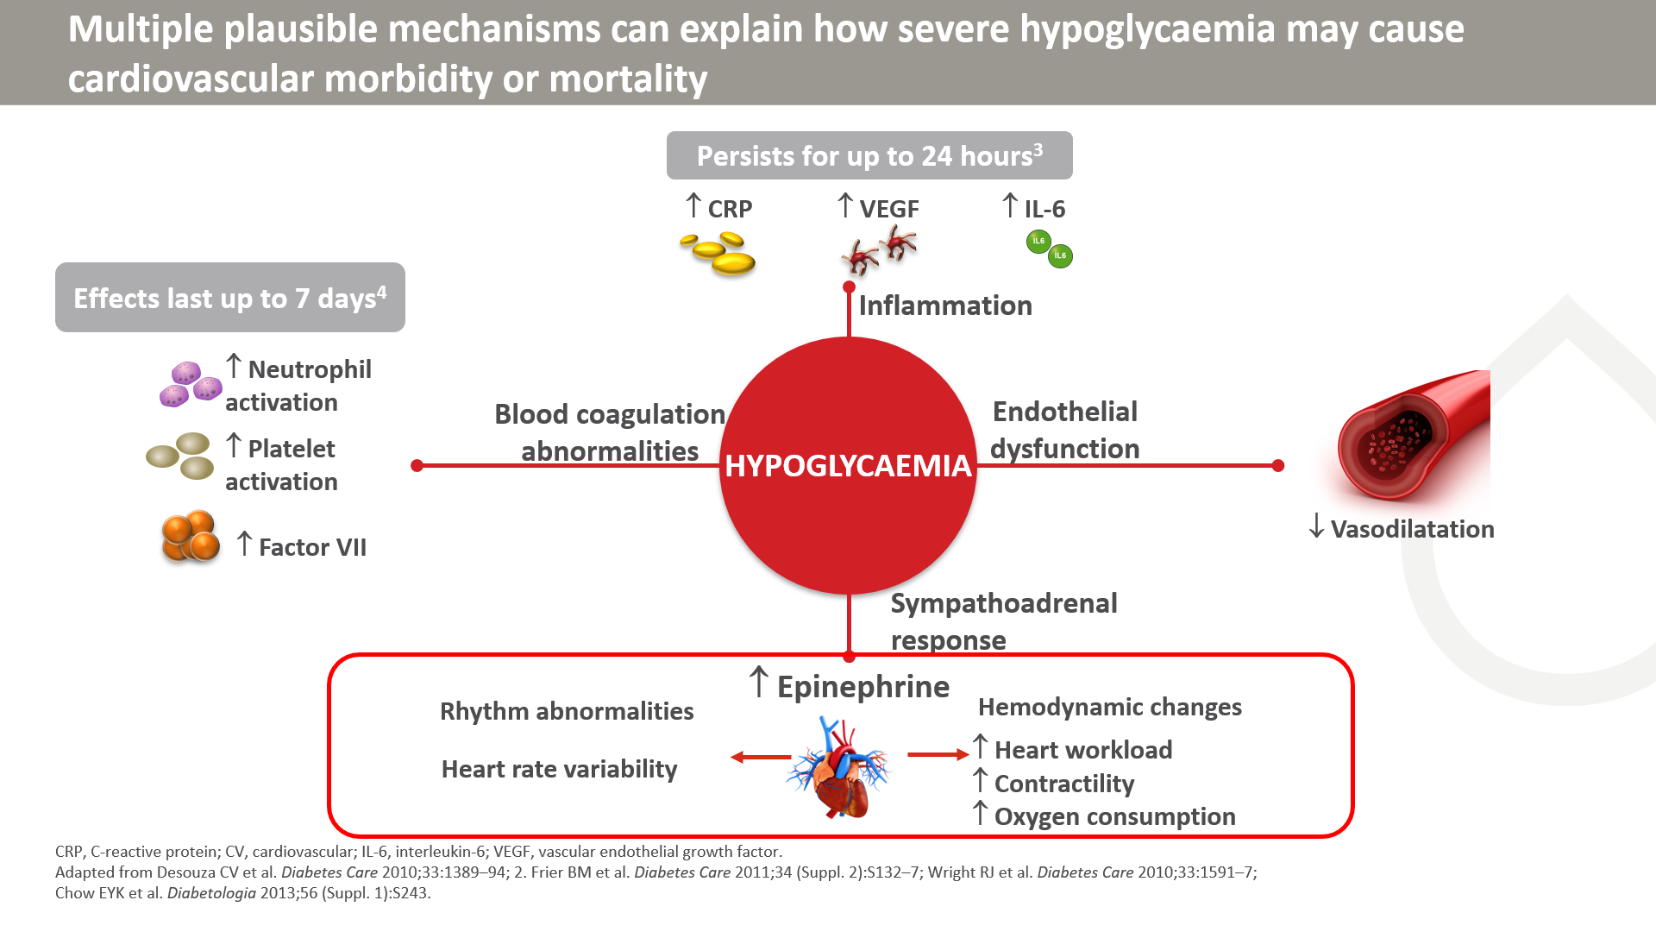
Notes:
Hypoglycaemia may affect cardiovascular events through increased inflammation, endothelial dysfunction, abnormal sympathoadrenal responses and blood coagulation abnormalities. Inflammatory responses trigger the release of multiple inflammatory markers (C-reactive protein, vascular endothelial growth factor and interleukin-6) and increase the overall levels of inflammatory cytokines that can lead to endothelial injuries and abnormalities in coagulation. The activation of the fibrinolytic system and increased epinephrine levels can also lead to blood coagulation abnormalities through increased neutrophil activation, platelet activation and increased factor VII.
The sympathoadrenal response leads to increased catecholamine release, which increases myocardial contractility, workload and cardiac output. Endothelial dysfunction can lead to decreased vasodilation and can place an even greater strain on the cardiovascular system and perpetuate the inability to meet oxygen demands. Recurrent hypoglycaemia leads to suppression of the normal sympathoadrenal response.

Slide 39
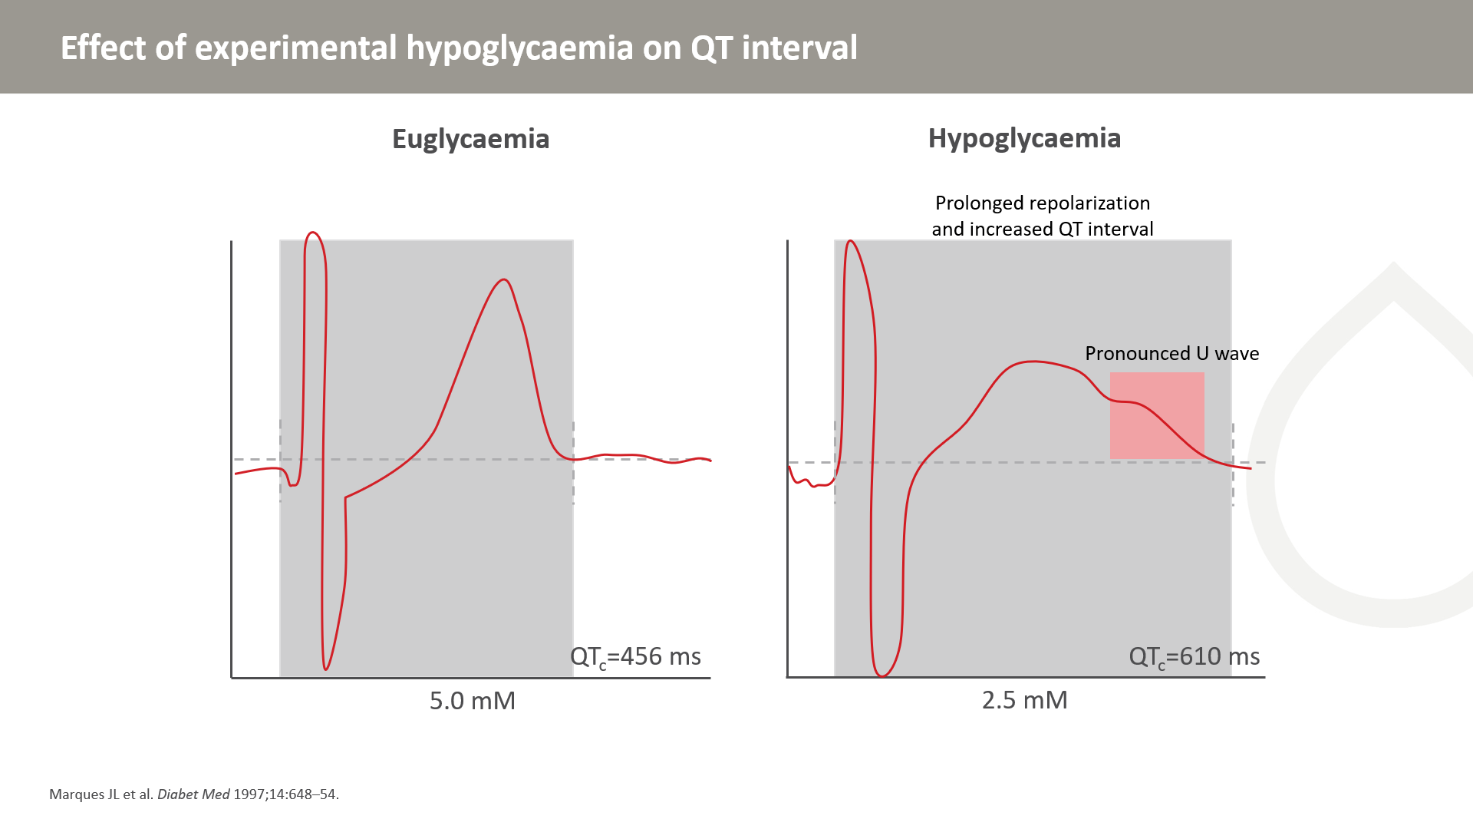
Notes:
Typical QT measurement with a screen cursor placement from a subject during euglycaemia. In patients with hypoglycaemia, prolonged QT interval reflecting abnormal cardiac repolarization can be observed.
Increased homogeneity of ventricular repolarization can increase vulnerability to the development of ventricular arrhythmias particularly ventricular tachycardia (VT) of Torsade de Pointe type and sudden death.

Slide 40
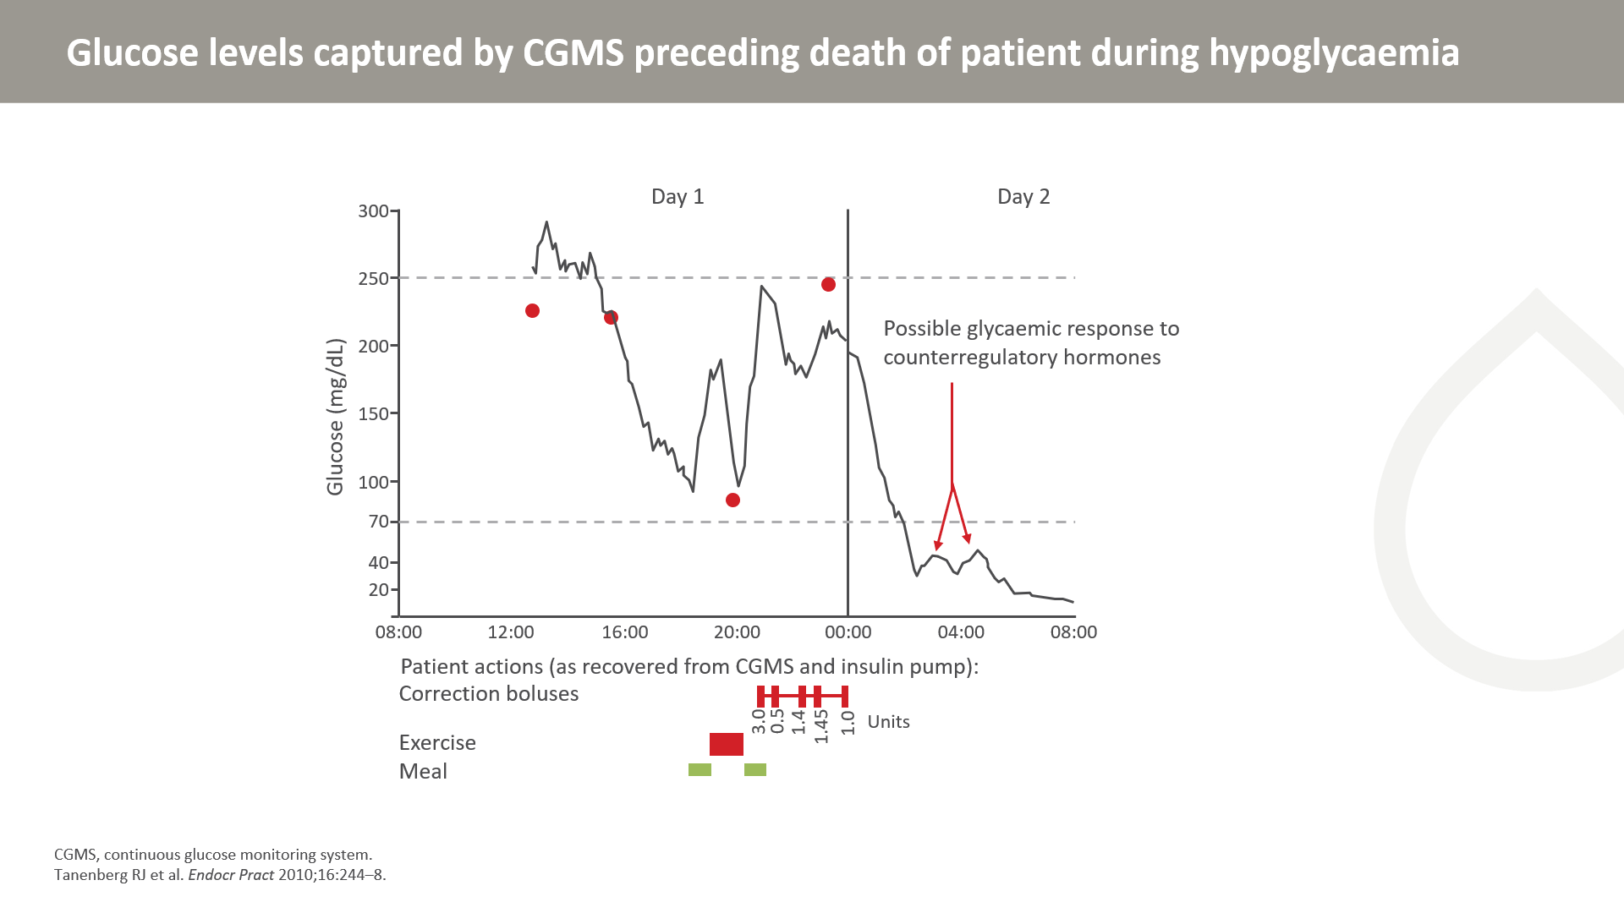
Notes:
Glucose levels captured by the continuous glucose monitoring system for the evening prior to, and the morning of, the patient’s death are illustrated. The patient measured and entered calibrations are represented by the 4 circles. Timing of the patient’s meals, exercise and correction insulin boluses are represented by the bars along the bottom of the graph.

Slide 41
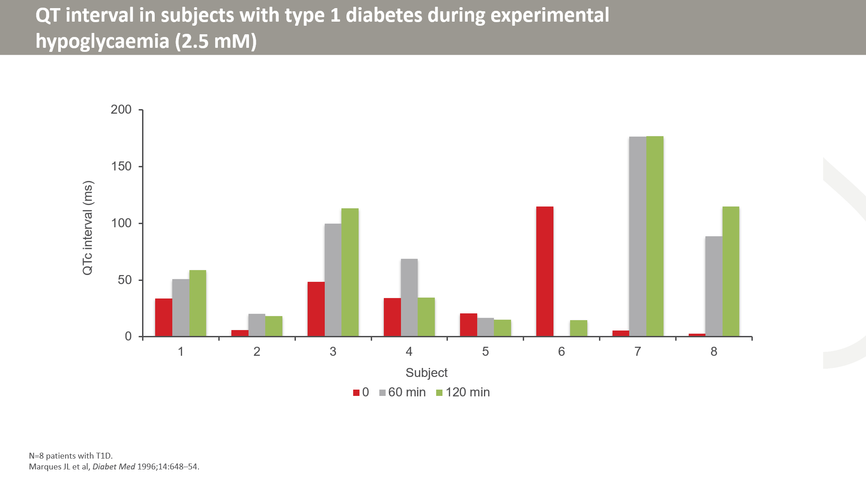

Slide 42
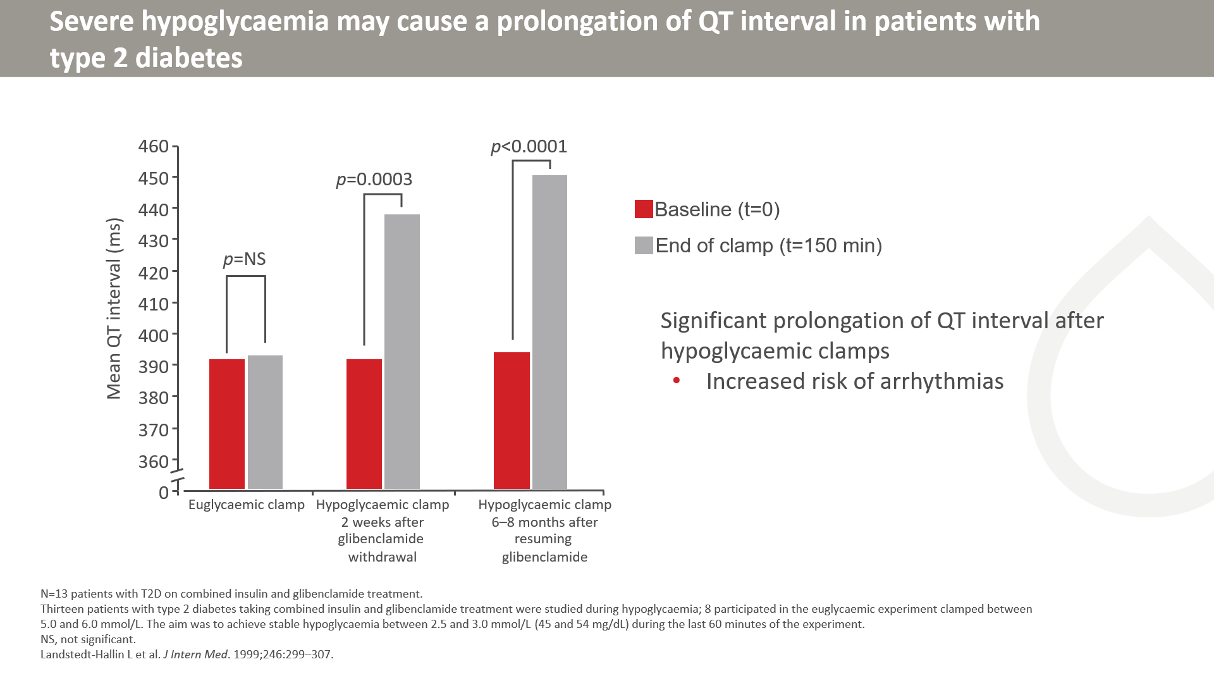
Notes:
Landstedt-Hallin et al examined the effect of insulin-induced hypoglycaemia on cardiac repolarization in 13 patients with type 2 diabetes. All patients had been treated with both insulin (10–48 U/day) and oral glibenclamide (10.5 mg) for at least 8 months before the start of the study.
The patients stopped using oral glibenclamide for 2 weeks but continued with insulin therapy. They were subjected to a first hypoglycaemic clamp at the end of these 2 weeks. The patients then resumed combined glibenclamide and insulin therapy, and after 6 to 8 months they participated in a second hypoglycaemic clamp. Eight patients were subjected to a third euglycaemic clamp study (clamped between 5.0 and 6.0 mmol/L) after an additional 3 to 4 months.
As demonstrated in the graph, the study showed that mean QT intervals were significantly prolonged after the hypoglycaemic clamps. These results showed that hypoglycaemia affected repolarization of the myocardium, indicating a potential increased risk of arrhythmias.
1. Landstedt-Hallin L et al. J Intern Med. 1999;246:299–307.
Purpose
To show the effect of severe hypoglycaemia on the QT interval in patients with type 2 diabetes.
Takeaway
This study showed that QT intervals were significantly prolonged by severe hypoglycaemia, indicating an increased risk of arrhythmias.
Calculations 3.0 mmol/L / .05551 ≈ 54 mg/dL
2.5 mmol/L / .05551 ≈ 45 mg/dL

Slide 43
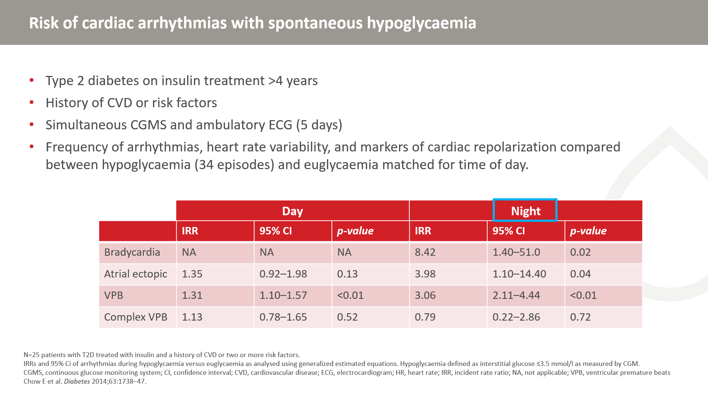
Notes:
Of 34 observed hypoglycaemic episodes, only 3 were symptomatic (IG<3.5).
Bradycardia did not occur during the day under either glycaemic condition.
During nocturnal episodes, a pattern of transient cardioacceleration with each glucose nadir was observed, followed by a phase of heightened vagal counteraction up to 40–50 min later that was associated with bradycardia. The occurrence of bradycardia may be linked to increased vagal counteraction after sympathetic neural activation.
Defective counterregulation during nocturnal hypoglycaemia is well-known, characterized by blunted and delayed epinephrine responses.

Slide 44
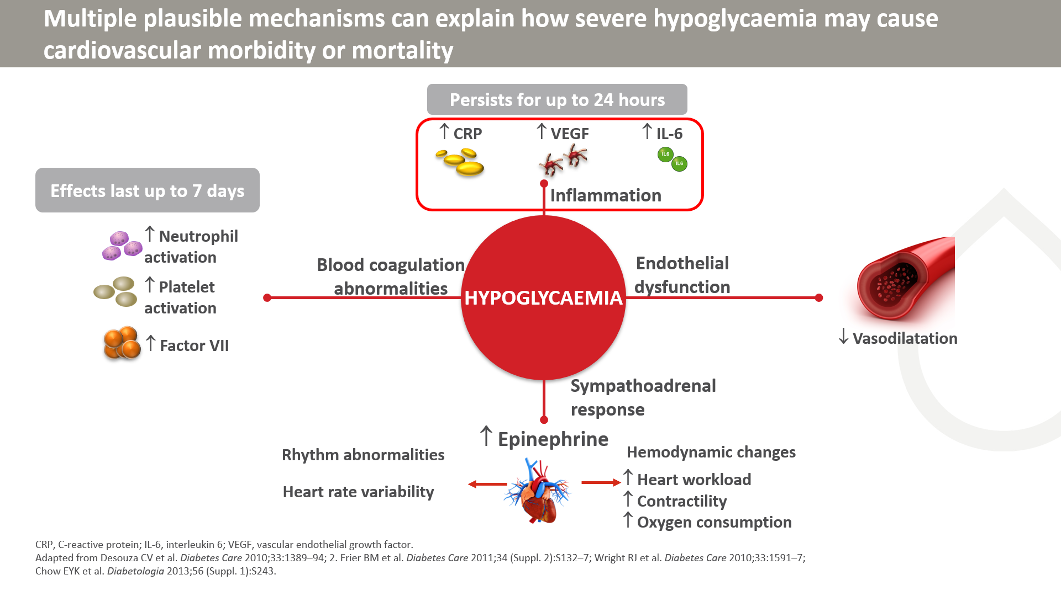
Notes:
Hypoglycaemia may affect cardiovascular events through increased inflammation, endothelial dysfunction, abnormal sympathoadrenal responses, and blood coagulation abnormalities. Inflammatory responses trigger the release of multiple inflammatory markers (C-reactive protein, vascular endothelial growth factor, and interleukin-6) and increase the overall levels of inflammatory cytokines that can lead to endothelial injuries and abnormalities in coagulation.
Reference
Desouza CV, Bolli GB, Fonseca V. Hypoglycaemia, diabetes, and cardiovascular events. Diabetes Care. 2010;33(6):1389-1394.

Slide 45
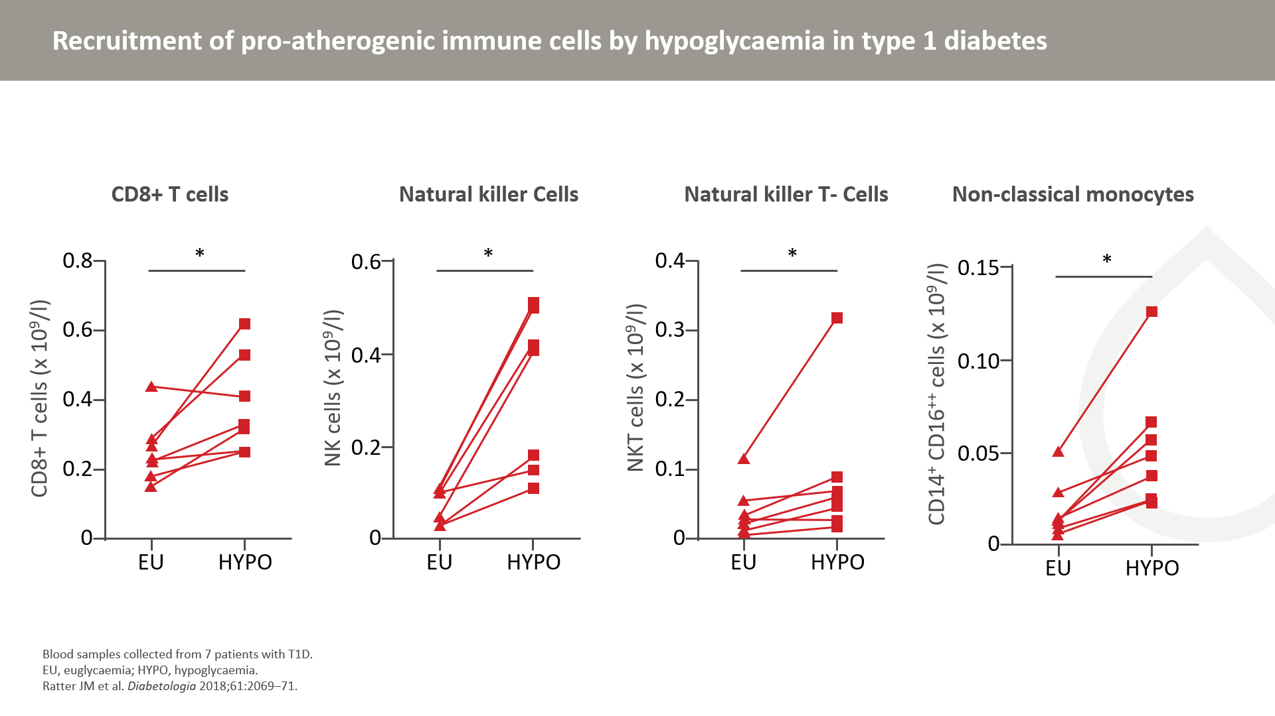
Notes:
Blood samples were collected during clamped euglycaemia or hypoglycaemia from seven people with type 1 diabetes (three men, age 27.1 ± 9.7 years, HbA1c 55.9 ± 8.9 mmol/mol [7.2 ± 0.8%] and diabetes duration 11.4 ± 5.4 years; mean ± SD).
Immune cell subsets recruited in response to hypoglycaemia were analysed by flow cytometry.

Slide 46
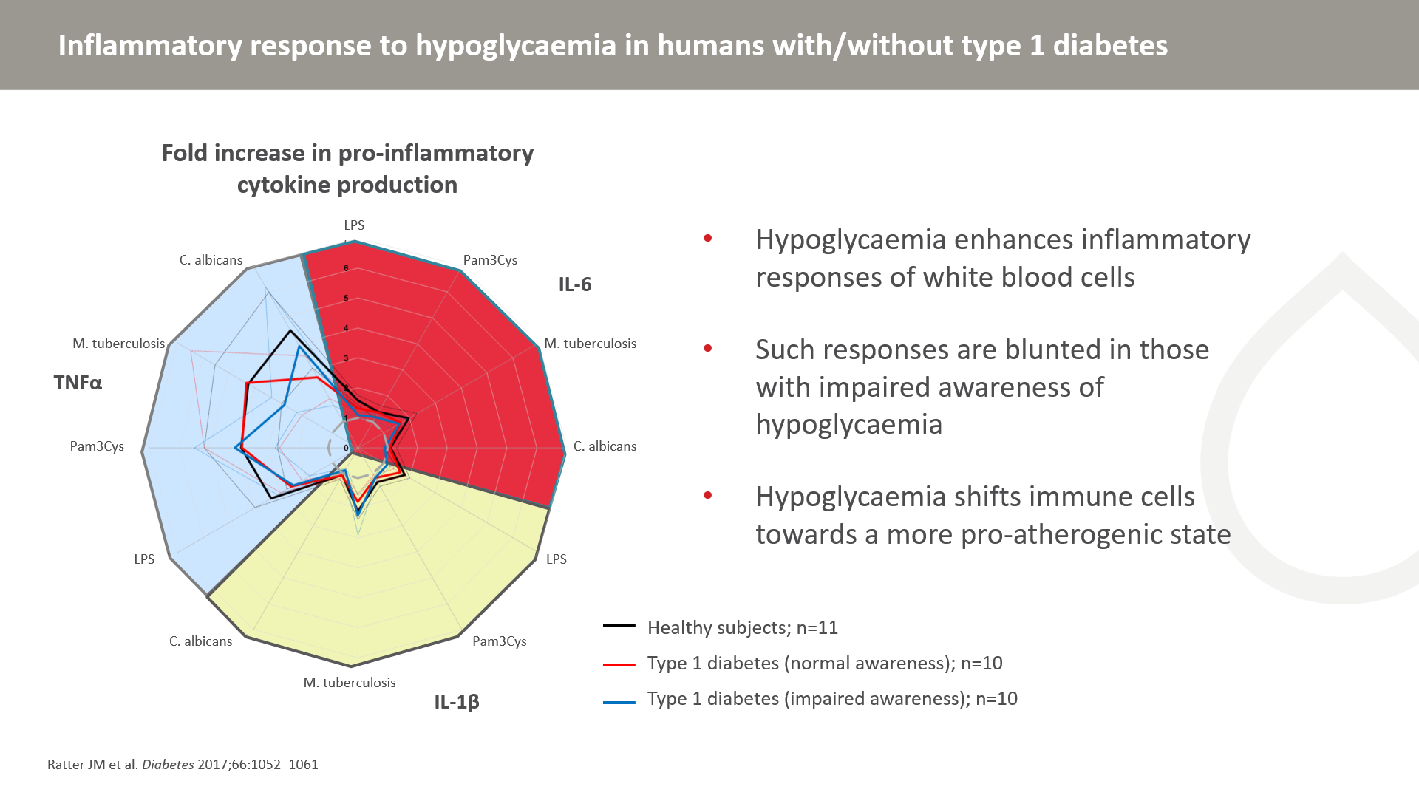
Notes:
Ex vivo stimulations of peripheral blood mononuclear cells and monocytes obtained during hyperinsulinemic-euglycemic (5.0 mmol/L)-hypoglycemic (2.6 mmol/L) clamps in 11 healthy participants, 10 patients with type 1 diabetes and normal awareness of hypoglycemia (NAH), and 10 patients with type 1 diabetes and impaired awareness, were used to test whether the composition and inflammatory function of immune cells adapt to a more proinflammatory state after hypoglycemia.
Hypoglycemia increased leukocyte levels in healthy subjects and patients with normal awareness of hypoglycaemia, but not in patients with impaired awareness. Leukocytosis strongly correlated with the adrenaline response to hypoglycemia.
PBMCs and monocytes displayed a more robust cytokine response to microbial stimulation after hypoglycemia compared with euglycemia, but was less pronounced in patients with impaired awareness.

Slide 47
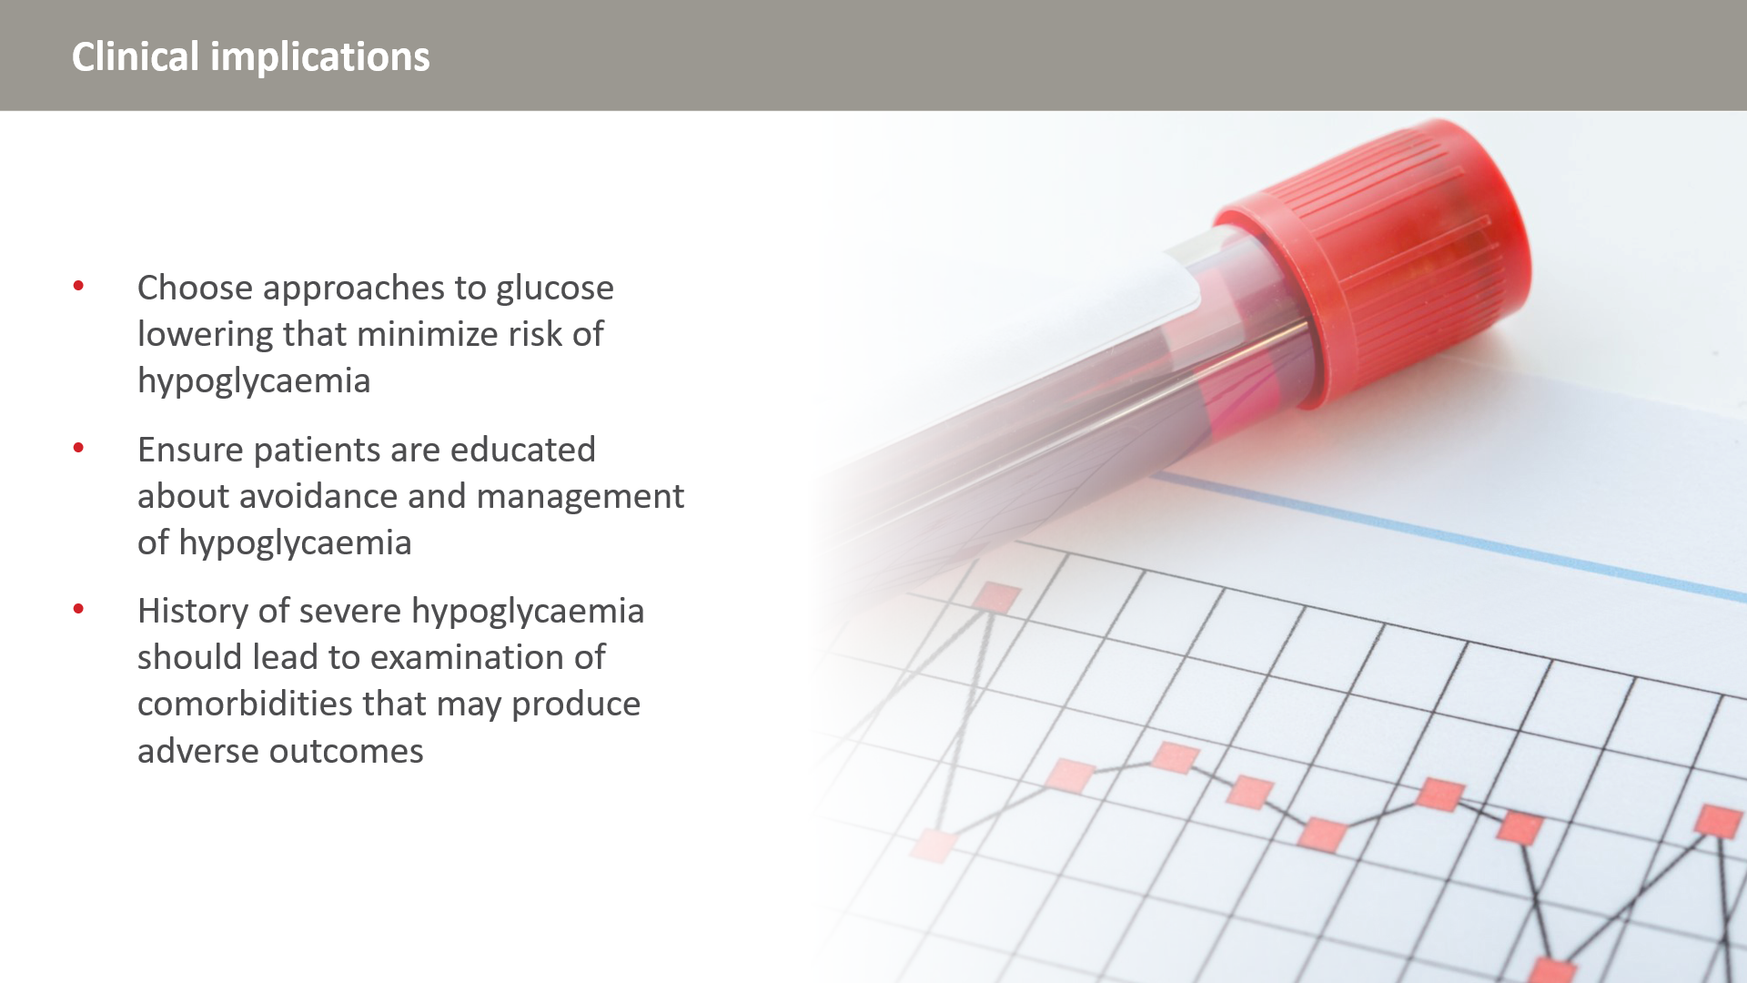

Slide 48
